Slide 1

ORAL COMMUNICATIONS

Slide 2
ORAL COMMUNICTIONS
RATIONALE FOR COMMUNICATION SKILLS
When you work with so many stakeholders, communication is key. For work to flow, you need to make sure that everyone is on the same page, working towards the same goals, and all kept in the loop about any changes or issues. The importance is reflected in 2018 PMI survey where managers identified communications as a primary factor in 29% of all failed projects. The most common form of communications on worksite tends to be oral, so a professions driver requires superior oral communications skills.

Slide 3

ORAL COMMUNICATIONS
TOPICS
Listening for understanding
Listening with empathy
Balanced communications
Using Assertive Statements
Using I- Messages

Slide 4
ORAL COMMUNICATIONS
Defining Communication
Communication: The transmission of ideas and exchange of ideas that leads to mutual understanding for common benefit.
For communication to be effective, you must listen attentively to fully understand the ideas being expressed by the other person.
For communication to be effective, you need to be able to transmit ideas, to get your point across. This involves combining the verbal and non-verbal content of your message so that what you intend to communicate is clear.
Knowing what to say and when to say it, along with choosing the right gestures, can help you convey the importance of a plan, comfort a disappointed worker, or redirect the inappropriate actions of disgruntled stakeholder

Slide 5
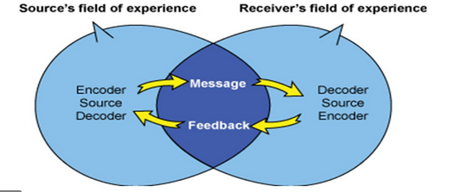
ORAL COMMUNICATIONS
Notes:
Explain the process of encoding and decoding an oral messages.
Explain how personal experience will affect the process of encoding and decoding

Slide 6
ORAL COMMUNICTIONS
ATTENTIVE LISTENING:
Hear- focus on the message (avoid interrupting), while showing interest
Interpret- check for understanding by summarizing the message or asking a question
Reflect- think about the what you have heard- do you need more information
Respond- show you have understood the message by paraphrasing the conversation
Notes:
Explain three levels of listening take take place prior to the listener responding

Slide 7
ORAL COMMUNICATIONS
ATTENTIVE LISTENING
Involves more than what is going on inside your head. The following behaviors will improve your ability to listen more attentively:
Maintain comfortable eye contact
Lean into speaker
Affirm you are listening
Do not interrupt

Slide 8
ORAL COMMUNICATIONS
PRACTICING ACTIVE LISTENING:
Form pairs
One person in the pair be “A”, the other “B”
“A” describes the scene on the slide in detail
“B” listens intently
“B” summarizes what they think they heard.
Compare summary with scene on the slide

Slide 9
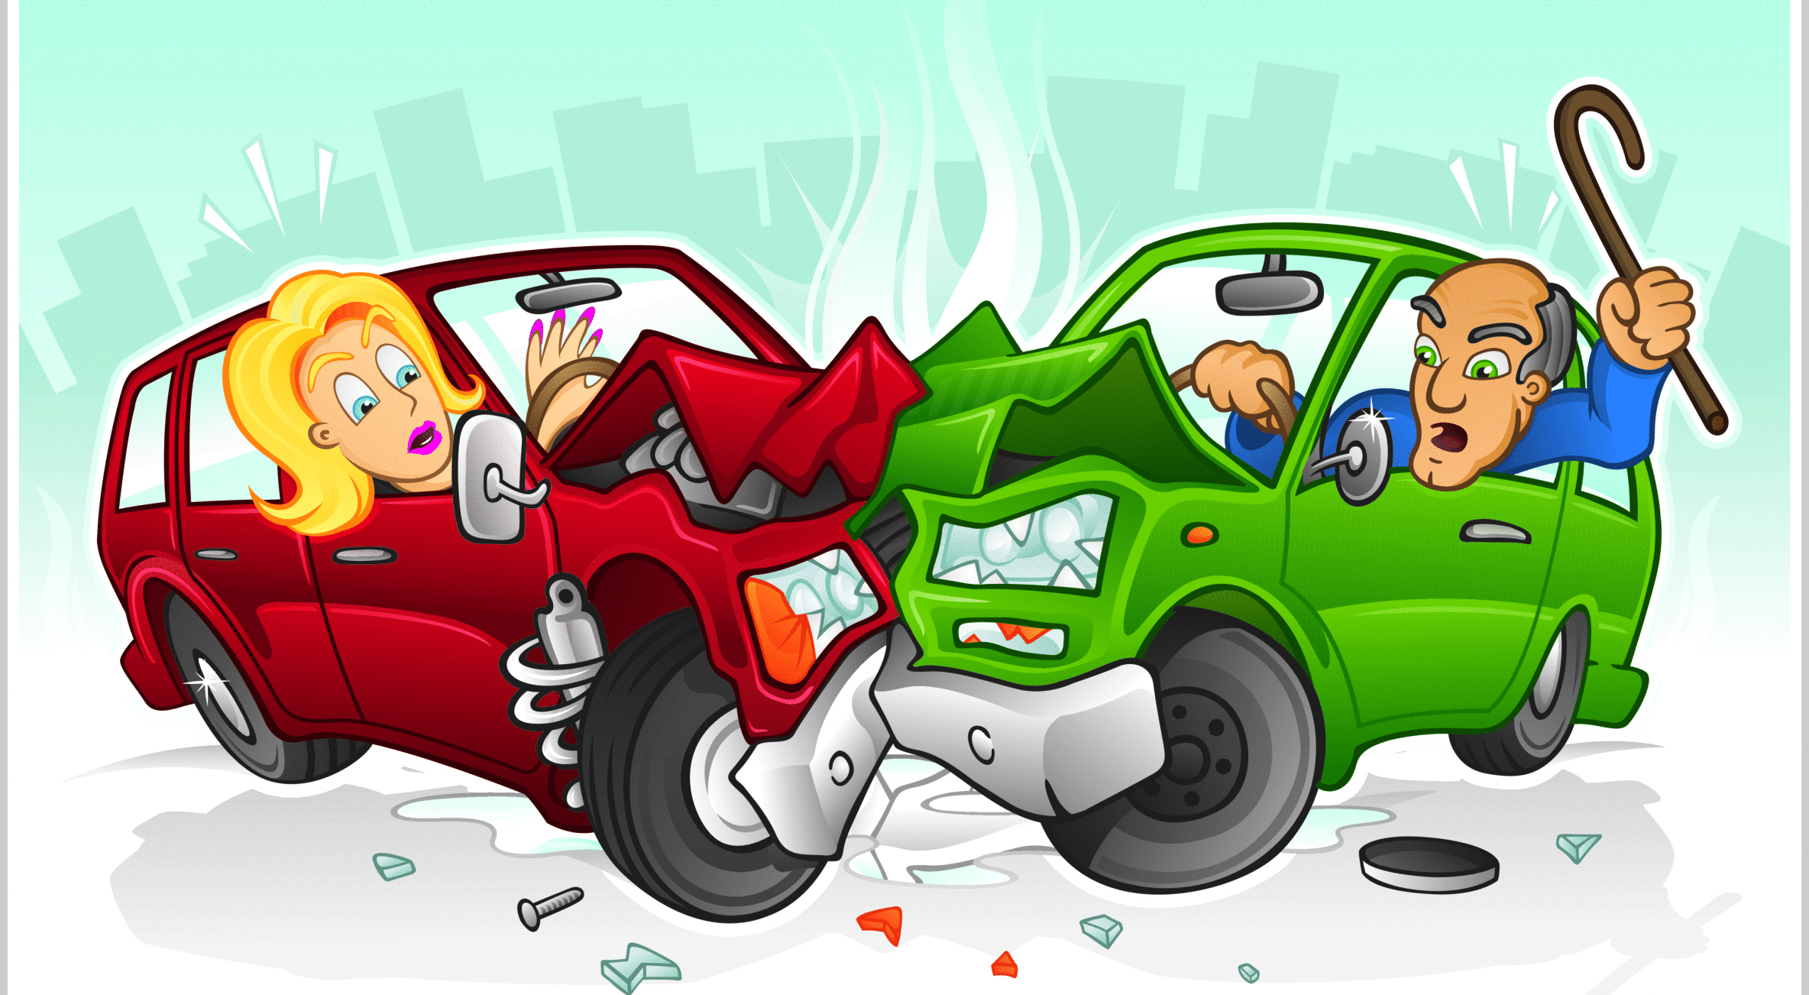
ATTENTIVE LISTENING #1

Slide 10
ORAL COMMUNICATIONS
INSTRUCTIONS:
A and B switch roles and re-do exoercise with a new slide.

Slide 11
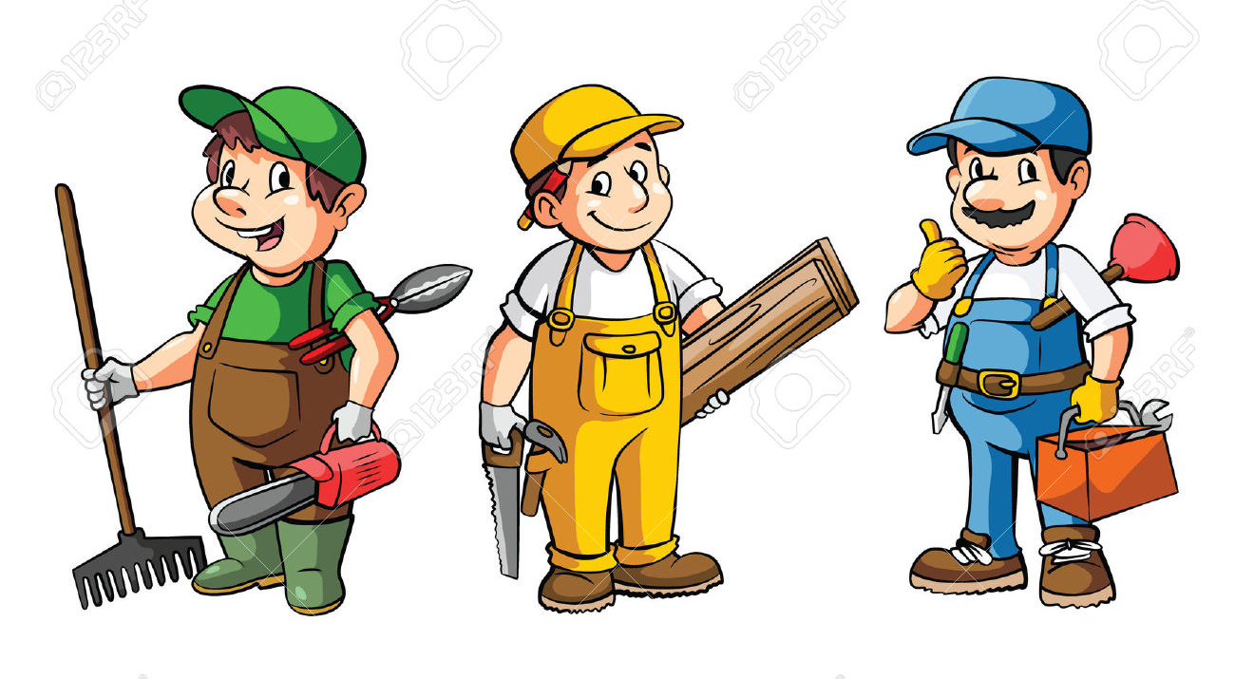
ATTENTIVE LISTENING #2

Slide 12
ORAL COMMUNICAIONS
DE-BRIEF:
Feelings about the exercises just completed?
When you were the listener what did you do the understand the message?
When you were the speaker what did you do the explain the message?

Slide 13

ORAL COMMUNICATIONS
ENHANCE YOUR UNDERSTANDING BY
Asking questions to clarify or learn more
Paraphrasing the speaker’s idea
Not judging the speaker
Not formulating reasons why you disagree with the speaker
Do not express your opinion or point of view
Do not giving advice (unless asked)
Notes:
Explain that we will do similar tasks to the ones just completed. The difference will be that the listener will be able to ask questions, paraphrase what they thought they heard.

Slide 14

ATTENTIVE LISTENING #3

Slide 15
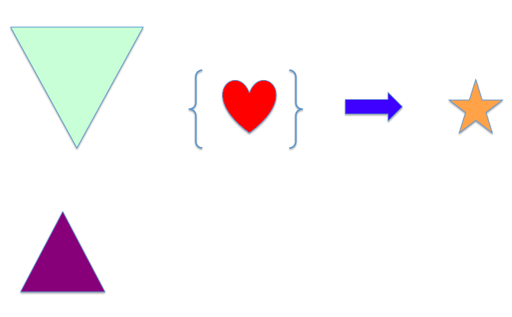
ATTENTIVE LISTENING #4

Slide 16

ORAL COMMUNICATIONS
DE-BRIEF
Feelings/ reactions to being an attentive listener?
How did your questions help clarify the message?
How did paraphrasing help clarify the message?
What do you have to work on to be a more attentive listener?

Slide 17

PROFESSIONAL DRIVER TRAINING
LISTENING WITH EMPATHY
Listening with empathy is understanding the feelings that are being communicated in the words, actions, tone of voice, and/ or body language. This is most important if the speaker is expressing strong emotions

Slide 18

ORAL COMMUNICATIONS
LISTENING WITH EMPATHY

Slide 19
ORAL COMMUNICATION
TUNE INTO FEELINGS

Slide 20

ORAL COMMUNICATION
LISTENING WITH EMPATHY

Slide 21

ORAL COMMUNICATIONS
TUNE INTO FEELINGS

Slide 22

ORAL COMMUNCATIONS
LISTENING WITH EMPATHY

Slide 23
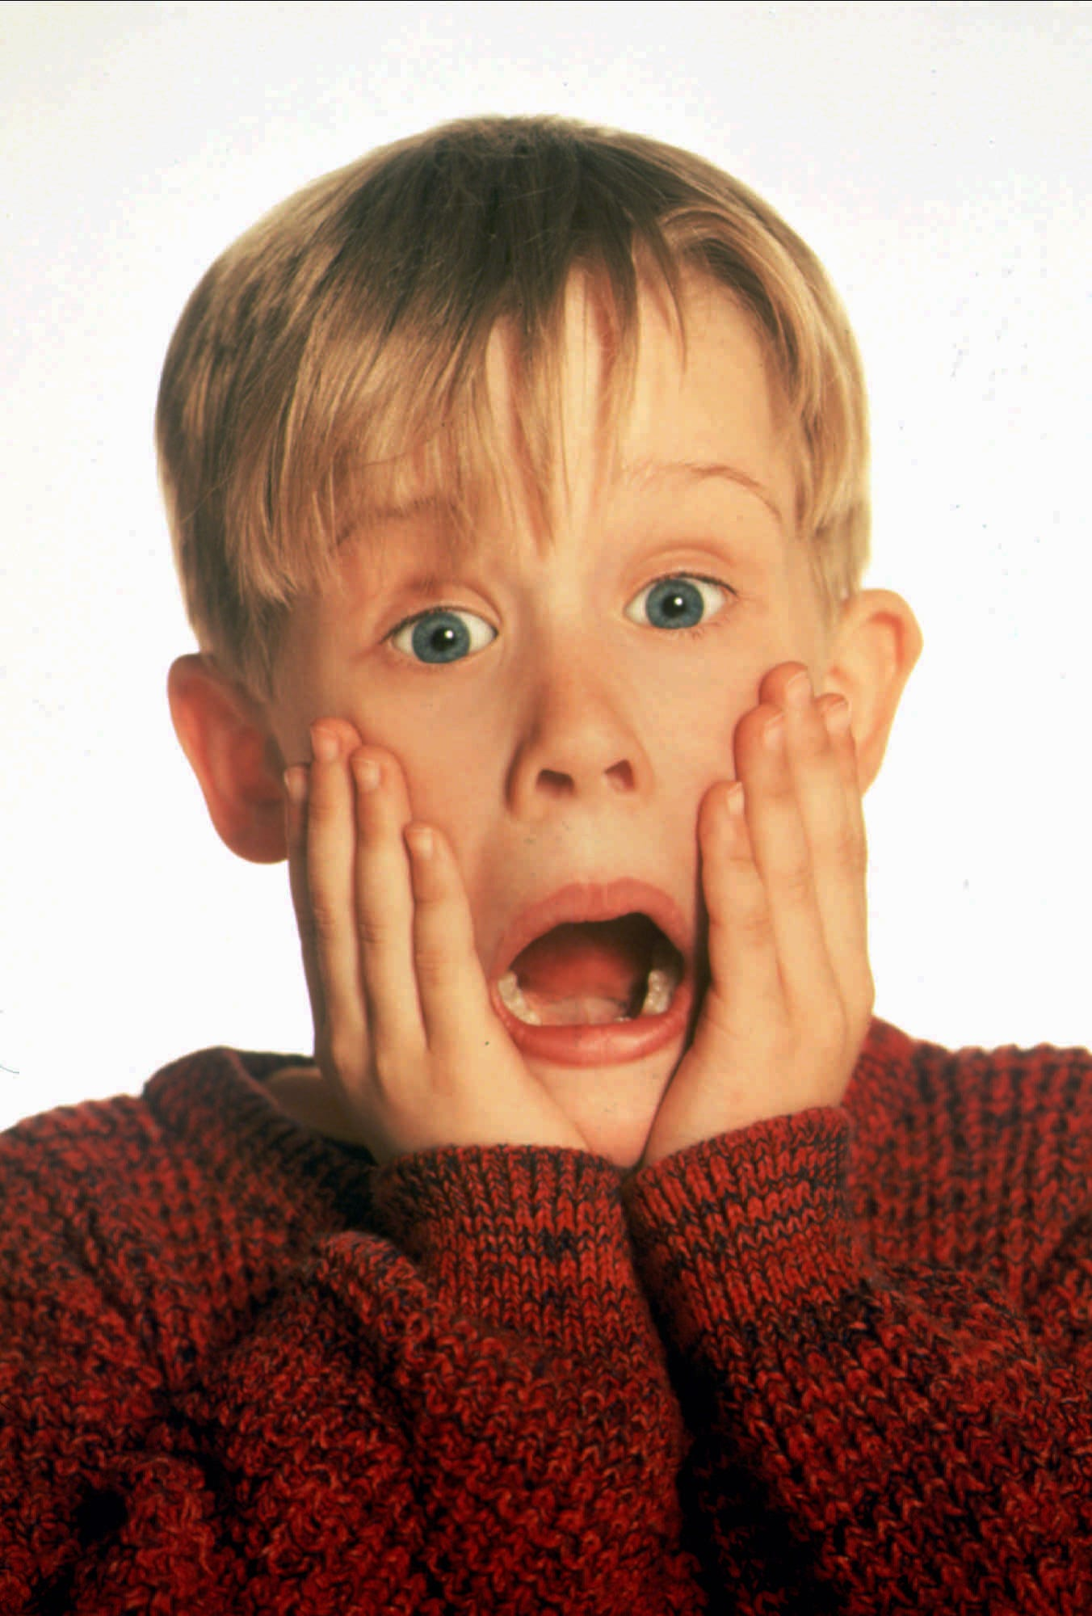
ORAL COMMUNICATIONS
TUNE INTO FEELINGS

Slide 24

ORAL COMMUNICATIONS
LISTENING WITH EMPATHY

Slide 25
PROFESSIONAL DRIVER TRAINING
TUNE INTO FEELINGS

Slide 26

ORAL COMMUNICATIONS
Notes:
Ask the learners what they can see in the body language of the people on the slide

Slide 27

PROFESSIONAL DRIVER TRAINING
LISTENING WITH EMPATHY
STATEMENT | POSSIBLE EMOTIONS
“This job sucks”
“I will never learn how to…”
“I let the team down”
“I am so glad it is over”
Boy! That’s a great job”
Notes:
This job sucks- emotions: anger, frustration, difficulty with the work
I will never learn how to…- emotions: dumb, want to quit, needs some help
KEY POINT: AS THE LISTENER YOU CAN CHOOSE THE EMOTION YOU WANT TO DEAL WITH. USUALLY IT IS THE EMOTION THAT CAN BE ADDRESSED IN THE MOMENT. YOU CAN DEAL WITH UNDERLYING EMOTIONS AT A LATER DATE AND IN A MORE CONDUCIVE SITUATION.

Slide 28

ORAL COMMUNICATIONS
Reflect upon the past activities and list actions as a listener you would like to:
STOP
CONTINUE
START

Slide 29
ORAL COMMUNICATIONS
BALANCE COMMUNICATIONS
Working with other people requires you to balance your communications between:
Co-operative communications- where you work to understand and satisfy the needs and interests of others
Assertive communications- where you attempt to have others understand and satisfy your needs and interests
Notes:
By balancing your communications you increase the likelihood of developing a positive relationship with the other person. This relationship can be the basis for more discussion later on.

Slide 30
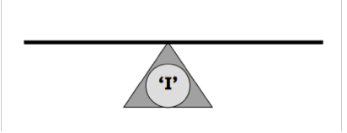
ORAL COMMUNICATIONS
BALANCED COMMUNICATIONS
ASSERTIVE
CO-OPERATIVE
ASSERTIVE STATEMENTS
I-MESSAGES
ATTENTIVE LISTENING
LISTENING WITH EMPATHY
ASKING QUESTIONS
PARAPHRASING
WHAT HAPPENS IF YOU EMPHASIZE ONLY 1 FORM OF COMMUNICTIONS?
Notes:
ANSWER TO QUESTION: IF YOU ARE TOO ASSERTIVE YOU MAY NEGATIVELY AFFECT YOUR RELATIONSHIP WITH THAT PERSON. IF YOU ARE TOO COOPEARTIVE YOU ARE NOT ABLE TO MAKE YOU POINTS AND THE OTHER PERSON DOES NOT LEARN WHAT YOU WANT THEM TO DO.

Slide 31
ORAL COMMUNICATIONS
TWO SKILLS FOR STATING YOUR POSITION
Assertive statement- respects the ideas and opinion of the speaker, while stating your point in a polite, yet forceful manner
I- Message- an assertive way to state your opinion without blaming or escalating the situation.
Notes:
BOTH SKILLS RESPET THE OTHER PERSONS THOUGHTS AND IDEAS WHILE ALLOWING YOU TO EXPRESS WHAT YOU NEED TO BE DONE. IF DONE PROPERLY THE RELATIONSHIP IS STRENGTHED AND THE WORK IS DONE PROPERLY.

Slide 32
ORAL COMMUNICATIONS
ASSERTIVE STATEMENTS- Is a two step process:
VALIDATE- the feeling, idea, or opinion of the speaker. Validate does not mean you agree with the speaker- just you accept their right to hold that view.
ASSERT- state your feeling, idea, or opinion without using the words “but” or “however”

Slide 33
ORAL COMMUNICATIONS
ASSERTIVE STATEMENTS
ISSUE: Worker believes he should get his birthday off work.
VALIDATE | YOUR VIEW
Many companies have this policy | For this company you are required to work on your birthday

Slide 34
ORAL COMMUNICATIONS
ASSERTIVE STATEMENTS TASK
ISSUE: Worker believes he can work faster with the safety guards off:
VALIDATE:
YOUR VIEW:
Notes:
AS A GROUP WORK TO DEVELOP A VALDATION STATEMENT AND EXPRESSION OF YOUR POSITION/ VIEW

Slide 35
ORAL COMMUNICATIONS
ASSERTIVE STATEMENTS TASK
ISSUE: Worker believes he can work faster with the safety guards off:
VALIDATE:
YOUR VIEW:
Notes:
AS A GROUP WORK TO DEVELOP A VALDATION STATEMENT AND EXPRESSION OF YOUR POSITION/ VIEW

Slide 36
ORAL COMMUNCATIONS
ASSERTIVE STATEMENTS TASK
ISSUE: Worker complains that he has to work with all the new inexperienced workers
VALIDATE:
YOUR VIEW:
It may feel like that to you
When I make the schedule, I ensure that every experienced worker is assigned new workers equally
Notes:
Have learners, individually formulate their responses. Sample answers will appear when you click on slide

Slide 37
ORAL COMMUNICATIONS
I-MESSAGE
Is an assertion about the feelings, beliefs, values, ideas of the person speaking. Generally, expressed as a sentence beginning with the word "I", and is contrasted with a "you-message”, which indicates a fault with the listener and may communicate blame for the situation.

Slide 38

ORAL COMMUNICATIONS
3 STEPS OF AN I-MESSAGE
I think/ feel…
When…
I need…

Slide 39
ORAL COMMUNICATIONS
SAMPLE I-MESSAGE
I think/ feel I am not able to develop my skills
When all I do is framing
I need an opportunity to use my skills

Slide 40
ORAL COMMUNICATIONS
SCENARIO: Your co-workers ignore you or they tease you on breaks
ROOT | STATEMENT
I THINK/ FEEL
WHEN
I NEED
Disrespected
When my workers talk about me behind my back
Workers to show me some respect

Slide 41
ORAL COMMUNICATIONS
SCENARIO: You do not feel comfortable assigning inexperienced workers to use larger power tools
ROOT | STATEMENT
I THINK/ FEEL
WHEN
I NEED
I do not think is is safe for inexperienced workers
To use the table saw
Time to provide instruction on using the table saw

Slide 42
ORAL COMMUNICATIONS
SCENARIO: Workers expect you to cover for them when they leave early
ROOT | STATEMENT
I THINK/ FEEL
WHEN
I NEED
I am put in an awkward situation
When you leave work early
Workers to put in a full day of work

Slide 43
ORAL COMMUNICATIONS
Benefits of I-messages
Allows you to take ownership for your feelings
Conveys the same information as a “you message”. But you will do so in a way that is less likely to provoke a defensive or hostile reaction
Simply describes a situation, without blaming someone for it
Does not escalate a conflictual situation

Slide 44
ORAL COMMUNICATIONS
DE-BRIEF:
Feelings about using Assertive Statements and I Messages?
What is the key to using these skills effectively?
What do you need to do to be affective in using these skills?
Where and how could you use these skills?

