Slide 1
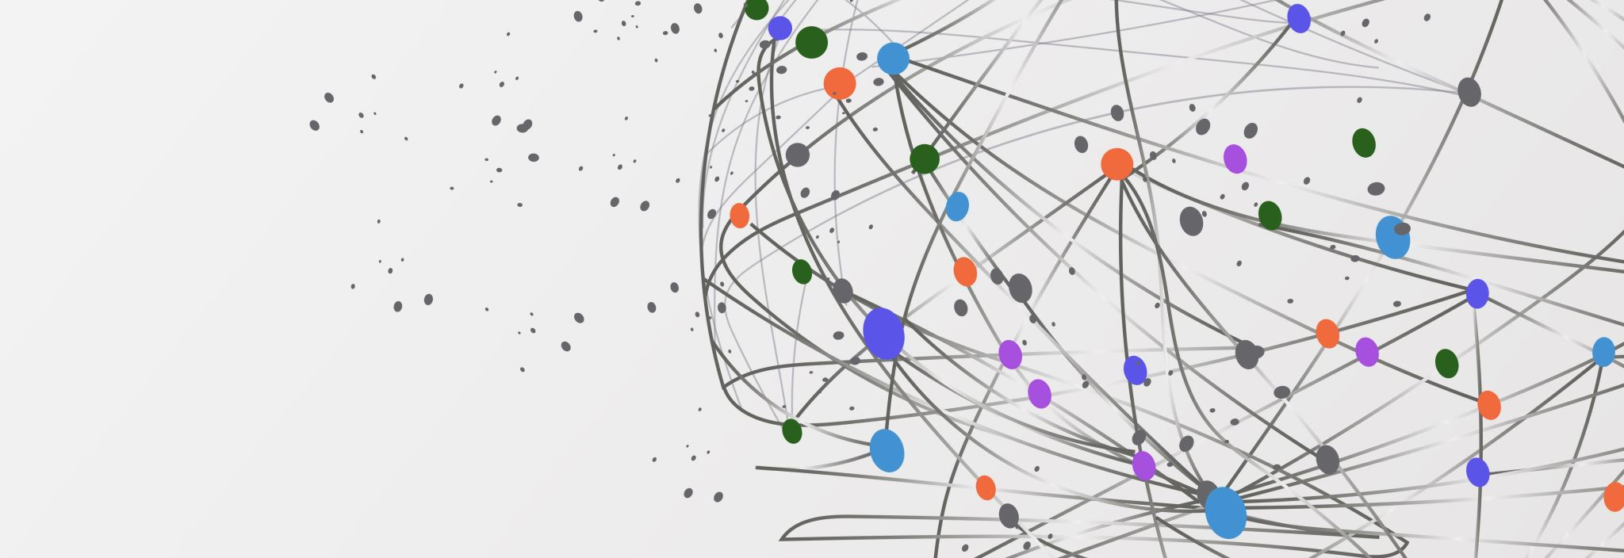
Systems Thinking
Skills to Navigate an Increasingly Complex
World for Effective
Problem Solving and Decision Making
Based on the book Systems Thinking for Beginners by Henry M. Burton

Slide 2

wem.mb.ca
“Helping people to develop Essential Skills that are needed for work, learning, and life.”
Our vision is that all Manitobans have access to the Essential Skills knowledge and training required to determine and pursue their goals related to
learning, the workplace and life.

Slide 3
Thank you!
Employment and Social Development Canada
&
Manitoba Education and Training
for supporting the development of this continuous learning curriculum.
This project was jointly funded through Human Resources Skills Development Canada and Entrepreneurship Training and Trade.
© Workplace Education Manitoba 2023 All Rights Reserved

Slide 4


Slide 5
WELCOME AND INTRODUCTIONS
Please share:
Your name and where you work.
What do you like most about your work?
What do you hope to get out of this training?

Slide 6
Learning Objectives
Define systems thinking.
Identify various types of systems.
Understand how systems behave.
Identify common patterns within systems.
Understand how to deal with common patterns.
Apply systems thinking.
© Workplace Education Manitoba 2023 All Rights Reserved

Slide 7
By the end of this Workshop
You will be able to:
Improve performance in personal and/or professional lives.
Improve conflict situations with family and/or co-workers.
Find solutions to problem patterns in your lives.
© Workplace Education Manitoba 2023 All Rights Reserved
Notes:
Facilitator Assessment Tools:
Gather comments and ideas shared throughout the session for reporting purposes.
Collect data through the workshop feedback form and pre/post training self-assessments.
FORMS:
Ensure each learner has completed an SPRS form for the fiscal year. Provide paper copies if not yet completed.
PRE-TRAINING SELF-ASSESSMENT:
Ask each person to write their name, today’s date, and complete the assessment and return it to the facilitator. Explain there will be a post-training self-assessment at the end of the workshop.

Slide 8
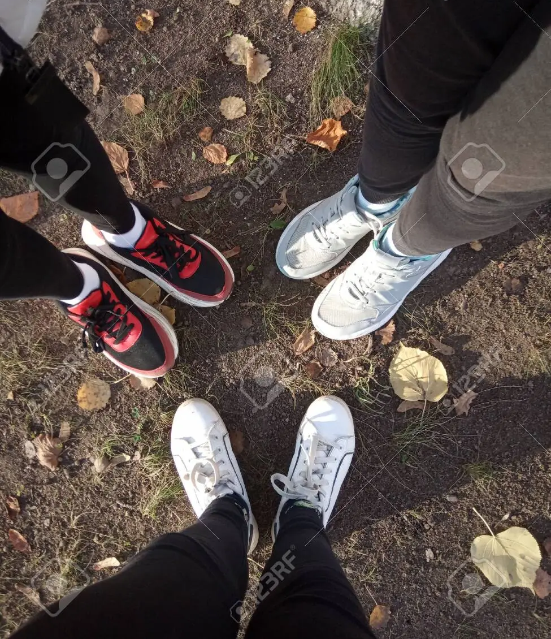
Defining Systems Thinking
© Workplace Education Manitoba 2023 All Rights Reserved
Notes:
Prepare for this activator by watching:
https://www.youtube.com/watch?v=hE9XdaI56qw
Ask learners to get out of their seats and gather in an open space.
Instructions:
Looking down at everyone’s feet, and without speaking to anyone or gesturing, find two people. Put yourself equal distance to those two people in a triangle.
Once everyone has found their triangle, choose one person to turn and take four steps into the larger group.
Again, while continuing to look down at everyone’s feet and without speaking to anyone or gesturing, find two new people. Put yourself equal distance to those two people in a triangle. Depending on time, you could do this one more time.
Now, look up!
Explain:
Each triangle demonstrates a system within a larger system and how one change within a system will impact the entire system. You cannot remove or change any part of a system without affecting other parts of the system and ultimately affecting the overall results.
Note how one part of one system moved. The effects were much greater than the one move.
Return to their seats.
Debrief activity by asking:
Why should we care about systems thinking? (get hired, see the big picture, solve problems)
Explain:
Systems Thinking allows us to see the effect of individual decisions and visualize individual decisions that people make in the workplace and how those decisions affect co-workers, managers, and the organization.
Individuals cannot simply operate from their own perspective but need to operate from the broader perspective of the entire organization or relationship. This creates a situation where value is being added to the organization.
Ask: If you were a leader, wouldn’t you want people to think that way? Yes, of course, you would!

Slide 9

PROBLEMS
No area of life is free of them
Make it difficult to reach our performance goals in life, learning and work
Our success is based on how well we deal with our problems
Can make relationships difficult
Can make managing our money difficult
© Workplace Education Manitoba 2023 All Rights Reserved

Slide 10


SOLUTIONS
Some solutions are easily found.
What should I wear today?
Where should I go for lunch?
Others are not so easily found.
- the solution we found didn’t work as well as we had expected,
- a problem may repeat itself,
- we struggle to find a solution,
- we are distracted by surface symptoms which makes it difficult to find
solutions that last.
© Workplace Education Manitoba 2023 All Rights Reserved

Slide 11
Applying Systems Thinking
We can apply Systems Thinking to various issues:
Global Issues
Community Issues
Social Issues
Workplace Issues
© Workplace Education Manitoba 2023 All Rights Reserved
Notes:
As you move through this list, ask learners to identify one or two issues for each category:
Global Issues – poverty, war, etc.
Community Issues – housing, supply shortages, etc.
Social Issues – racism, mental health, etc.
Workplace Issues – diversity and inclusion, confidentiality, privacy rights, etc.

Slide 12
CAUTION!
Systems Thinking may cause you to question the assumptions that have motivated your choices in the past.
A lasting solution to a stubborn problem may make the situation worse for a while before it gets better.
When done right, it is empowering because when there is a problem, you can act intelligently.
© Workplace Education Manitoba 2023 All Rights Reserved
Notes:
Read through all three points, one at a time, and see if any comments or questions come from the learners.

Slide 13

WHERE DO WE BEGIN?
Systems Thinking begins with the insight that we are surrounded by interconnected systems, which is a shift from our tendency to see things in isolation.
© Workplace Education Manitoba 2023 All Rights Reserved
Notes:
Ask:
How would you define Systems Thinking? (write in workbook, then share)
Record their answers on a whiteboard or flip chart paper.

Slide 14
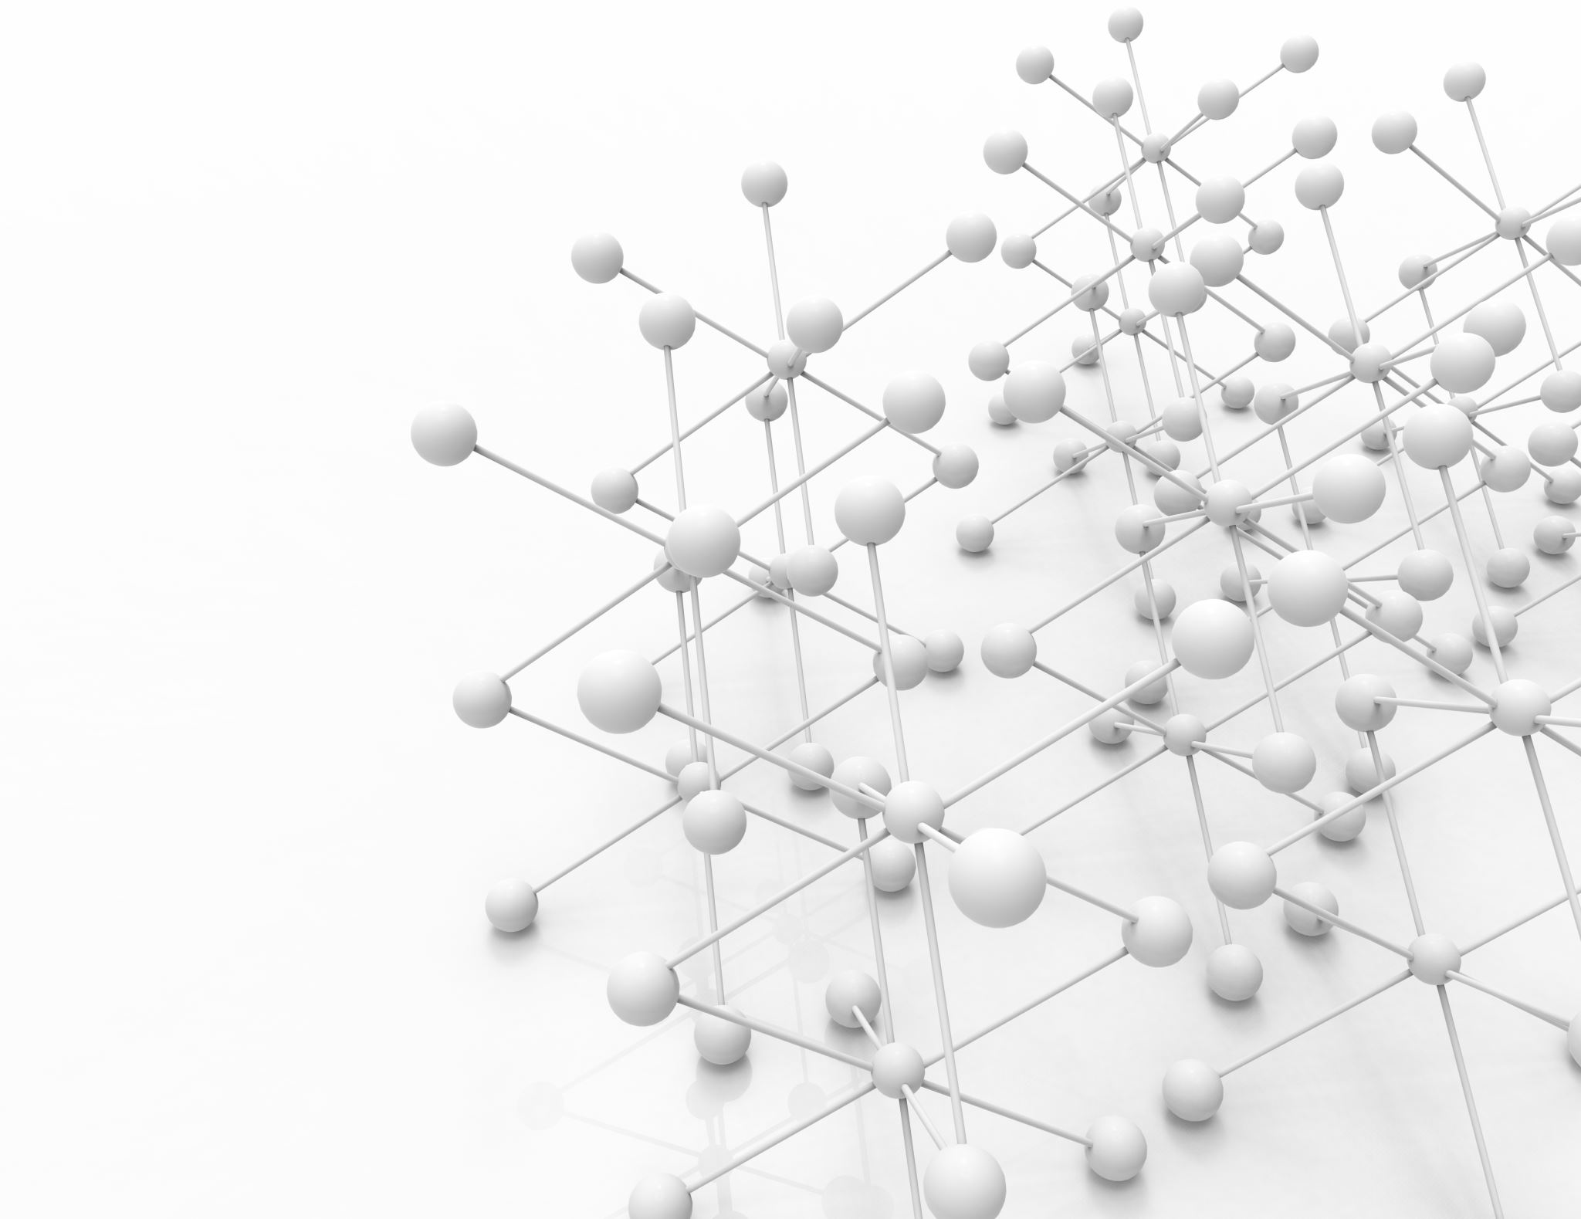
Systems Thinking is:
A group of related or interconnected entities that work together to produce a desired result.
Systems can be either natural, mechanical, or social in nature.
Each of these systems has a purpose. Either one that it was expressly designed for or perhaps one that people assign to it over time.
© Workplace Education Manitoba 2023 All Rights Reserved
Notes:
Examples:
The purpose of digestive system is to digest the food we eat.
The purpose of the medical system is to provide medical assistance when we are ill.
The purpose of a vehicle (mechanical system) is to transport us from one place to another.
Each of these systems needs all its parts to work at their best.
Examples:
A vehicle has thousands of parts.
Ask: Which would you consider critical parts? Which less critical?
Some are critical to its running, such as a working engine and tires.
Some are less critical to its running; motor to raise and lower windows.
Your hand is made up of many parts –
Ask: Which would you consider critical parts? Which less critical?
Some critical - bones, muscles, tendons
Some less critical - nails
A system will frequently use feedback to maintain its own stability. Systems have the means to adjust to change and/or repair the damage.
Vehicle –
When you press the accelerator on your car, the system will push more fuel through the fuel injectors into the engine, so the car has the power it needs to pass another car or get itself rolling after stopping at a red light.
Hand –
Can heal if it is cut or can mend a broken bone.
Explain:
System Thinking means taking a holistic approach, keeping the entire system in mind when we need to address a problem or make a change. When we think and act with the whole system in mind, we are more likely to identify the root causes or problems and find lasting solutions.
Whatever symptoms that troubled us before are less likely to come back. We are also less likely to encounter unintended consequences because we can see all the relationships within the system. Even if there are likely to be negative side-effects, we will know about them in advance and can be ready to deal with them.
Debrief Discussion
Debrief activity as a large group.
1. What does Systems Thinking mean to you?
2. Why is this important in the workplace?

Slide 15

IDENTIFYING TYPES OF SYSTEMS
© Workplace Education Manitoba 2023 All Rights Reserved
Image from: Case School of Engineering
Notes:
Activity 1:
Have learners break into groups of 2-3 people.
Ensure each group has paper and a pen.
Ask each group to make a list of as many types of systems they can think of in their lives.
Give them 2-3 minutes to brainstorm ideas together.
Have each small group share their list with the large group making notes on a flip chart or white board (leaving space for a second column for Activity 2).
Examples may include:
Human Body
Company
Family
Assembly Line
Computer
Appliance
Public Education
Medical
Transportation
Chocolate Cake
Sports Team
NOTE: If they are having trouble, suggest they look around the room they are in or think about their morning and what they did or used before getting to class.
Debrief by asking:
Do you see any defining features across all systems? (They all have parts that interact.)
Why might an understanding of a system be helpful when solving a problem that has been identified within it? (one part affects the next)

Slide 16

THE PARTS OF A WHOLE
© Workplace Education Manitoba 2023 All Rights Reserved
Notes:
Once the group has identified types of systems in their lives, begin to explore the parts within each system.
NOTE: This activity helps the learner to focus on the transformation process identifying the forces able to transform parts into a system.
On the flip chart or whiteboard, add another column with the heading PARTS.
Have learners identify the parts of each of these systems.
Have learners identify what needs to be done to transform the PARTS into a SYSTEM.
Examples:
Human Body as a whole (parts include circulatory, skeletal, muscular, nervous, endocrine, cardiovascular, lymphatic, respiratory, digestive, urinary, and the reproductive systems, etc.)
Company (parts include upper management, middle management, employees, customers, etc.)
Family (parts include parents, siblings, aunts, uncles, cousins, grandparents, etc.)
Computer (parts include monitor, keyboard, mouse, software, hardware, etc.)
Appliance (parts include doors, electronics, trays/racks/shelves, etc.)
School / Education (parts include division, administration, teachers, students, curriculum, etc.)
Medical (parts include Regional Health Authority, doctors, nurses, ERs, dr. offices, clinics, etc.)
Transportation (parts include vehicles, city buses, trains, transport trucks, roads, etc.)
Chocolate Cake (parts include flour, sugar, eggs, cocoa powder, salt, etc.)
Sports Team (parts include manager, coach, players, fans, etc.)
Debrief by asking:
What distinguishes a PART from a SYSTEM, and a SYSTEM from its PARTS? (segments vs whole)
What needs to happen to transform PARTS into a SYSTEM? (become interdependent)
EXPLAIN:
The process of transformation from parts into a system happens when interaction among elements influence or change each part. We have an interaction among parts when the behaviour of one part influences and modifies the behaviour of another part.

Slide 17

UNDERSTAND HOW SYSTEMS BEHAVE
© Workplace Education Manitoba 2023 All Rights Reserved
Notes:
Explain:
Every day we deal with minor inconveniences, unexpected situations, mundane activities, and occasionally pleasant surprises. The dog chews on your slippers, you get a phone call from a coworker asking if you can cover their shift, a friend invites you to dinner. These are isolated events, and we treat them that way; we deal with them as they come, and we move on to the next thing.
Sometimes, there is more to an event than initially meets the eye. System thinkers sometimes describe events as the tip of the iceberg. What we see above the water is just a small part of something larger. What we see is a relatively minor incident, but underneath that may be patterns that we should be noticing and systems we should be making ourselves familiar with. Beyond that may be assumptions and information that we might need to consider.

Slide 18
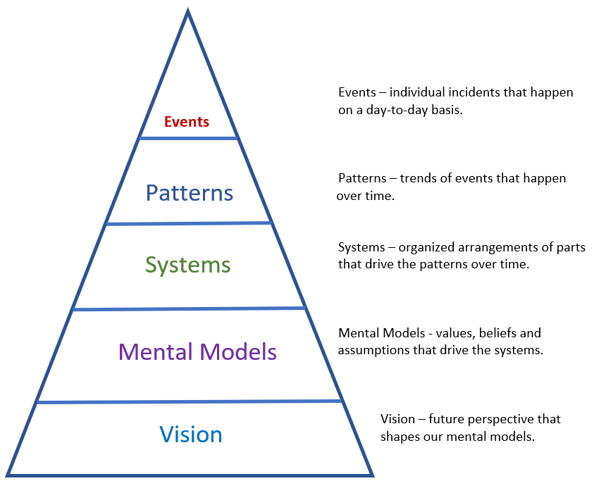
The Systems Thinking Model
© Workplace Education Manitoba 2023
All Rights Reserved
Notes:
Share the following Scenario to Explain Diagram:
Suppose you’re at work in an office and you’re working with your computer. Up to now, this computer has served you well. You’ve had it a couple of years, and it hasn’t caused you any problems.
You are responding to an email or entering data into a spreadsheet, and the computer freezes on you. After a minute or so of waiting, you reboot and pick up whenever you last saved your file. Hopefully, it won’t happen again. This is an EVENT.
An hour or so later, your computer freezes again. That’s twice in one day! The freeze-ups are starting to form a PATTERN. You may still believe the computer is reliable, and you don’t need to call tech support. Hopefully, this is just a coincidence, or it will clear up on its own. Still, you might begin to deal with the symptom by saving your work more often until the symptom goes away.
Or perhaps you start to think about your computer as a SYSTEM. You almost certainly will after it locks up one or two more times. You probably aren’t ready to ask for a new machine, but you suspect that there is something wrong that needs to be corrected. If you have some computer knowledge, you might start to think about the hardware or software inside your computer. Maybe a file is corrupted? Or there is a problem you downloaded that isn’t compatible? Or there is a problem with the memory? You might call in a technician. This thing isn’t going to go away on its own.
At this point, you are starting to engage in some system thinking. But that doesn’t guarantee your problem will be solved immediately. If you and the technician are unable to find the problem, you will have to reconsider your MENTAL MODEL for the computer system. Up to now, you have assumed that the problem is a relatively minor one: a software glitch or a relatively inexpensive part that needs to be replaced. The computer is still basically reliable and up-to-date and should last five years as your last one did. Or so you think. But if this problem continues to go on, you will start to consider asking for a replacement. Maybe this thing just can’t be fixed. Now you have called into question one of your assumptions from when this whole thing started.
Finally, you may learn from your coworkers that they are having problems with their computers too. And their problems may be larger in scope than yours. The network can’t handle all the data they send in and out, and the software your company uses is behind that used by your clients and competitors. Someone might suggest replacing all the computers and servers with new equipment and installing new software. That is a VISION for a replacement system that spans the entire office. Addressing the root cause might mean additional costs and effort in the short term, but it will benefit the company in the long term because staff will have equipment that does more for them with fewer breakdowns.
All that is what might lie underneath the initial event.
The challenge is to identify when an event is part of a pattern, and the pattern points to systemic issues. If there is a system problem, whether it’s a defective desktop or your entire office computer system is outdated and unable to do the job, the number and severity of problems will likely escalate.
In that case, the sooner you and your team realize you have a systemic problem, the sooner you can start looking at the system, find the root of the problem, and address it. By applying system thinking, you can even anticipate and prepare for issues that might arise, head off problems before they start, and optimize your system to provide the results you want.

Slide 19

GETTING TO THE ROOT OF THE PROBLEM
© Workplace Education Manitoba 2023 All Rights Reserved
Notes:
There is a practice that system thinkers sometimes apply when they identify a problem – The 5 Whys.
The basic principle is that you should begin by asking why an event happened.
Then take the explanation, turn it around, treat it as a separate event and ask why that happened.
Then take the second explanation, treat that as another event, and ask why that happened.
Keep going until you have asked ‘why did that happen?’ five times.
At that point, you should have gotten down to the root cause.
Example:
Manufacturing Plant – Foreman and New Trainee Manager – facility tour.
Along the way they see a pool of oil on the floor which is a slipping hazard.
The Foreman orders an employee to clean up the spill immediately, but the trainee decides to apply the five whys.
Why is there oil on the floor? Machine overhead is leaking.
Why is the machinery leaking? Broke down.
Why is the machine broken down? Gaskets were defective.
Why are the gaskets defective? Heard that purchasing got a good deal on them.
At this point, it is obvious the trainee is onto something. Digging around a bit, they discover that the company had adopted a policy of buying the cheapest possible replacement parts without regard to quality or reliability. The policy wasn’t limited to gaskets and defective replacement parts were causing breakdowns and hazards throughout the plant.
New Policy = Fewer Breakdowns = Increased Production = Increased Profits

Slide 20

THE 5 WHYS
© Workplace Education Manitoba 2023 All Rights Reserved
Notes:
ACTIVITY
Scenario for small group activity:
Problem: Your company was unable to get the customer’s product request to them on time.
1. Why were you unable to produce the product on time? (the equipment failed)
2. Why did the equipment fail? (the circuit board burned out)
3. Why did the circuit board burn out? (it overheated)
4. Why did it overheat? (the air filter wasn’t changed)
5. Why wasn’t the filter changed? (there was no afternoon preventative maintenance
shift scheduled to change it)
Followed by this scenario for individual activity:
Have each learner identify a problem they have been dealing with. Make sure it is one that has repeated and become a pattern.
Once each learner has this problem in mind, have them walk through the 5 Whys and break down the problem to its root cause.
Debrief by asking:
Would anyone like to share their example with the group? (If not, have one of your own in mind to share.)

Slide 21
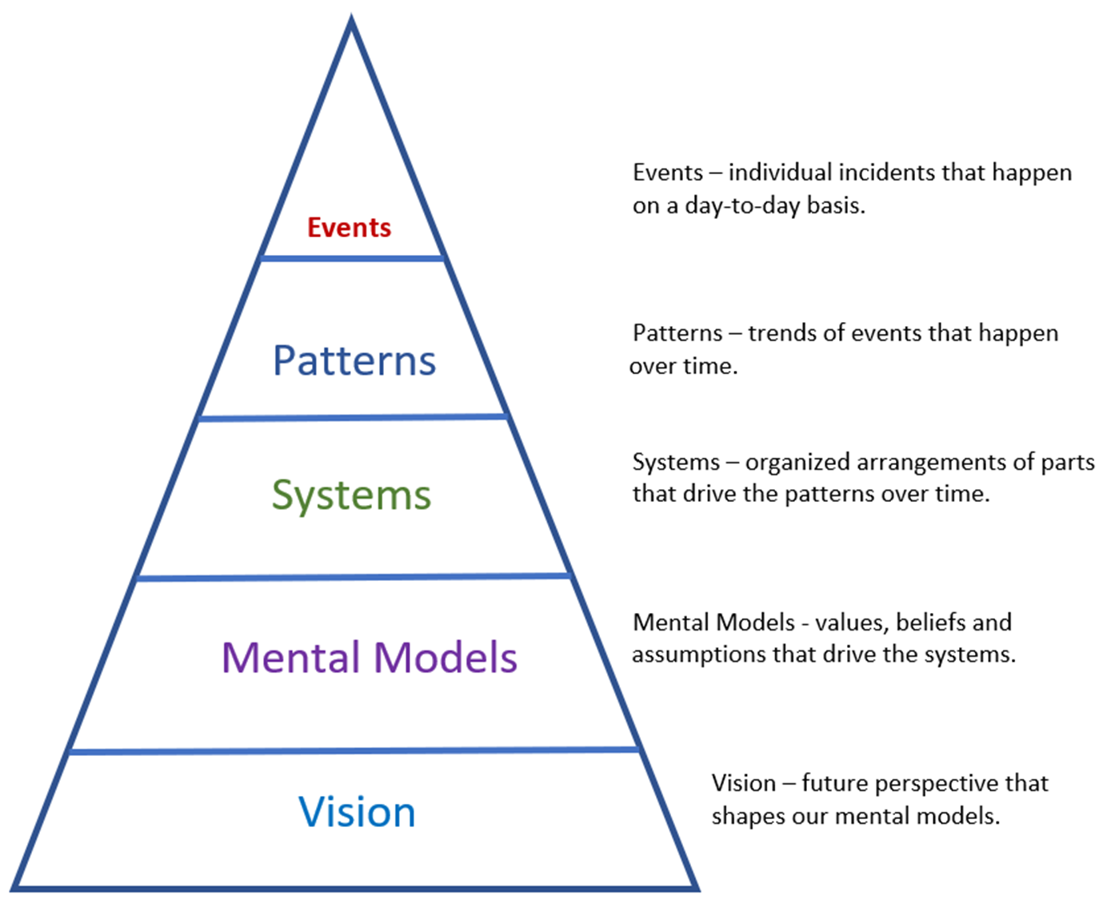

BRINGING IT TOGETHER
© Workplace Education Manitoba 2023
All Rights Reserved
Notes:
Walk through the Systems Thinking Model and the 5 Whys (also can refer to workbook).
Debrief by asking:
How did this impact your ability to resolve the problem you worked on?
Record answers for reporting purposes (skill gains and transfers).

Slide 22
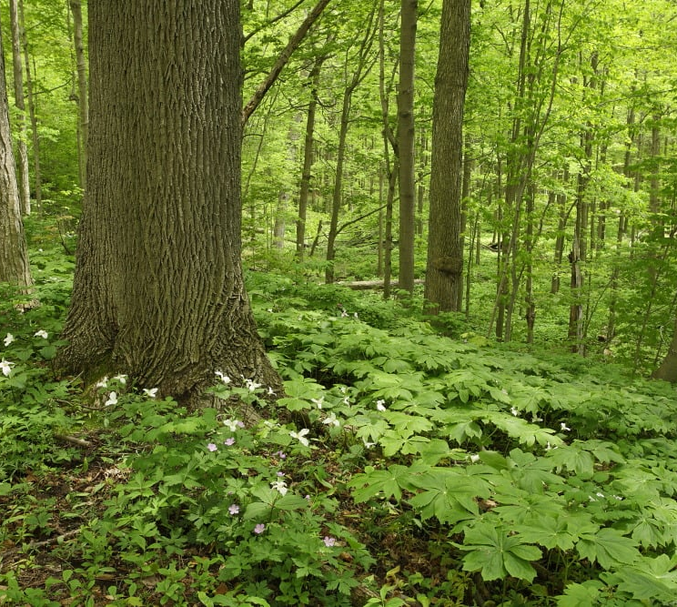
IDENTIFY COMMON PATTERNS WITHIN SYSTEMS
Image by Canadian Geographic
© Workplace Education Manitoba 2023 All Rights Reserved
Notes:
Activity: Making a Forest Model
Description:
Think of a forest system. Ask learners to brainstorm parts of the forest they wish to include and decide, using their bodies and any objects in the room, what parts they will include. The physical objects are to represent the structure, content, and interacting parts of the model.
Supplies Needed:
Paper
Scissors
Tape
Paper Tubes
Boxes
Etc.
Supplies To Be Determined but attempt to use things already in the classroom or gather recycled materials.
Sub-Systems – a self-contained smaller system within a larger system. Each sub-system has PARTS of its own.
Ask: Are there any sub-systems in your model?
Example may include:
Tree root system
Fungi growth
Pause to allow group to add items to include any sub-systems to their model, if not already included.
Feedback – a healthy system will use feedback to sustain itself. Feedback can reinforce and amplify or balance and correct the system’s functions. Feedback can lead to balance, or at least a bit of back and forth around an average that the system can handle reasonably well.
Ask: What feedback is present in your model?
Example:
As trees burn and decay, they release carbon back into the atmosphere. And with fewer trees left, more carbon dioxide remains in the atmosphere. Both lead to further warming and more tree dieback.
Pause to allow group to add a feedback loop to their model, if not already included.
Time – the passage of time can sometimes complicate the operations of a system. Parts of a system do not always respond to each other instantaneously. The parts may be closely related, but they do not always act simultaneously. It may take anywhere from minutes to years for one part of a system to respond to activity in another part. This delay can complicate things. Delays may result in a system breakdown.
Ask: How does the passage of time affect your model?
Example:
After a forest fire, animal and plant life will move into the burned-out area, but the effect may take years to become apparent. Also, time for the seasons to change.
Pause to allow learners to add a time factor to their model, if not already included.
Boundaries – systems thinking recognizes that systems can be influenced by environmental conditions outside of the system’s influence.
What is in the system? What is outside the system?
Rule of Thumb: The system includes all the parts that are necessary for the system to function.
Ask: Where will you set your forest system boundaries?
Example: The weather and seasons affect what plant life will grow. The solar system is necessary for plant life. Are these necessary? Include? Or not?
Caution! We could potentially wrap up everything, everywhere, at all times into one system – forest, community, province, country, world, planet, solar system, galaxies, and the universe. Don’t take it too far!
Pause to allow learners to add boundaries to their model, if not already included.
Hierarchies – Hierarchies help us to understand how systems respond and what the purposes of all the parts are. They help us understand who is in charge and why we are doing what we’re doing.
Ask: What hierarchies might you find in your forest system?
Example: Forests are populated by both moose and wolves. As the wolf population increases, they prey on the moose which decreases their population. However, as the moose die off, there is little food for the wolves and they then begin to die off, allowing the moose population to re-establish itself.
Pause to allow learners to include a hierarchy in their model, if not already included.
Synergize – parts of a system will often synergize so the collective result is greater than what those same parts would have produced separately. It’s a lot like teamwork.
Ask: Where do you see synergy in action in your forest model?
Example: Deadfall may create an ideal place for insects and/or fungi to thrive.
Pause to allow learners to add synergy to their model, if not already included.
Resources – a system may store, move around, use, produce and distribute resources among its various parts. Observing how much is available and how they move – stocks and flows – will often be key to understanding and working with a system.
Ask: What resources are evident in your forest system?
Example:
Water runs from high ground to low ground creating pools of water for waterfowl, marsh plants.
Berries that grow on bushes may be picked by locals or eaten by birds.
Pause to allow learners to add resources to their model, if not already included.
Debrief by asking:
What parts of the forest are interdependent?
How does this apply to the workplace?
How do models or visuals help us understand how a system functions?
How does this apply to the workplace? (organizational charts, tables, huddle boards)

Slide 23

UNDERSTAND HOW TO DEAL WITH COMMON PATTERNS
What happens when…?
© Workplace Education Manitoba 2023 All Rights Reserved
Notes:
Activity: What happens when…?
Keeping with the forest system, select various events and patterns that may sustain or diminish the model and allow time for the learners to adjust their model accordingly.
Examples:
What happens when locals use the forest to hike and enjoy nature?
What happens when a local developer wants to build a lodge nearby?
What happens when the seasons change year after year?
What happens when locals pitch in to maintain hiking trails each year?
What happens when a weather system passes through the region?
What happens when the municipality issues several permits to allow trees to be removed for burning to heat houses?
What happens when you remove piles of branches and small trees to be shredded or mulched?
Once learners have adjusted their model after each question, have learners take their seats.
Debrief by asking:
What did you learn about systems and common patterns within them? (more than meets the eye)
What actions sustained the system? (maintain hiking trails, enjoy nature)
What actions diminished the system? (lodge building, permits to remove trees)
What does it mean to be a part of an interdependent system? (every change affects another)
How does this apply to the workplace? (our actions have consequences, if we don’t complete our duties, others can’t complete theirs, if we make a mistake, it affects others being able to do their jobs well or on time)

Slide 24
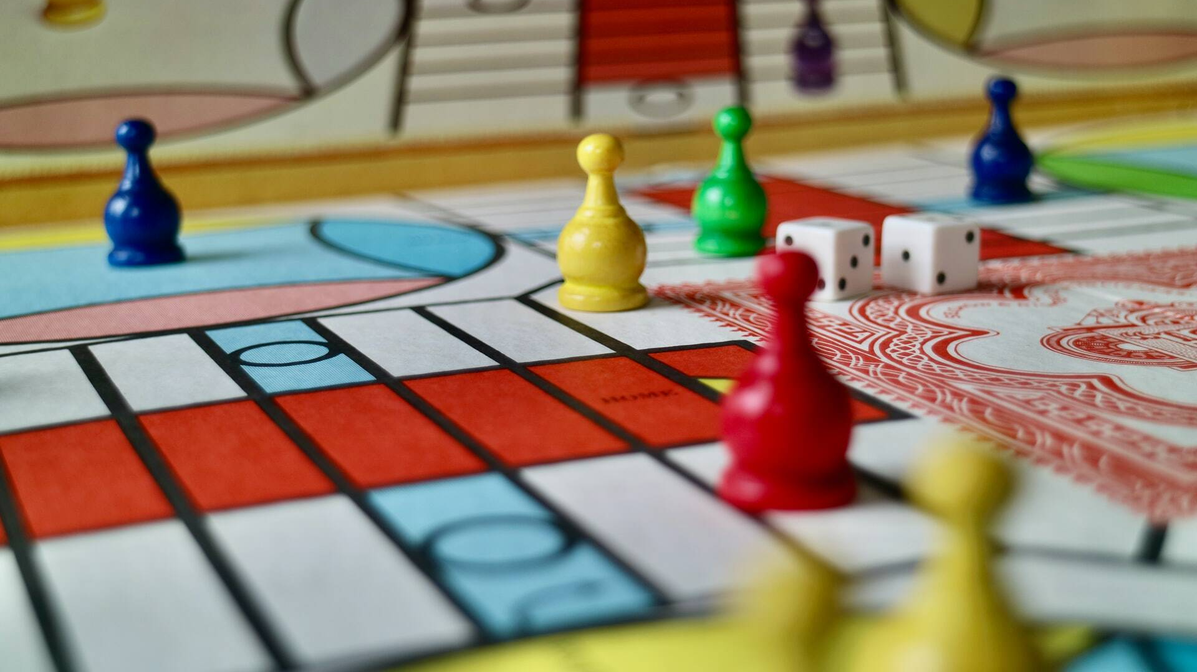
APPLY SYSTEMS THINKING
© Workplace Education Manitoba 2023 All Rights Reserved
gamesreviews.com
Notes:
Activity: Playing and Designing a Game
Description of Activity:
Select a simple and familiar card or board game (Yahtzee, Crazy 8s) that requires little supplies (deck of cards, dice). Review the rules of the game with the learners. Play one round/hand of the game.
Next alter the rules. Depending on the size of your group, have ¼ of the learners contribute one change/addition/elimination of the original rules to create a new variation of the game. Play one round/hand of the new version of the game.
Debrief by asking:
What does having a set of rules tell us about the way a system works? (who, what, why, how, how many, what parameters to function within, etc.)
What is the difference between playing a game and designing a game? (follow system vs create the system)
What is different about the system when the game is being played (turn taking according to a set of rules) and when it is being designed (think differently – higher order of cognitive skill by reflecting upon the possible alterations and their consequences of playing according to the new set of rules, requires an understanding of the entire system which is not needed when playing the game)?

Slide 25

APPLY SYSTEMS THINKING TO PERSONAL AND PROFESSIONAL LIFE
© Workplace Education Manitoba 2023 All Rights Reserved
Notes:
Activity: Applying Systems Thinking to Personal and Professional Relationships
Description: This activity is a conversation best applied with 3-4 learners.
Select a situation of interest that is likely to provoke a range of reactions; family gathering or work barbeque.
Ask each learner to write down their initial reaction to the situation. Then each learner imagines the reaction of the others and writes each one down on a separate piece of paper.
Each learner’s name is written on the outside of the paper after it is folded. The papers are sorted into piles by name, and the piles are distributed to those named.
Each learner takes a turn reading aloud the responses, identifying which one is their original reaction.
Debrief by asking:
Of what importance is the perception of others in a system comprised of people?
In what ways does a system of people learn about itself through the views of its members?
What can the perceptions of others and the group tell us about systems thinking?

Slide 26
SUMMARY
The perceptions of oneself and others, communicated in conversation, reveal the character, climate, vitality, health, and dysfunction in social systems.
© Workplace Education Manitoba 2023 All Rights Reserved

Slide 27

REVIEW
© Workplace Education Manitoba 2023 All Rights Reserved
Notes:
Review:
Learning Objectives 1-6 along with activities for each learning objective.
Record any final insights, skill gains and transfers for reporting purposes.
HANDOUT POST SELF-ASSESSMENT
Ask each person to write their name, date the form and complete it and return the completed assessment to you.

Slide 28

© Workplace Education Manitoba 2023
All Rights Reserved
Kelly Brennan/Daily Bruin
Notes:
WRAP-UP ACTIVITY
Ask learners to respond to the following questions/statements.
Record participant responses for reporting purposes.
Share a specific activity/explanation/discussion that caused a change in your thinking.
What did you most like learning about?
Name two things you can do to implement your learning into your life, learning or work.

