Slide 1

Workplace Connections
Skills for Success

Slide 2
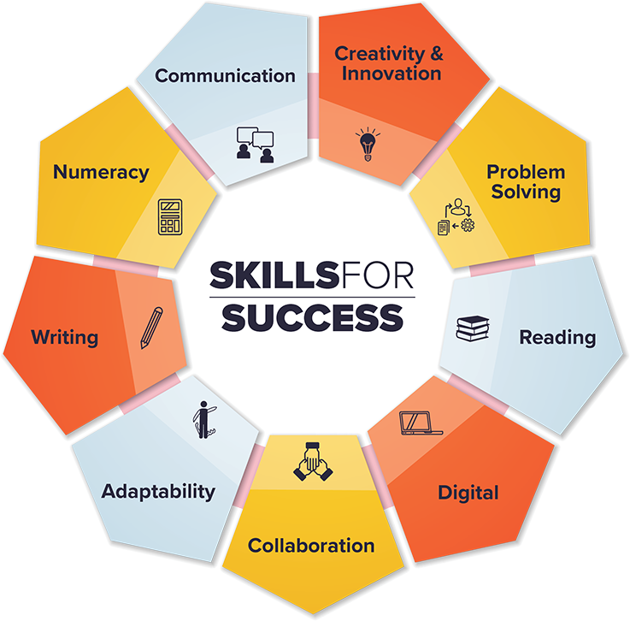
Skills for Success Framework
ESDC

Slide 3
What is
Workplace Connections – Skills for Success?
Comprehensive training response
Create increased capacity for Skills for Success Workplace delivery across Canada – including ability for workplaces to build engagement, assess training needs, deliver training, and evaluate training outcomes.
Increased Skills for Success competency will provide the foundational supports employers need related to sustainability, scalability and consistency of delivery and outcomes related to Skills for Success in workplaces.

Slide 4
What are we doing?
Certifying 120 Skills for Success Workplace Practitioners across Canada
  Included is 12 day training program
    Relational Skills curriculum
    Access to Toolkit
    Practicum delivery with mentorship

Slide 5
What are Relational Skills
The relational skills cluster is made-up of eight skills that together equip employees not only to work well together but also do so in a way that
builds trust
creates a respectful workplace
supports inclusion and
helps employees manage effectively in the ever changing an increasingly digital and global world

Slide 6
Relational Skills Cluster
Communication in the New World of Work
Aspects of Problem Solving and Thinking Skills - Systems Thinking
Change Ready Mindset (Adaptability)
Collaboration
Cultural Competence
Social Intelligence
Resilience
Civility & Citizenship

Slide 7
Some Identifiers of Gaps in Relational Skills
• Frequent miscommunications
• Inability for team members to recognize when they have offended or are perceived to have disrespected others
• Difficulty for individuals and teams to adapt to change
• Reports of mistrust amongst the work team
• Difficulty with group discussions, events, or problem solving
• Individuals taking more time off e.g., as sick days
• A lack of team orientation
• Complaints from team members about “tone” of communications
• Hesitation or inability of individuals to self-direct their learning
• Tendency for employees to blame the company or coworkers when things don’t go as planned
• Difficulty for individuals to “fit” into the workplace culture
• Team members disengaging from group interactions
• Persistent reports of high stress in the workplace
• Day to day rudeness /incivility in the workplace
• Individuals seeming to focus only on their own needs and wants

Slide 8
The Relational Skills Program helps organizations to address
Diversity and Inclusivity
Onboarding “quick to fit” solutions
Staff Retention
Staff and Workplace Mental Health
Safety by building trust
Productivity Efficiencies
Customer Service
Teamwork

Slide 9
Some benefits for employees who are offered Relational Skills training
Be situationally aware,
Show empathy and shared perspective,
Relate from a “people first” point of view
Be change ready
See situations from a systems perspective
Adopt a “global citizen” mindset where there is increased understanding of shared experience
Engage with others in a respectful way which fosters an ease in communication
Build self-management and self-awareness skills that help employees self-direct and manage stress.

Slide 10
To contact us email

