Slide 1




CHANGE READINESS
Funding provided by the Government of Canada and the Manitoba government.
Workplace Education Manitoba (WEM) is a leader in providing customized training and assessment responses across Manitoba.
SESSION 1
What is Change?

Slide 2

Session Objectives:
1. Define change (both internal and external).
2. Identify the benefits of change.
3. Understand the 5 Building Blocks of Change.
4. Evaluate personal change readiness through self-awareness and desire for change.
5. Recognize the connection between emotions/feelings with change and how they relate depending on internal or external factors.
6. Apply change readiness methods to life, learning, or work.

Slide 3

ACTIVATOR:
The Ups and Downs of Change

Slide 4

What is Change?
Notes:
Learning Objective 1
Define change (both internal and external).
Activity 1: Personal Journey Through Both Internal and External Changes

Slide 5
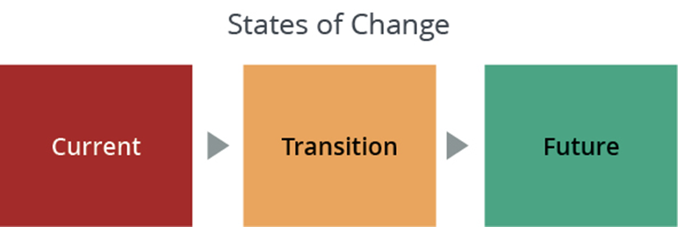
External
Internal

Slide 6
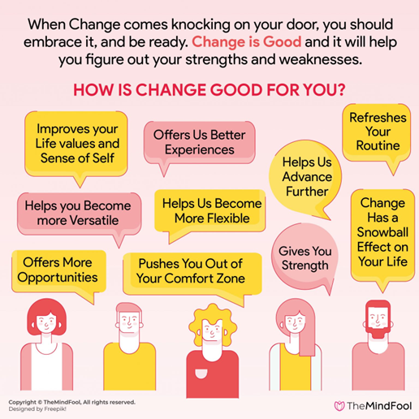
The
Benefits
of
Change
Source: https://themindfool.com/how-change-is-good-for-your-personal-and-professional-life/
Notes:
Learning Objective 2
Identify the benefits of change.
Activity 3: Exploring Personal Experiences and Impact

Slide 7
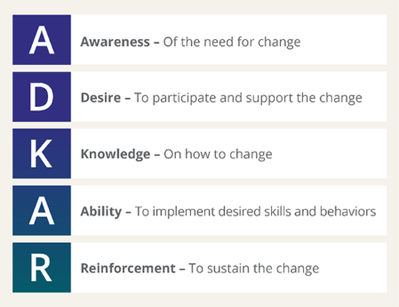
The 5 Building Blocks of Change
Source: www.prosci.com
Notes:
Learning Objective 3
Understand the 5 Building Blocks of Change.
Activity 2: Focus on Awareness and Desire

Slide 8

Personal Change Readiness Survey
Photo source: www.pexels.com
Notes:
Learning Objective 4
Evaluate personal change readiness through self-awareness and desire for change.
Activity 4: Personal Change Readiness Survey

Slide 9

Feelings About Change
7 common emotions to change:
Fear
Grief
Enthusiasm
Anger
Confusion
Loneliness
Sadness
Numbness
Source: https://ronedmondson.com/2014/07/7-emotions-of-change.html
Notes:
Learning Objective 5
Recognize the connection between emotions/feelings with change and how they relate depending on internal or external factors.
Activity 5a: Feelings About Change

Slide 10

Exploring the
7 Traits
of
Change Readiness
Resourcefulness
Optimism
Adventurousness
Drive
Adaptability
Confidence
Tolerance for Ambiguity
Notes:
Learning Objective 5
Recognize the connection between emotions/feelings with change and how they relate depending on internal or external factors.
Activity 5b: The Seven Traits of Change Readiness

Slide 11

As a result of today’s workshop:
What would you say had the most impact on your thinking around change?
Source: Thebutterflyreader.com
Notes:
WRAP-UP ACTIVITY
Ask participants to respond to the questions/statements on the slide.
Observer will record participant responses on the last page of Lesson Plan or in notes for assessment use. (Note to Facilitator) This is valuable information for the final report.

