Slide 1

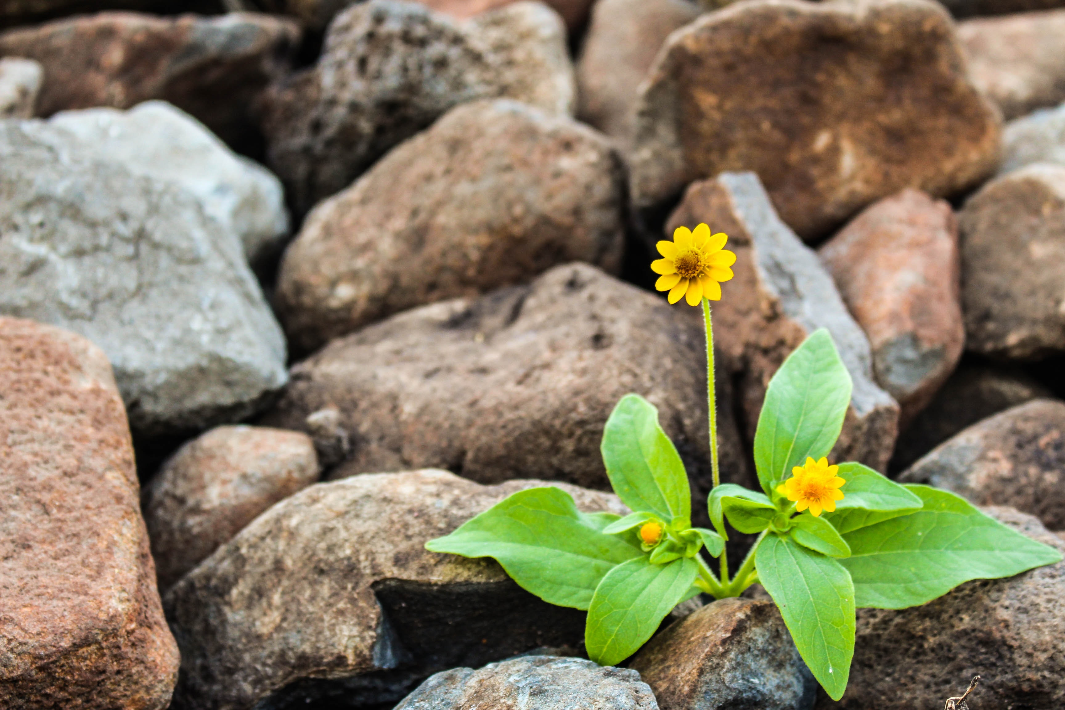

CHANGE READINESS
SESSION 2
Resilience
Funding provided by the Government of Canada and the Manitoba government.
Workplace Education Manitoba (WEM) is a leader in providing customized training and assessment responses across Manitoba.

Slide 2
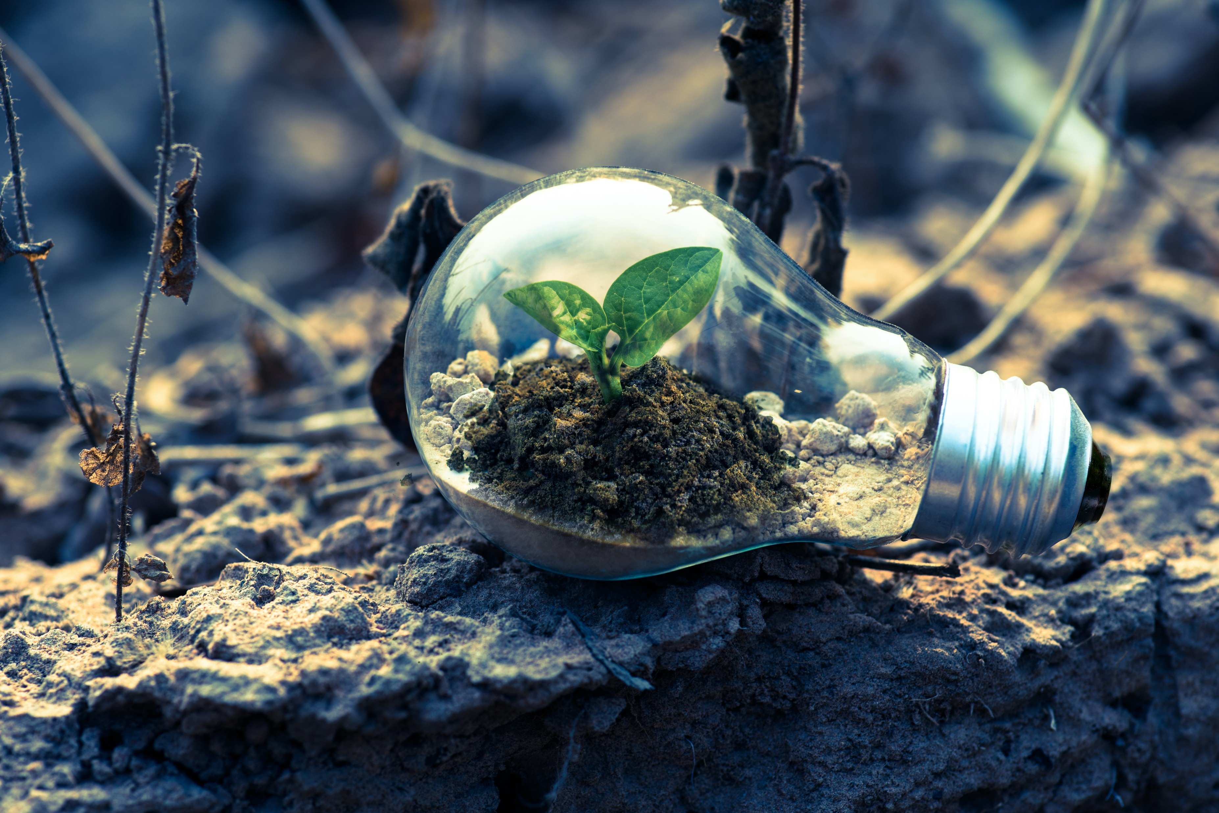

Session Objectives:
Define resilience.
Recognize the characteristics of resilient people.
Review the 5 Building Blocks of Change (ADKAR model).
Increase understanding of Knowledge and Ability focus more detail on these building blocks.
Connect personal values to individual approach of coping with change and developing resilience.
Evaluate personal adaptability skills.
Apply resiliency methods to life, learning, or work.

Slide 3
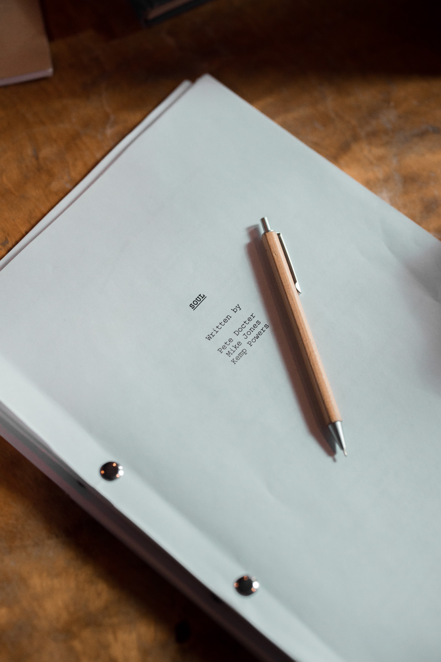
ACTIVATOR:
Whose Story Is It?
Notes:
An activity that involves group members writing a personal story on a piece of paper and placing it into a container. Members then randomly pick out pieces of paper from the container and read them aloud to the group. Then, members try to guess who wrote the story. This activity can allow groups to share personal anecdotes and learn more about other members of the group.
Facilitator can highlight that everyone has their own story and journey in life and connect to the topic of developing resilience in relation to change readiness.

Slide 4

RESILIENCE
The capacity and dynamic process of adaptively overcoming stress and adversity while maintaining normal psychological and physical functioning. It can be viewed as a defense mechanism, which enables people to thrive in the face of adversity.
What does it mean to you?
Source: https://happyproject.in/resilience-definition/
Notes:
DEFINING RESILIENCE
Refer to pages 2-4 of the workbook and discuss.
Learning Objective 1
Defining Resilience
Activity 1: A picture tells a thousand words…
A group activity designed to introduce, educate, and spark discussion on resilience.
Facilitator will spread miscellaneous pictures or magazine cut-outs on the floor. Ask participants to choose a picture card they think best relates to the word resiliency.
Participants then share what their card means in relation to resiliency and what resilience means to them.
Observer to record responses.

Slide 5
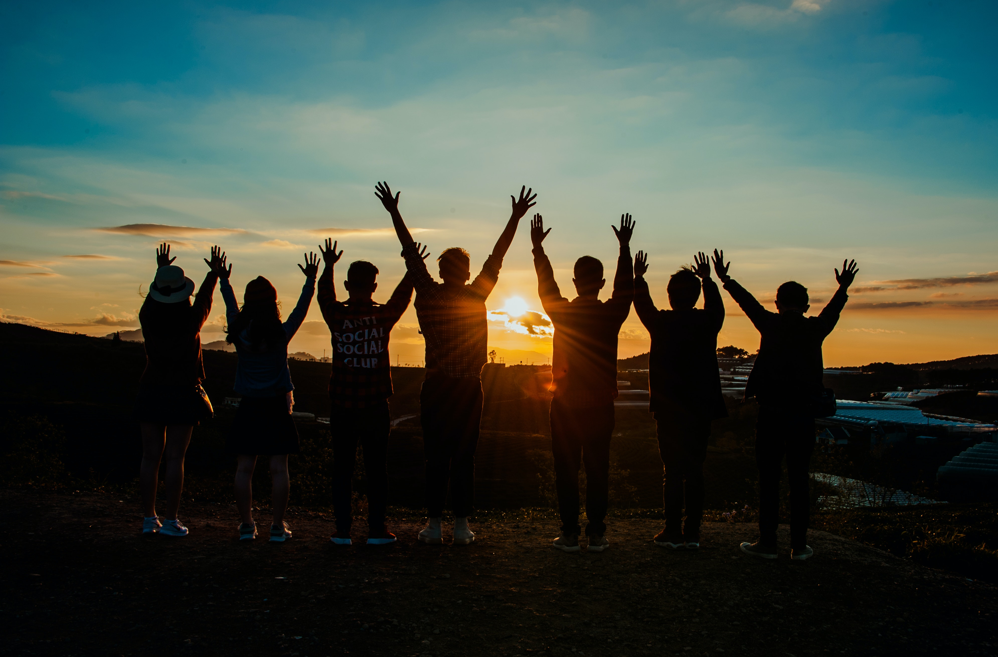
CHARACTERISTICS OF RESILIENT PEOPLE
1. They are able to detect the cause of their problems
2. They know how to handle their emotions
3. They keep calm in stressful situations
4. They are realistic
5. They trust themselves
6. They are empathetic
7. They are able to motivate themselves
8. They don’t ask why, they ask how
Source: https://exploringyourmind.com/8-characteristics-resilient-people/
Notes:
BENEFITS OF RESILIENCE AND CHARACTERISTICS OF RESILIENT PEOPLE
Refer to pages 6-7 of the workbook.
Learning Objective 2
Recognize the characteristics of resilient people.
Activity 2a: How resilient are you?
Hand out “How resilient are you?” self-assessment.
Ask participants to complete the assessment individually.
Discuss each statement for understanding.
Ask participants what thoughts they now have about their resiliency skills.
Activity 2b: Three Trees
The purpose of this activity is to become self-aware of our response to change, and how well we adapt and cope with inevitable change.
Facilitator will have large pictures of an oak tree, willow, and tumbleweed posted.
Handout individual worksheets with these pictures on them and the brief explanation of these coping styles, and a questionnaire for each participant to complete individually.
Once everyone has completed the worksheet, Facilitator will discuss and debrief.
Observer will record reflections and responses.

Slide 6
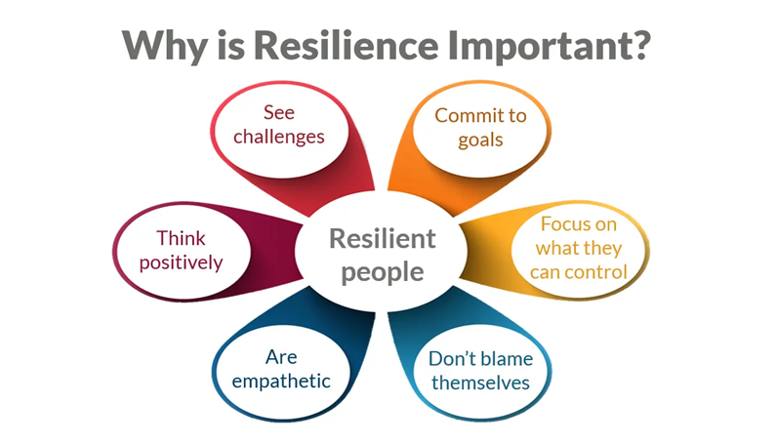
Notes:
Benefits of resilience

Slide 7
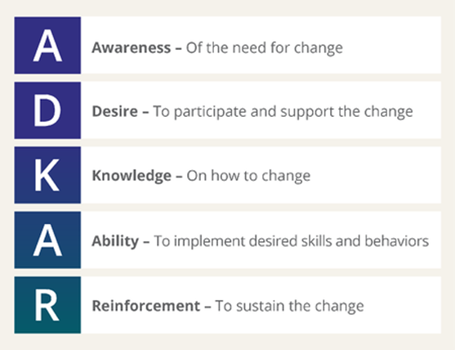
The 5 Building Blocks of Change
Source: www.prosci.com
Notes:
THE 5 BUILDING BLOCKS OF CHANGE
Refer to pages 6-7 of the workbook.
5 Building Blocks of Changes (ADKAR model) review from Session 1.
Specific focus on Knowledge and Ability with more detail on these building blocks and how they relate to resilience.
Learning Objective 3 & 4
Review the 5 Building Blocks of Change (ADKAR model).
Increase understanding of Knowledge and Ability focus more detail on these building blocks.

Slide 8
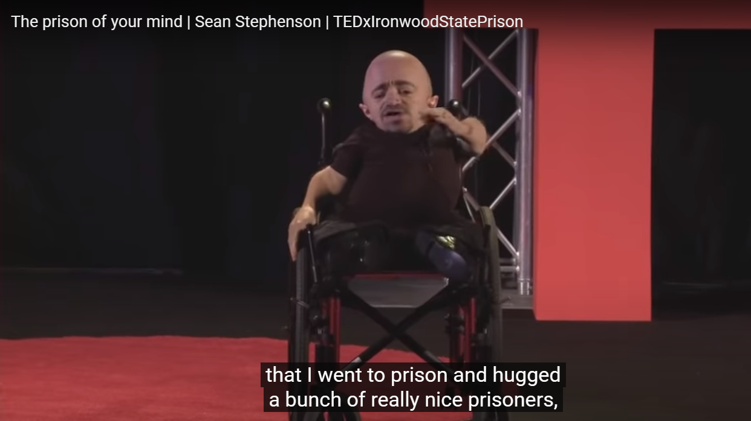
Video –
The prison of your mind
~ Sean Stephenson
https://m.youtube.com/watch?v=VaRO5-V1uK0
Notes:
Activity 3: Video – The prison of your mind, Sean Stephenson
https://m.youtube.com/watch?v=VaRO5-V1uK0
Watch the video as a group.
Encourage participants to share their insights from the video.
What do you feel Sean shared in his TedX Talk that relates to knowledge and ability, resilience, and change readiness?
Discuss as a group.
Observer to record responses.

Slide 9
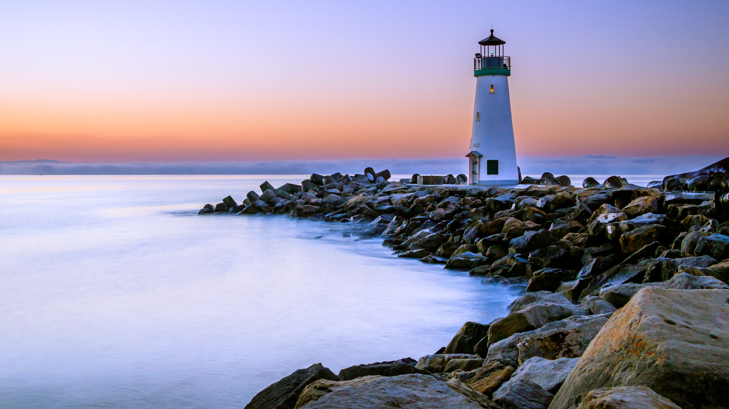

CONNECTING PERSONAL VALUES TO INDIVIDUAL APPROACH OF COPING WITH CHANGE AND DEVELOPING RESILIENCE
Our personal values shape our experience of the world.
Notes:
Learning Objective 5
Connect personal values to individual approach of coping with change and developing resilience.
Activity 5: Values Cards
Facilitator to handout a set of values cards to each participant.
Ask participants to move to an area that they have more room (either using another table, or floor space, etc).
Explain to place the five category cards in a row in front of them.
These are “Most Important to Me”, “Very Important to Me”, “Important to Me”, “Somewhat Important to Me”, and “Not Important to Me.”
Ask participants to go through the set of values cards and place each under the category card that best reflects their ranking of importance.
Once everyone has finished, discuss and connect to how their values can support their ability to cope with change and develop their resilience.
Observer to record responses.

Slide 10
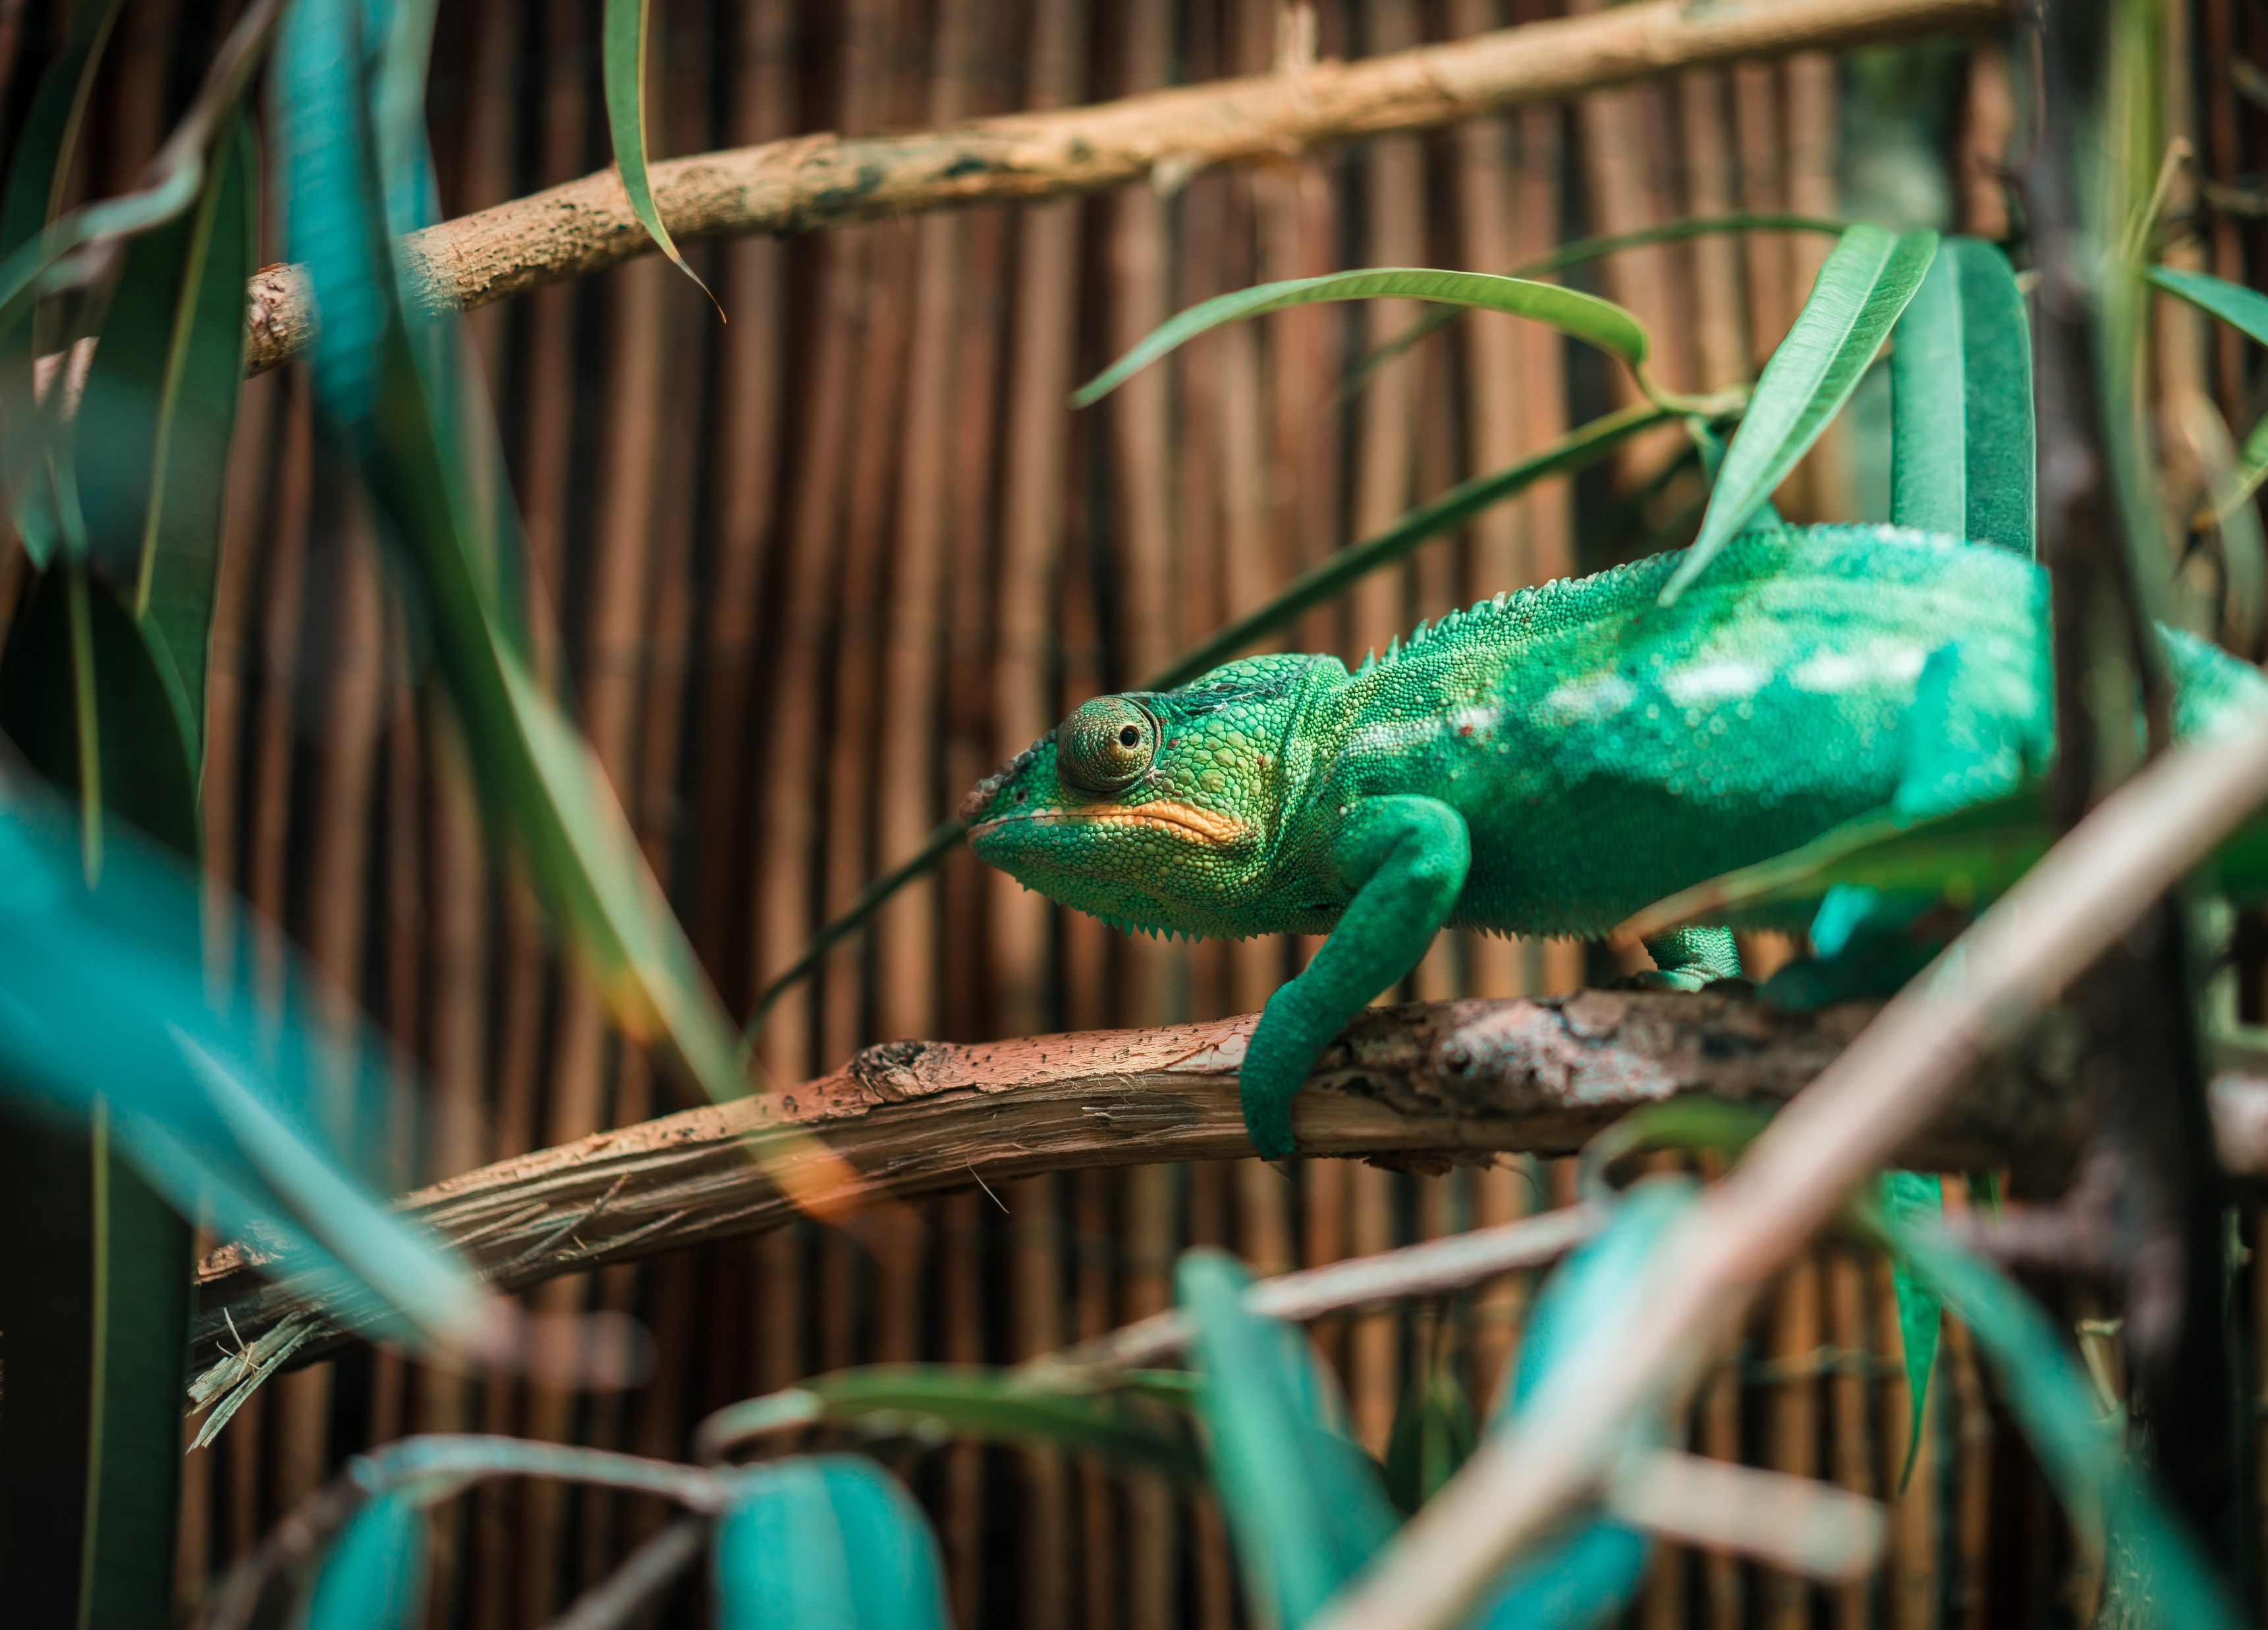
PERSONAL ADAPTABILITY SKILLS
Adaptability is the ability to respond to unexpected change with grace and to be able to accomplish a task even if things go wrong.
Notes:
Learning Objective 6
Evaluate personal adaptability skills.
Activity 6: Adaptability In My Life - reflection
Write the following statements on a flipchart paper:
• The positive outcomes I have experienced from being able to adapt to situations in my life are…
• How do I know this?
• Who else may have experienced a positive impact from changes I made?
Provide the participants with time to reflect on the statements individually and then ask them to share their responses to the statements.
As each person shares encourage them and provide positive responses.
Observer to record each participant response.

Slide 11

What would you say had the most impact on your thinking around resilience because of today’s workshop?
Source: Thebutterflyreader.com
Notes:
WRAP-UP ACTIVITY
Ask participants to respond to the questions/statements on the slide.
Observer will record participant responses on the last page of Lesson Plan or in notes for assessment use. (Note to Facilitator) This is valuable information for the final report.

