Slide 1


CHANGE READINESS
SESSION 3
Strategies
Funding provided by the Government of Canada and the Manitoba government.
Workplace Education Manitoba (WEM) is a leader in providing customized training and assessment responses
across Manitoba.

Slide 2


Session Objectives:
Review the 5 Building Blocks of Change (ADKAR model).
Increase understanding of Knowledge and Ability focus more detail on these building blocks.
Review strategies covered in Session 1 and Session 2.
Evaluate personal adaptability skills.
Understand the ABCDE Formula.
Develop a 30-Day growth plan.
Introduce concept of mastery – Reinforcement (Maintenance).

Slide 3

ACTIVATOR:
Clenched Fist
Notes:
Ask people to stand and then pair them up with another participant.
Encourage them to get some space so not all huddled together.
Get them to play “Rock-Paper-Scissors” and whoever loses is the person to make a clenched fist first.
Challenge the other participant to get the other person’s fist unclenched within 30 seconds (without hurting the other person – also confirm comfort level prior to pairing).
Get them to change roles and see if the other person can now get the fist unclenched (if appropriate/needed).
Ask participants to return to their spots and debrief as a group.
Ask if anyone was able to get their partners fist unclenched
Ask them how they did it, what strategies did they try, etc.
Ask the participants what they learned from this activity.
Facilitator to guide discussions/reflections and make connections to change readiness and session topic of strategies.
Lesson Reflection/Notes/Variations
Ideally people would have just asked a partner to open their first and they would have done it taking less than 10 seconds. However, a few scenarios generally emerge:
1) People immediately try to force a fist open which meets with resistance
2) People ask the other person to open their fist and they refuse
3) People start to use all sorts of convoluted reasons why somebody should open their fist
There are multiple lessons that can be drawn from this very quick exercise. These include:
Our default response to a challenge and our assumption on how the other person will act and react causing us to proceed in a way that aligns with our image of the other person and the task we have been given
Our assumptions around intent - Do we think the other person wants to help us or wants to be difficult
Do we approach the task with a willingness to help and listen?
Our immediate reactions to an instruction, especially when we are under time pressure and reliant on somebody else.

Slide 4
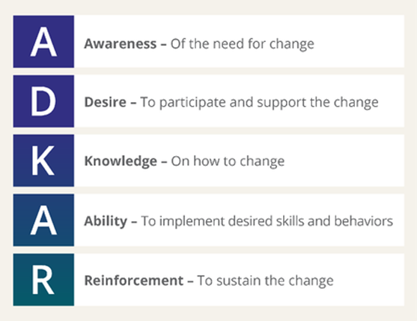
The 5 Building Blocks of Change
Source: www.prosci.com
Notes:
THE 5 BUILDING BLOCKS OF CHANGE
Refer to pages 7-8 of the workbook.
5 Building Blocks of Changes (ADKAR model) review from Session 1 and 2.
Specific focus on Knowledge and Ability with more detail on these building blocks and how they relate to resilience.
Learning Objective 1 & 1
Review the 5 Building Blocks of Change (ADKAR model).
Increase understanding of Knowledge and Ability focus more detail on these building blocks.

Slide 5
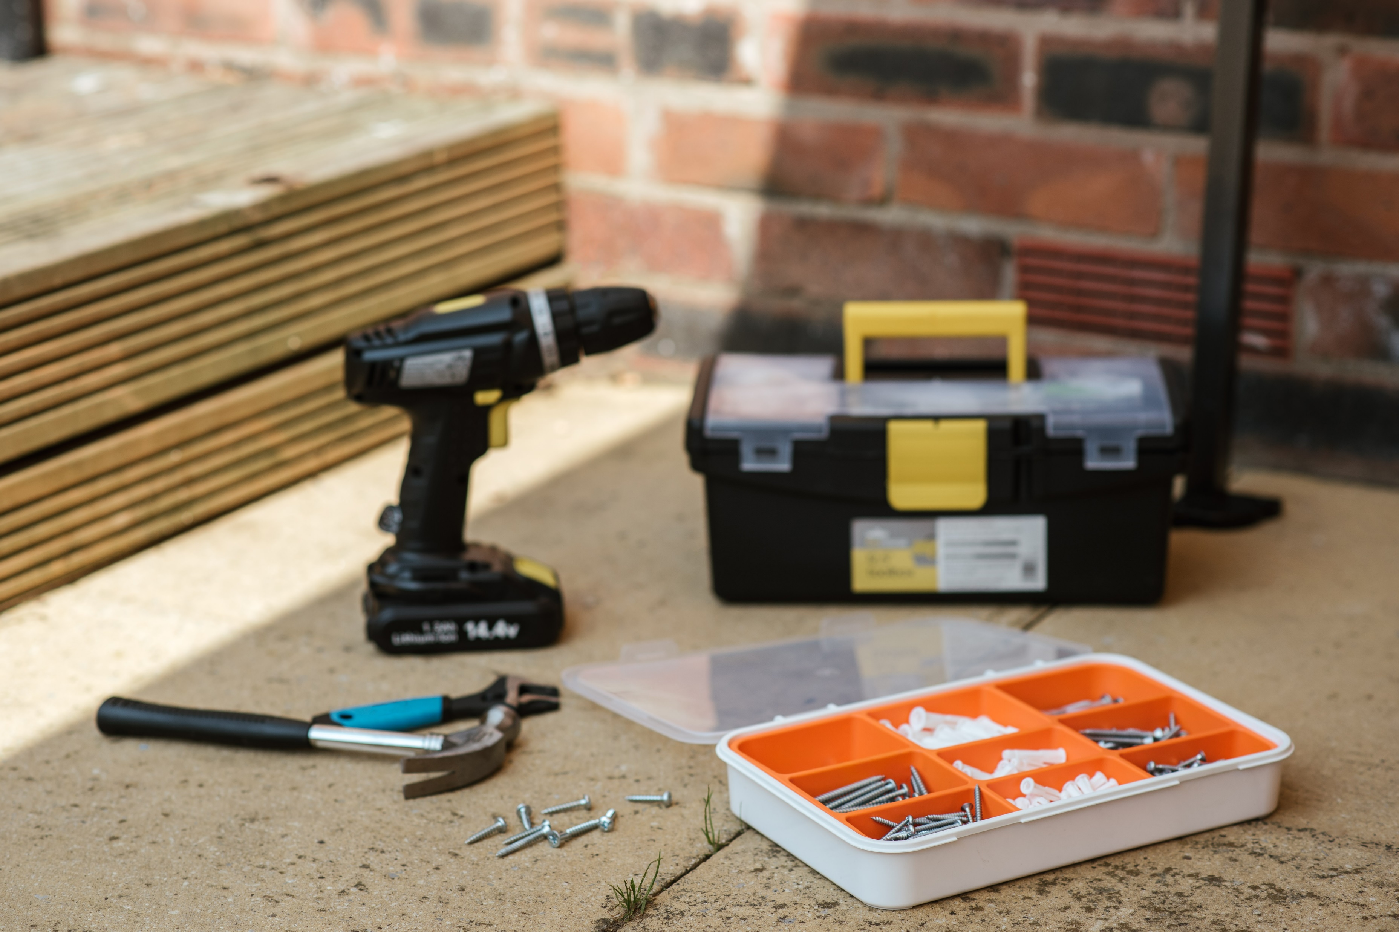

Review of Strategies and Building Your Toolkit of Resources

Slide 6
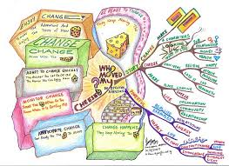

Slide 7

Your Perceptions of Change
What are your reactions when you hear the word “change”?
Negative perceptions
Positive perceptions

Slide 8
The Journey Through Change
Comfort and Control
Learning, Acceptance, and Commitment
Fear, Anger, and Resistance
Inquiry, Experimentation, and Discovery

Slide 9

Think!

Slide 10
Characteristics of Comfort and Control
Comfortable
Safe
Everything’s fine
Happy
Satisfied
No problems
Positive
Rewarding
In control
I’m okay, you’re okay!
People feel comfortable, safe and in control. They are working hard – but often on the wrong things.

Slide 11
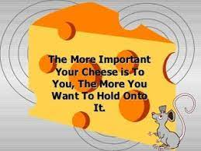
Think!

Slide 12
Characteristics of Fear, Anger, and Resistance
Frustration
Anger
Fearful
Betrayed
Upset
Confused
Challenged
Hostility
Anxiety
Self-doubt
Lost
Dazed
People feel frustrated, angry, and fearful about the change. Performance deteriorates.

Slide 13
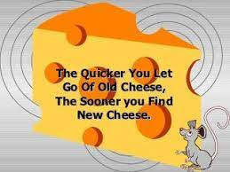
Think!

Slide 14
Characteristics of Inquiry, Experimentation, and Discovery
Confused
Questioning
Hopeful
Opportunity
Frustrated
Disappointed
Challenged
Half-way there!
Making progress
Going all directions at once!
Searching for solutions
Exciting!
Innovation/creativity
People want to make the change work – on their terms as well as those of the organization – but they don’t have clear answers.

Slide 15
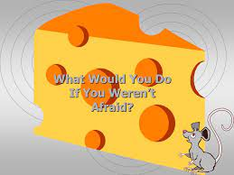
Think!

Slide 16
Characteristics of Learning, Acceptance, and Commitment
Now I know!
Energized
Success!
We made it!
Relief
Wow!
Self-confidence
Satisfied
Comfortable
What’s next?
People are focused on and excited about the future. They begin working together to accomplish the change vision.

Slide 17
Getting Stuck in the Journey
When people get stuck here…
It can lead to this…
Comfort and Control
Fear, Anger and Resistance
Inquiry, Experimentation, and Discovery
Learning, Acceptance, and Commitment
Complacency and Obsolescence
Sickness and Depression
Anxiety and Lack of Integration
Gradual Drift “Backward” into Comfort and Control

Slide 18
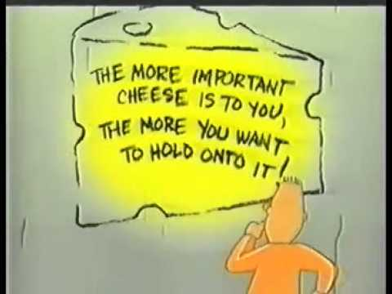
Think!

Slide 19
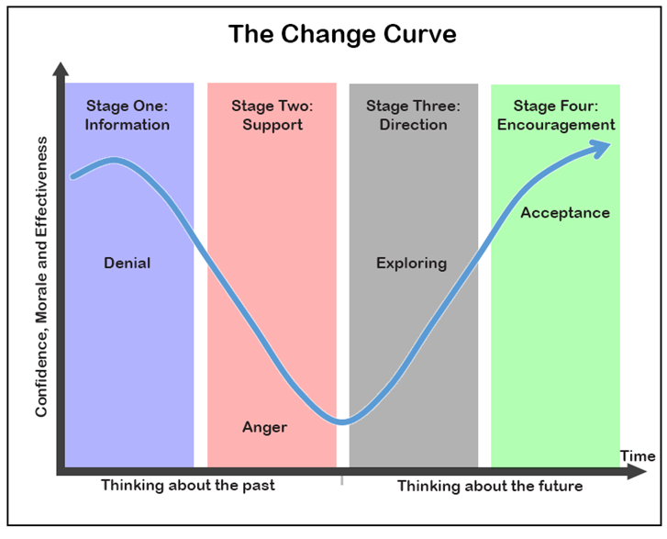
The Change and Transition Curve Model
Source: https://www.skillsyouneed.com/ps/personal-change-management.html

Slide 20
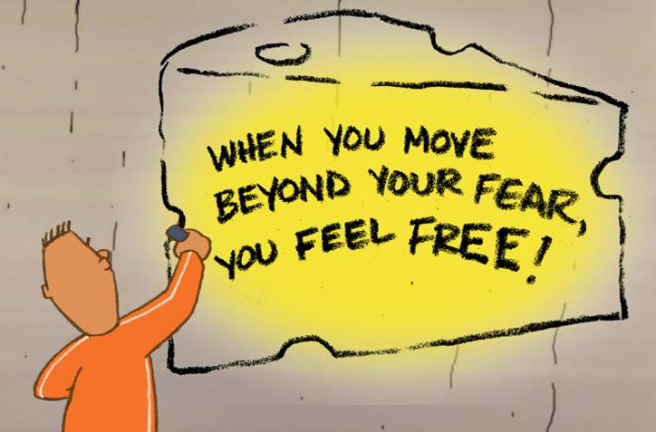
Think!

Slide 21
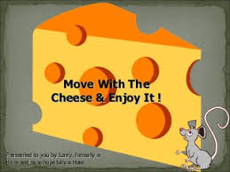
Think!

Slide 22
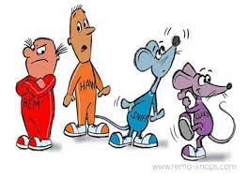
Which one are you a little bit like?
Notes:
Sniff: Sniffs/looks ahead; anticipates change
Scurry: Scurries ahead into action
Hem: Denies changes and resists it out of fear
Haws: Hesitant at first, but open-minded enough to learn and adapt

Slide 23
Do you agree?
Change Happens
They keep moving the cheese
Anticipate Change
Get ready for the cheese to move
Monitor Change
Smell the cheese often so you know when it is getting old
Adapt To Change Quickly
The quicker you let go of old cheese the sooner you can enjoy new cheese
Change
Move with the cheese
Enjoy Change!
Savor the adventure and enjoy the taste of new cheese!
Be Ready to Quickly Change & Enjoy it, again
They keep moving the cheese

Slide 24

Practice makes permanent!

Slide 25
ABCDE Formula to deal with negative thoughts and change
A = Adverse event or situation
B = Beliefs about that event
C = Consequences of those beliefs
D = Disputation and Distraction
E = Effect

Slide 26


Your 30-Day Growth Plan

Slide 27
Reinforcement
TO SUSTAIN THE CHANGE
MASTERY
MAINTENANCE

Slide 28

What would you say is the most important strategy to implement that you feel will have the biggest impact on your ability to be successful in your
30-day growth plan?
Source: Thebutterflyreader.com
Notes:
WRAP-UP ACTIVITY
Ask participants to respond to the questions/statements on the slide.
Observer will record participant responses on the last page of Lesson Plan or in notes for assessment use. (Note to Facilitator) This is valuable information for the final report.

