Slide 1



CHANGE READINESS
SESSION 4
Mastery and Maintenance
Funding provided by the Government of Canada and the Manitoba government.
Workplace Education Manitoba (WEM) is a leader in
providing customized
training and
assessment responses
across Manitoba.

Slide 2


Session Objectives:
Explore progress on their individual 30-Day growth plan.
Review the 5 Building Blocks of Change (ADKAR model).
Increase understanding of the final building block, Reinforcement.
Recognize common Mind Traps and Mental Models.
Identify and explore intelligence, self-efficacy, and personal mastery.
Define systems thinking.
Identify barriers/limitations/gaps and develop action or coping plan (internal or external).
Identify strengths, areas for development, and an action step regarding change readiness.

Slide 3

ACTIVATOR:
The 5 C’s
CHOOSE:
a cartoon character
a colour
a car
a creature
a cuisine
that best describes your personality
Notes:
Ask each person to name a cartoon character, a colour, a car, a creature and a cuisine that best describes his or her personality – 3-5mins.
Allow time and space for people who are less spontaneous and like to think before committing thoughts to paper.
It can help to have the 5 C’s up in writing or to give this to each person on a sheet of paper.
Invite them to share with the team why they chose what they chose and explain why – 2 mins/person.
Debrief as a group. Facilitator to lead discussion to help connect choices with strengths in mastery of change maintenance.
This is a fun, often light-hearted, activity that helps people to connect and see each other in a different light.

Slide 4
What went well over the past 30 days as you implemented your plan?
What didn’t go according to plan?
What did you learn?
Next Steps…
Your 30-Day Growth Plan
Check-In
Notes:
REVIEW AND EXPLORE PROGRESS ON YOUR INDIVIDUAL 30-DAY GROWTH PLAN
Refer to page 2-4 in the workbook and discuss evaluation/review of their goals and plan.
Facilitator will check in with participants and review progress on 30-Day Growth Plans.
➢ What went well over the past 30-days as you implemented your plan?
➢ What didn’t go according to plan?
➢ What did you learn?
➢ Next Steps…

Slide 5
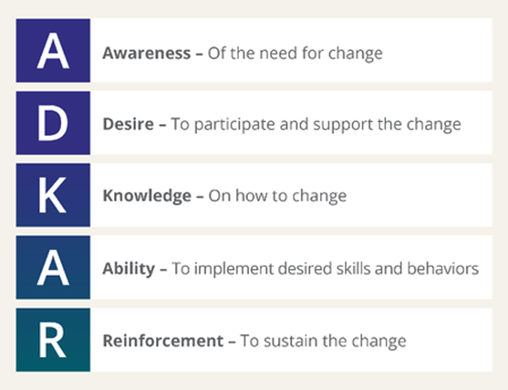
The 5 Building Blocks of Change
Source: www.prosci.com
Notes:
THE 5 BUILDING BLOCKS OF CHANGE
Refer to pages 4-5 of the workbook.
5 Building Blocks of Changes (ADKAR model) review from Session 1, 2, and 3.
Learning Objectives 2 & 3
Review the 5 Building Blocks of Change (ADKAR model)
Increase understanding of Reinforcement
Activity 1: Valuing Recognition, Rewards, and Incentives
Facilitator will put participants in pairs and have them move to a quiet place to support discussion.
Ask them to bring their 30-Day Growth Plan.
Have them share their plans with each other, and identify how they have incorporated the opportunity for recognition, rewards, and incentives in their plan to help keep themselves on track and motivated to maintain and reinforce their change.
If they need help or support with ideas, their partner can offer insights and suggestions.
Have participants write down their ideas and enhance their growth plan.
Facilitator and Observer will move around to support understanding and encourage discussions.
Have participants return to the main group and debrief/discuss together.
Observer to record responses and photograph activity discussion notes for reporting purposes.

Slide 6
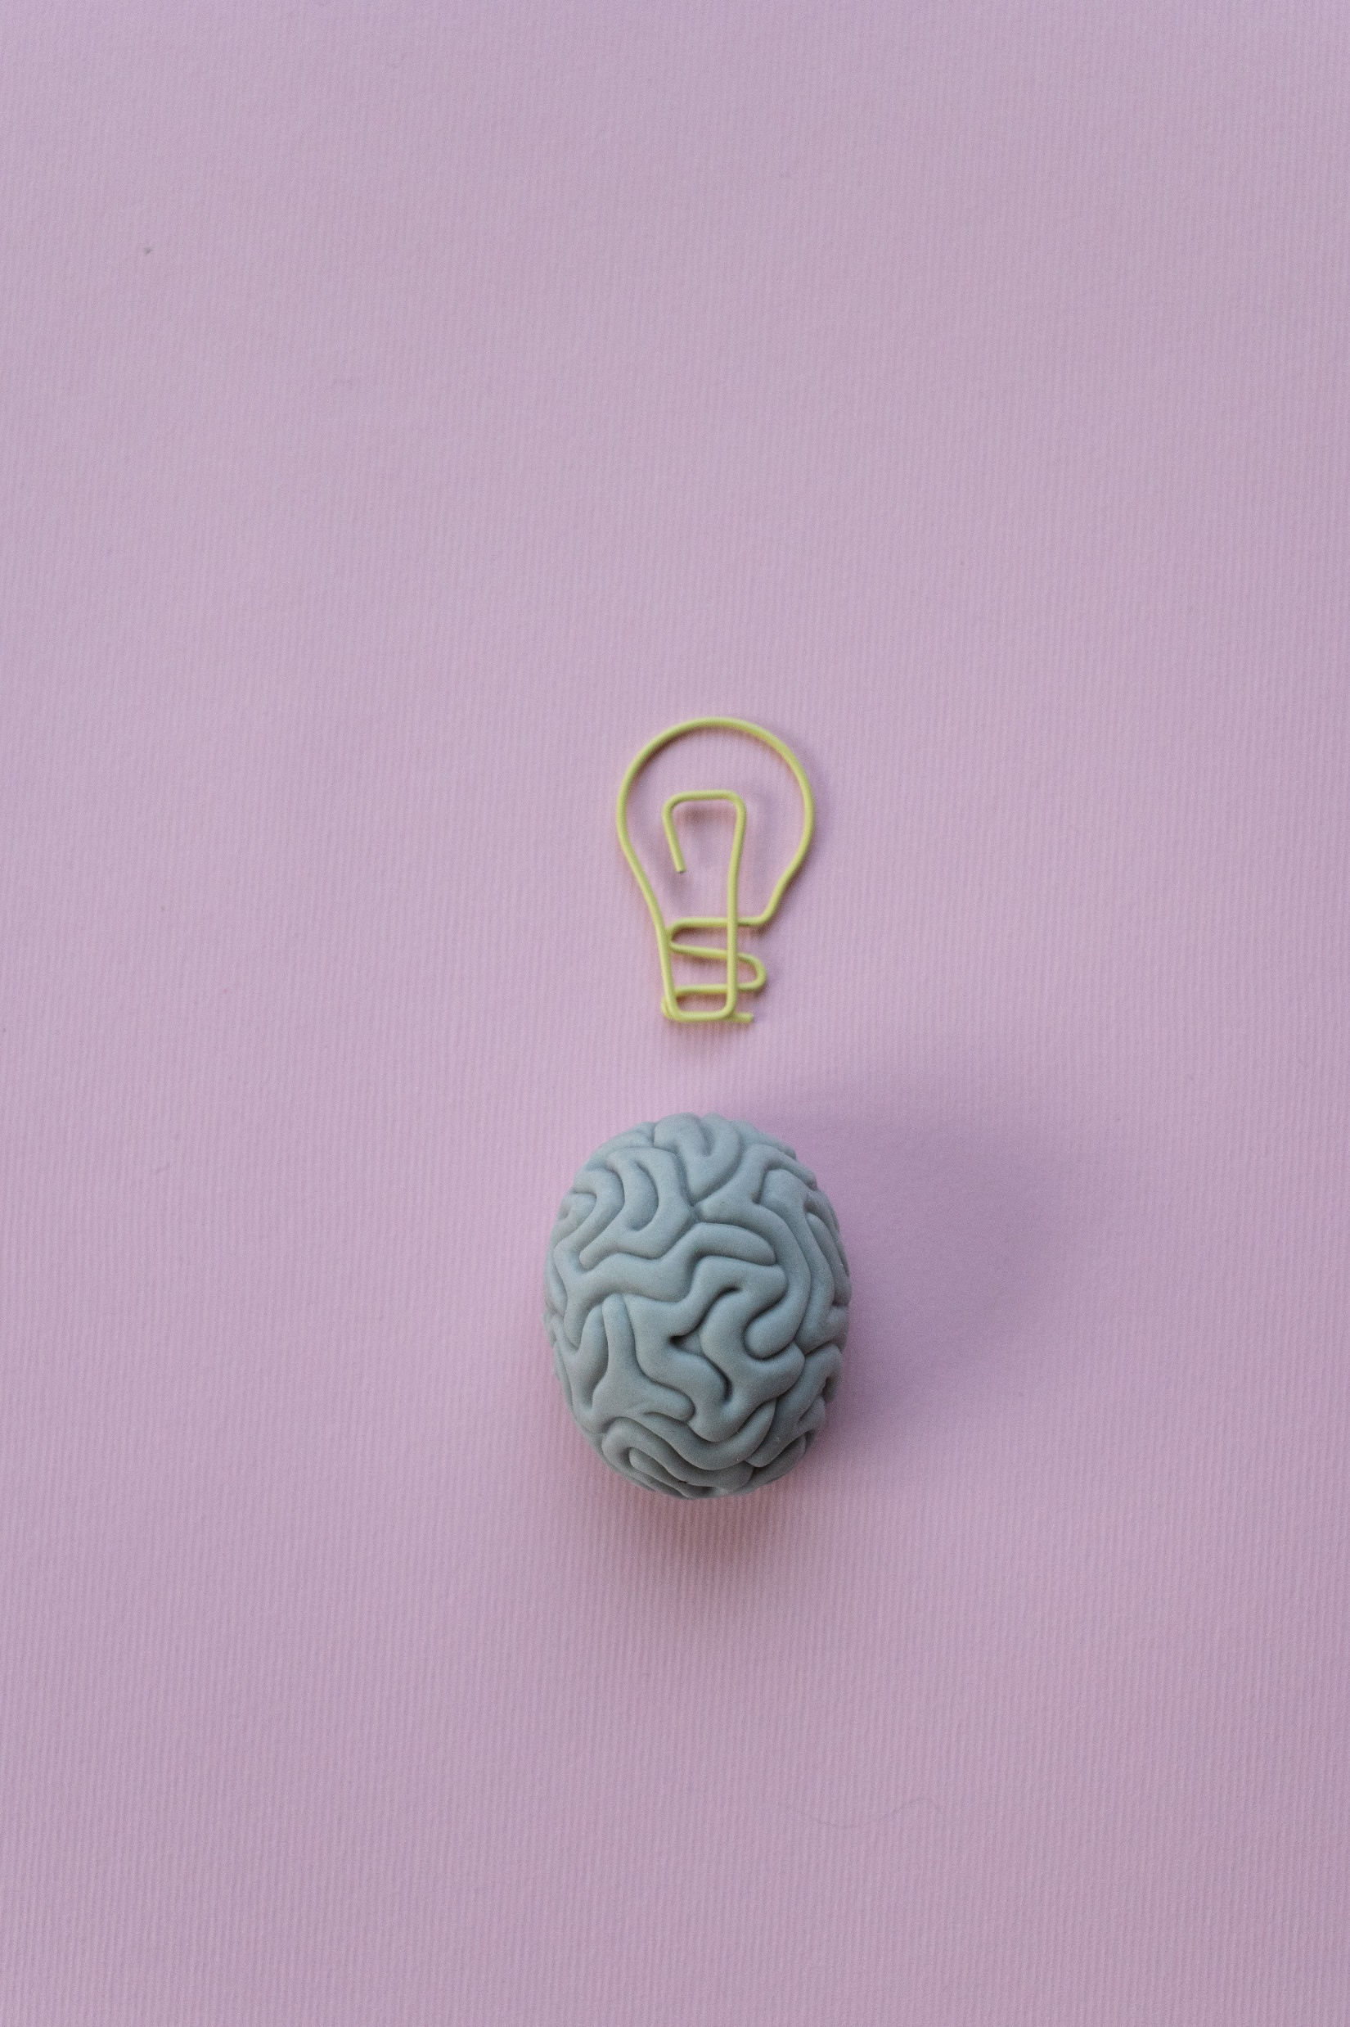
Common Mind Traps
#1: CLOSED MIND
#2: DIVING IN WITHOUT THINKING
#3: CATASTROPHIZING
#4: SOLVING THE WRONG PROBLEM PERFECTLY
#5: OVERCONFIDENCE IN ONE’S OWN JUDGMENT
#6: BUSY SPINNING WHEELS
#7: MINDLESSNESS
Notes:
COMMON MIND TRAPS AND MENTAL MODELS
Refer to pages 5-10 in the workbook. Review/discuss common mind traps and mental models.
Learning Objective 4
Recognize Common Mind Traps and Mental Models

Slide 7


Mental Models
A mental model of a system is a reduction of how it works. The model identifies the core components that matter and how they interact.
This clarity is necessary to drastically improve the system:
When you improve the system of business, you make more money.
When you improve the system of relationships, you gain deeper friendships.
Notes:
COMMON MIND TRAPS AND MENTAL MODELS
Refer to pages 5-10 in the workbook. Review/discuss common mind traps and mental models.
Learning Objective 4
Recognize Common Mind Traps and Mental Models
Activity 2: Limiting Beliefs
Facilitator will post a sign on a chair located near each of the four walls of the room stating:
1) Always
2) Sometimes
3) Rarely
4) Never
Facilitator will have participants stand in the middle of the room as a group and will read a statement of belief, and each participant will move to the response that most accurately reflects their common thinking/beliefs about that statement.
1) I don’t have enough time
2) I don’t have the resources to be successful
3) I’m just not someone who follows through
4) Nobody else is doing it, so I’m not either…
5) I’m not good enough
6) I fear being successful
7) I don’t have a voice or power to change this
8) I can’t do everything
9) I have a fear of failure
10) I can’t help this situation…I don’t know how
11) That’s not my job…
12) I don’t have enough experience
Take time to have everyone share their thoughts as the activity progresses and encourage those willing to share more about their response and how often they experience that limiting belief.
Reflect where these limiting beliefs may have developed in their childhood and life. Knowing the influence and impact creates an awareness around taking responsibility now.
Ask participants if they feel any of their limiting beliefs are currently holding them back?
If so, what can they do to change those limiting beliefs?

Slide 8


Automatic Me
Set Back Me
Smarter Me
Notes:
INTELLIGENCE, SELF-EFFICACY, AND PERSONAL MASTERY
Refer to pages 10-13 of the workbook. Review/discuss the “3 Me’s”, self-efficacy, and personal mastery.
Learning Objective 5
Identify and Explore Intelligence, Self-Efficacy, and Personal Mastery

Slide 9
“Self-efficacy is a person’s belief in his or her ability to succeed in a particular situation.”
~Albert Bandura
The Three Elements of Self-Efficacy
• Beliefs-Based – believe it or not. Your underlying beliefs wire you for success or failure.
• Ability-Based – you need skills to make an impact on your work life.
• Situation-Based – self-efficacy can vary from one situation to another.
Notes:
INTELLIGENCE, SELF-EFFICACY, AND PERSONAL MASTERY
Refer to pages 10-13 of the workbook. Review/discuss the “3 Me’s”, self-efficacy, and personal mastery.
Learning Objective 5
Identify and Explore Intelligence, Self-Efficacy, and Personal Mastery

Slide 10


PERSONAL MASTERY
Ultimately, personal mastery is about creating your own life and driving your own destiny.
You are in the driver’s seat.
Notes:
INTELLIGENCE, SELF-EFFICACY, AND PERSONAL MASTERY
Refer to pages 10-13 of the workbook. Review/discuss the “3 Me’s”, self-efficacy, and personal mastery.
Learning Objective 5
Identify and Explore Intelligence, Self-Efficacy, and Personal Mastery
Activity 3: My Mantra for Change Readiness
The things we consistently see & hear (our perceptions) shape how we speak, and how we speak shapes our perceptions (i.e., what we see and hear).
➢ How we speak also shapes how we believe.
➢ How we believe shapes how we think & feel, and then
➢ How we think & feel shapes our actions & behaviors.
➢ Our actions & behaviors shape our results & outcomes,
➢ Which then begin to change what we see & hear.
This cycle works in both the positive and negative, meaning it can create a positive feedback loop or a negative feedback loop,
A mantra can intervene at the point of what we are speaking, which shapes both our perceptions and our beliefs.
Facilitator will handout the Change Mastery Mantra worksheet to each participant and have them complete it individually.
Facilitator and Observer will move around to support understanding and encourage development of an empowering mantra (mission statement) for change mastery based on learning and inspiration from today’s workshop.
Facilitator will ask participants to stand and read their mantra to the group (as they are comfortable doing so).

Slide 11


Systems thinking is a way of making sense of the complexity of the world by looking at it in terms of wholes and relationships rather than by splitting it down into its parts.
Notes:
Learning Objective 6
Define Systems Thinking
Activity 4: The Daffodil Principle
Facilitator will read the story, “Commitment – Daffodil Principle” to the group.
Ask participants to share their reflections and how they connect elements of the story to the concept of systems thinking.
Can participants identify and share how they are (or can) plant “bulbs” in their own lives and relationships over time in order to achieve their goals.
Does this story inspire them? How and why?

Slide 12

STRENGTHS
AREAS FOR DEVELOPMENT
ACTION STEP TOWARD DEVELOPMENT
Source: Unbridlingyourbrilliance.com
Notes:
Learning Objective 8
Identify strengths, areas for development, and an action step regarding change readiness.
Activity 6: Strength and Development Worksheet
Hand out Strength and Development Worksheets to each participant.
Ask participants to write about what they now see as their strengths, areas for development, and an action step toward their area for development as a result of today’s workshop.
Facilitator will collect the worksheets to chart responses for each participant.

Slide 13

Please list the skills and mindsets you have developed and implemented to start making positive changes as you have progressed through the four Change Readiness workshops.
Be specific about how you have put your learning into ACTION in your daily life.
Source: Thebutterflyreader.com
Notes:
WRAP-UP ACTIVITY
Ask participants to respond to the questions/statements on the slide.
Observer will record participant responses on the last page of Lesson Plan or in notes for assessment use. (Note to Facilitator) This is valuable information for the final report.

