Slide 1

Workplace Education Manitoba
“Helping people to develop Essential Skills that are needed for work, learning and life.”
www.wem.mb.ca
© 2016 Workplace Education Manitoba. All Rights Reserved.

Slide 2
Our vision is that all Manitobans have access to the Essential Skills knowledge and training required to determine and pursue their goals related to learning, the workplace and life.
Vision
© 2016 Workplace Education Manitoba. All Rights Reserved.

Slide 3
Workplace Education Manitoba would like to express appreciation to the following for supporting the development of this Continuous Learning Skills curriculum:
Employment and Social Development Canada (ERSDC) and
Manitoba Education and Training.
This project was jointly funded through Human Resources Skills Development Canada and Entrepreneurship Training and Trade.
For more information, visit www.wem.mb.ca or contact info@wem.mb.ca
© 2016 Workplace Education Manitoba. All Rights Reserved.

Slide 4
Welcome to
Change Readiness
The Five Building Blocks of Change
© 2016 Workplace Education Manitoba. All Rights Reserved.

Slide 5
Today’s Agenda
Introduction and Housekeeping | 5 minutes
What is Change Management | 10minutes
States of Change Management/ consequences | 30 Minutes
BREAK | 15 minutes
ADKAR | 30 minutes
Continuous Learning | 30 minutes
Conclusion | 15 minutes
© 2016 Workplace Education Manitoba. All Rights Reserved.

Slide 6
Session Objectives
Today you will:
Define a Learning Opportunity
Discuss five key building blocks of any successful change:
  Awareness of the need for change management
  Desire to participate and support change management
  Knowledge of how to apply change management
  Ability to implement requires change management skills and behaviours
  Reinforcement to sustain change management applications
Learn how to create a culture of organizational learning and practice continuous learning
Describe:
  Systems thinking
  Personal mastery
  Mental models
Discuss how Continuous Learning as an Essential Skill is imperative to professional development and success
© 2016 Workplace Education Manitoba. All Rights Reserved.

Slide 7

Remember?
What is change?
© 2016 Workplace Education Manitoba. All Rights Reserved.
Notes:
Describe what change is.
Describe kinds of change.
Describe stages of change.
Why is it important to have a good attitude? Why are you here? Yesterday we talked about the fact that you can only change yourself and not others….what is in your control.
What are some of the benefits of change?
What are some challenges?

Slide 8
What is Change Management?
The process, tools and techniques to manage the people side of change to achieve the required outcome.

Slide 9
Change Management
Manage resistance to change
Increase probability of success
Reduce transition time
Notes:
These are the primary reasons for change management

Slide 10
Three States of Change
Current State – How things are done today.
Transition State – How to move from currentto future.
Future State – How things will be done tomorrow.

Slide 11
Consequences on managing change at work
Lower productivity
Passive resistance
Active resistance
Employees quitting
Disinterest
Arguments about the change
More sick days
Change is not fully implemented
People find work arounds
Revert to old ways
Divides between us and them
Notes:
Brainstorm ideas consequences of not changing at work.
Could any of these consequences happen at home or in community? Example?

Slide 12
The ADKAR Model
Awareness
Desire
Knowledge
Ability
Reinforcement
© 2016 Workplace Education Manitoba. All Rights Reserved.
Notes:
We just talked about the fact that continuous learning is essential for personal growth.
The five building blocks of change are based on the ADKAR model by Prosci (prosigh)
This is an individual change model and we are going to discuss these 5 steps for making successful change whether it is at work, home or in the community.
It describes the phases that will have to go through for successful change.
A – awareness of the need for change
D – desire to participate and support the change
K – knowledge on how to change
A – ability to implement required skills and behaviours
R – reinforcement to sustain the change

Slide 13



The ADKAR Model:
A Personal Example
https://www.prosci.com/adkar/adkar-model
© 2016 Workplace Education Manitoba. All Rights Reserved.

Slide 14
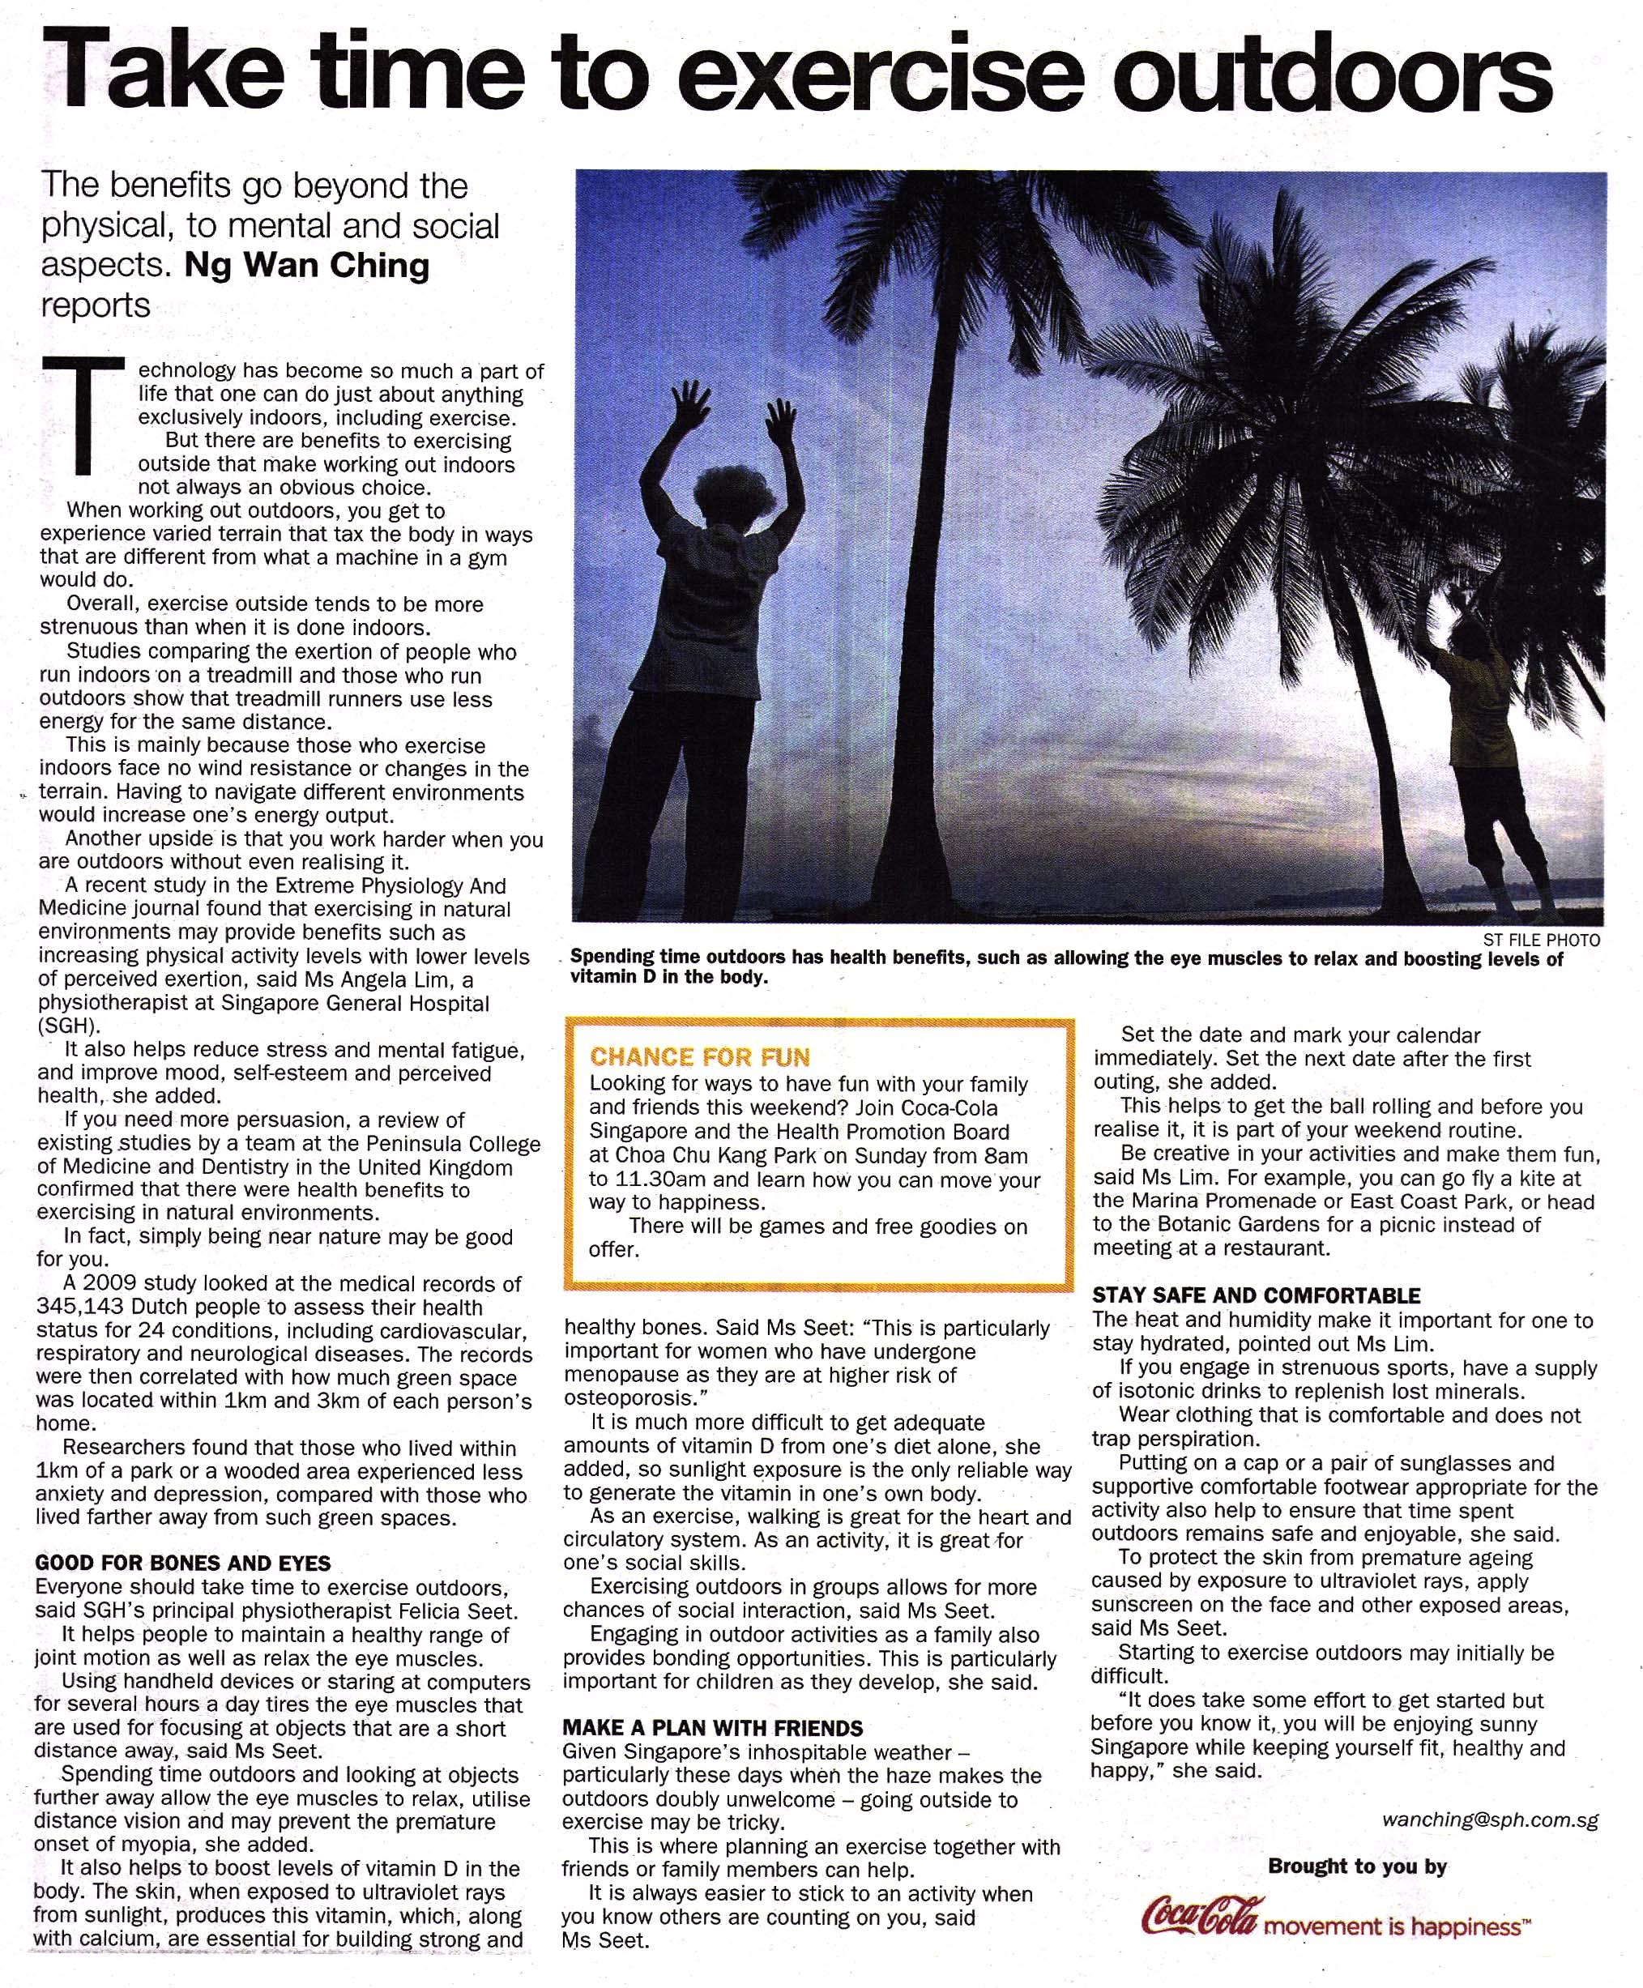
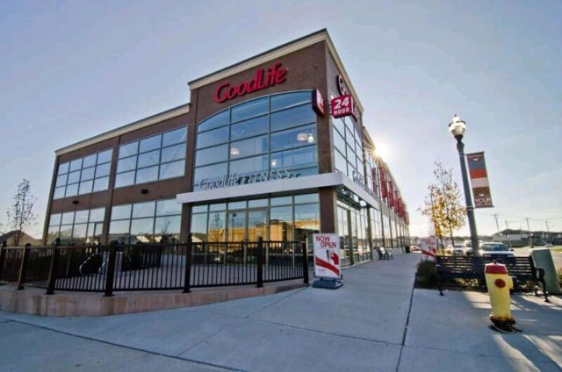
Awareness
http://www.sgh.com.sg/about-us/newsroom/News-Articles-Reports/Documents/Year%202014/09%20Sept/ST%20Exercise%20Outdoor.jpg
© 2016 Workplace Education Manitoba. All Rights Reserved.
Notes:
What is the nature of the change?
Why is this change happening or needed?
What is the risk of not changing? Is this important?

Slide 15
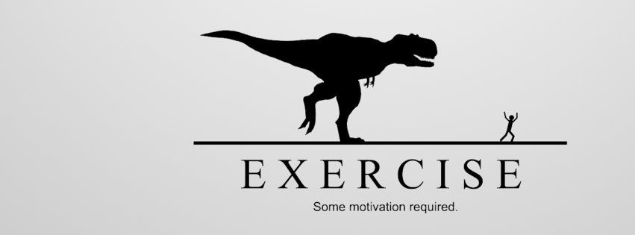
Desire
http://www.good-covers.com/covers-images/download/Exercise-Needs-Motivation.jpg
© 2016 Workplace Education Manitoba. All Rights Reserved.
Notes:
This includes personal motivation to support the change.
Why is it important to change?

Slide 16
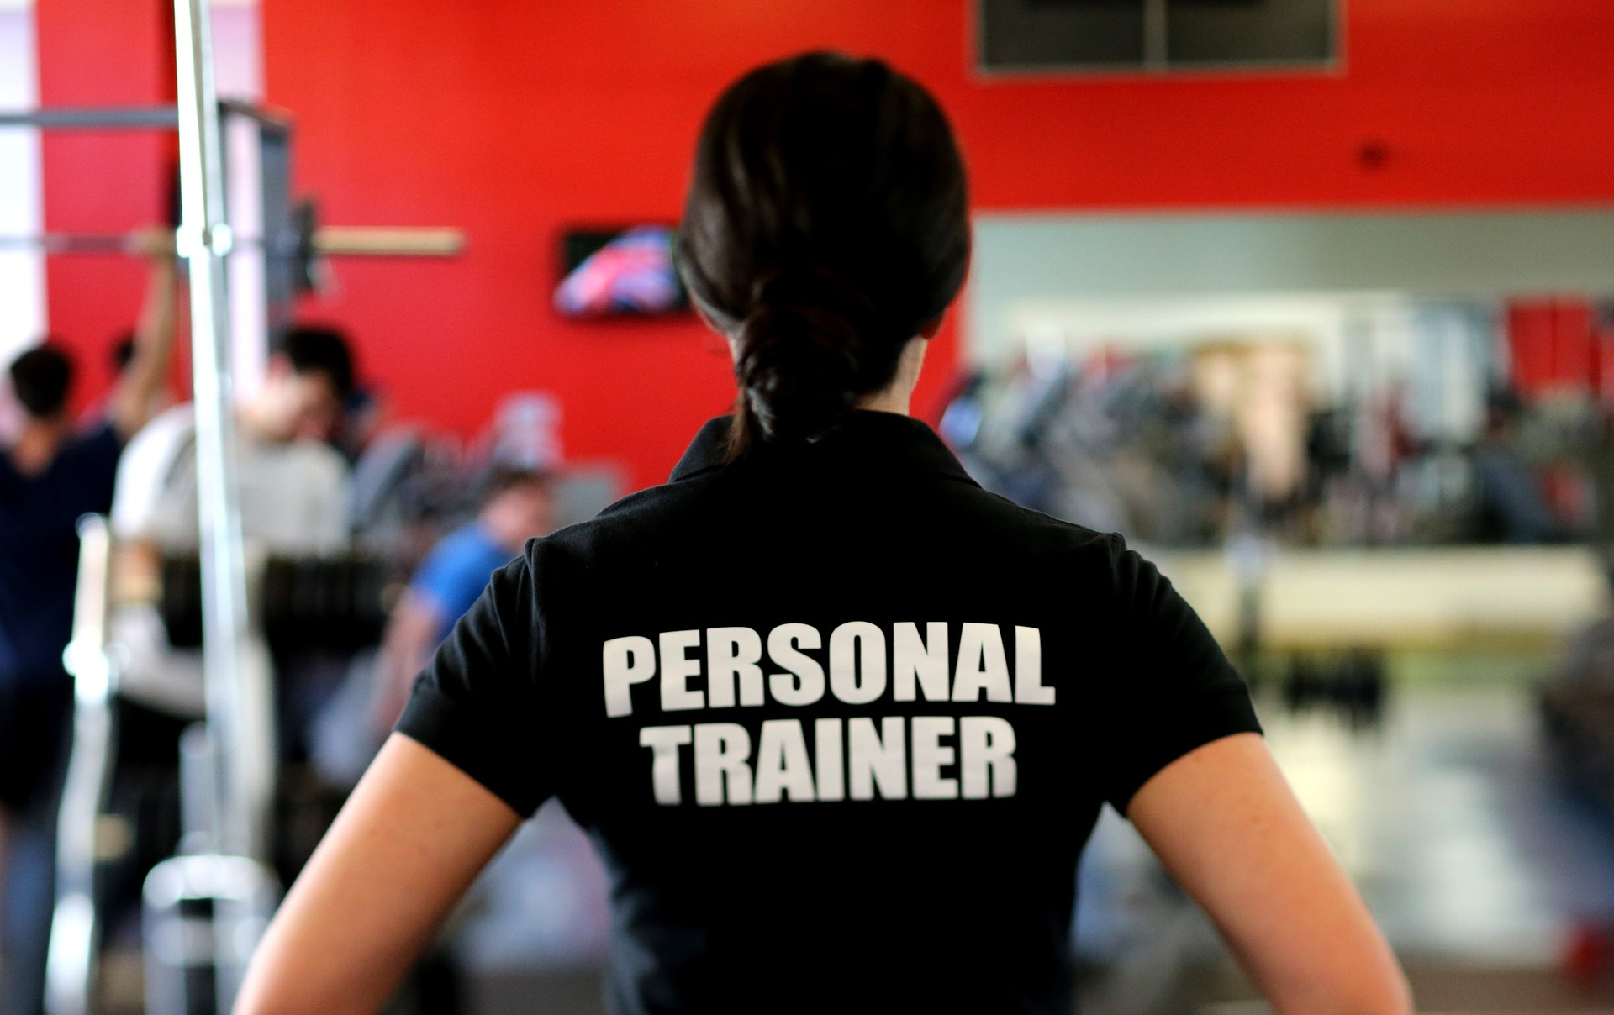
Knowledge
© 2016 Workplace Education Manitoba. All Rights Reserved.
Notes:
This is the development of the knowledge, skills and behaviours during and after the change.
What are some things that you can do?
Who can you look to?
This is also where the understanding of how to change develops.

Slide 17

Ability
© 2016 Workplace Education Manitoba. All Rights Reserved.
Notes:
The use/implementation of the new skills – practice!!
You are able to demonstrate the ability to implement the change and to identify barriers that may inhibit implementing the change

Slide 18


Reinforcement
© 2016 Workplace Education Manitoba. All Rights Reserved.
Notes:
This is where you sustain change.
You have the right mechanisms, supports, guides to keep change in place.
What are some example of reinforcement? (Recognition, rewards, incentives, successes)

Slide 19
ADKAR Model
Awareness of the need for change management
Desire to participate and support change management
Knowledge of how to apply change management
Ability to implement required change management skills and behaviors
Reinforcement to sustain change management
© 2016 Workplace Education Manitoba. All Rights Reserved.
Notes:
To review…

Slide 20
Connecting ADKAR
A and D – currrent
K and A – transition
A and R - future

Slide 21
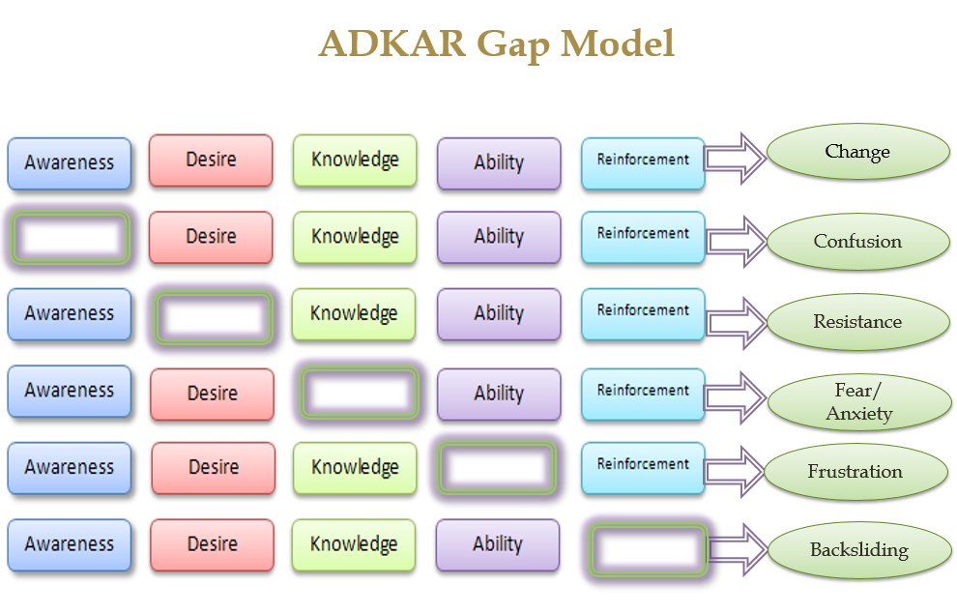
© 2016 Workplace Education Manitoba. All Rights Reserved.
Notes:
Lets talk about filling the gaps –
A missing – confusion – communication for the reasons, face to face meetings on how the change will impact you personally
D missing – resistance – look for the why you are resisting, discuss this
K missing – fear/anxiety – get some training, how to change, learn the skills needed
A missing – frustration – more specific training to allow you to do what is needed on the job, coaching, troubleshooting
R missing – backsliding – reinforcement from those in charge or even your personal support team that change is here to stay, coaching.
(tickets for speeding, weight gain,

Slide 22
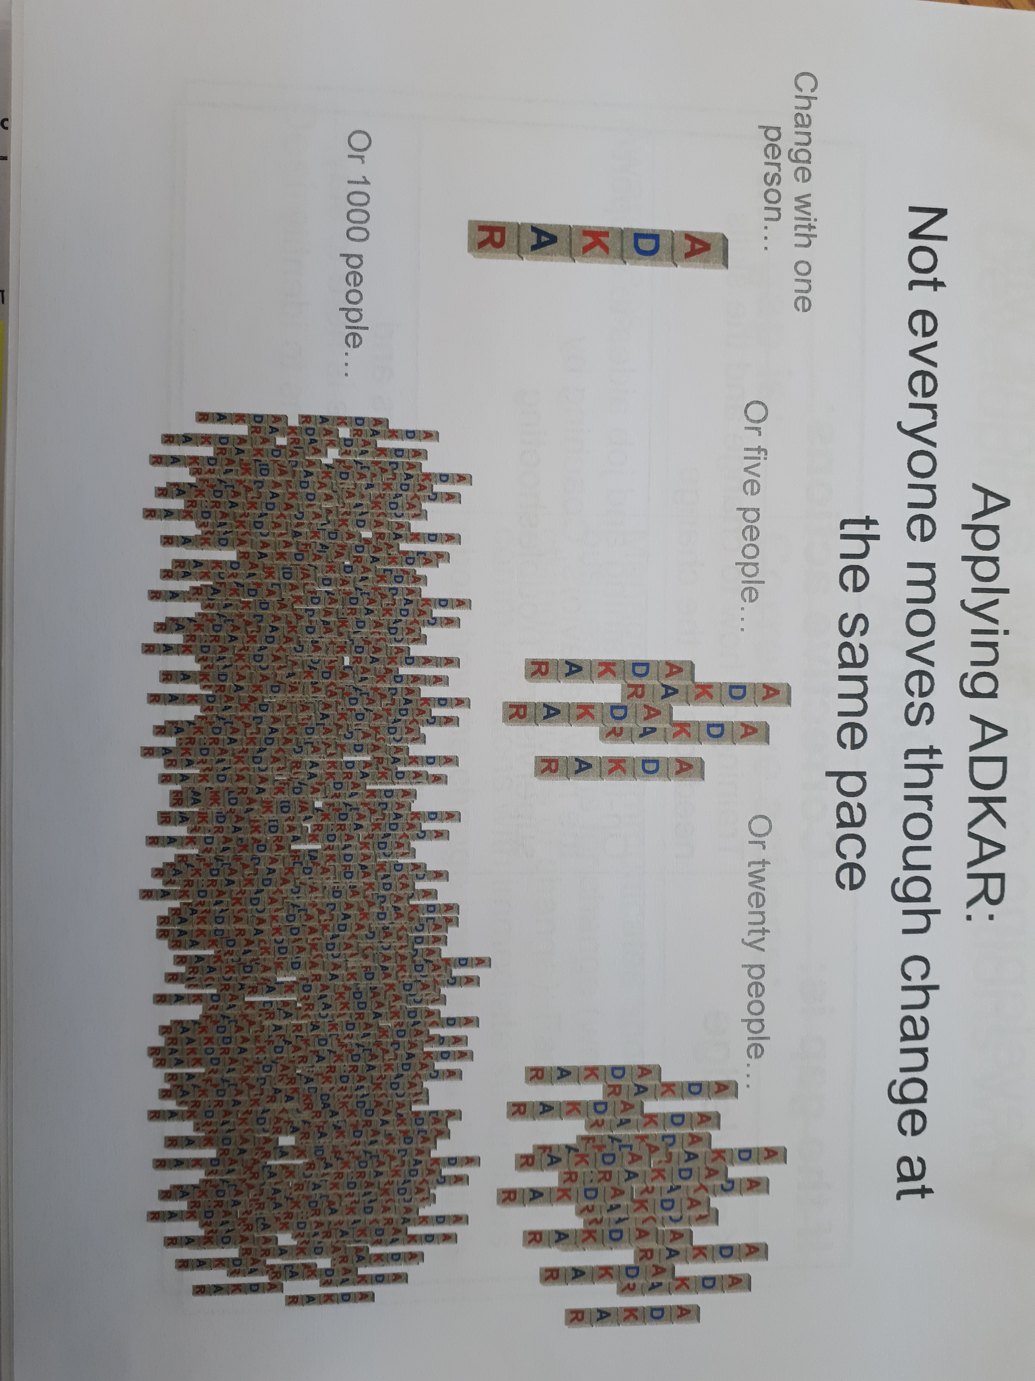

Slide 23
BREAK – 10 minutes

Slide 24
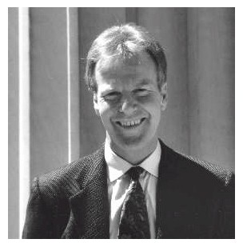
What is a Learning Organization?
According to Peter Senge, a learning organization is one where people continually expand their capacity to create the results they truly desire, where new and expansive patterns of thinking are nurtured, where collective aspiration is set free, and where people are continually learning to see the whole together.
http://infed.org/mobi/peter-senge-and-the-learning-organization/
© 2016 Workplace Education Manitoba. All Rights Reserved.

Slide 25
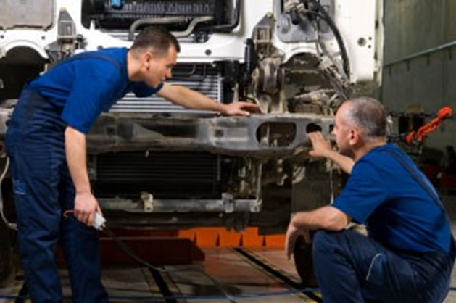
What is Continuous Learning?
is the ability to participate in an ongoing process of acquiring skills and knowledge.
© 2016 Workplace Education Manitoba. All Rights Reserved.

Slide 26

Video
The Importance of Self-Directed Learning
© 2016 Workplace Education Manitoba. All Rights Reserved.
Notes:
Listen to this video and please write down 2 – 3 thoughts/opinions from the video
We will be discussing the video afterwards

Slide 27
Discussion Questions
How important do you think learning is? Why?
How can you contribute to creating a learning environment?
What are the points that interested you in the video?

Slide 28
Creating a Culture of Learning
Peter Senge is a leading theorist and writer in the area of learning organizations. He describes five disciplines that must be mastered when introducing learning into an organization:
Systems Thinking
Personal Mastery
Mental Models
Building Shared Visions
Team Learning
© 2016 Workplace Education Manitoba. All Rights Reserved.

Slide 29


Systems Thinking
Think about the big picture
© 2016 Workplace Education Manitoba. All Rights Reserved.

Slide 30
Systems Thinking
An appreciation of how our actions shape our reality
An appreciation that ones actions impinge all the members in a work unit.
Focus on interrelationships and not things
Think in circles, not in lines
Move beyond blame
There is no outside, you and the cause of the problem are linked
Seeing processes of change rather than snapshots
Starts with understanding the concept called ‘feedback’
Notes:
What is feedback??

Slide 31
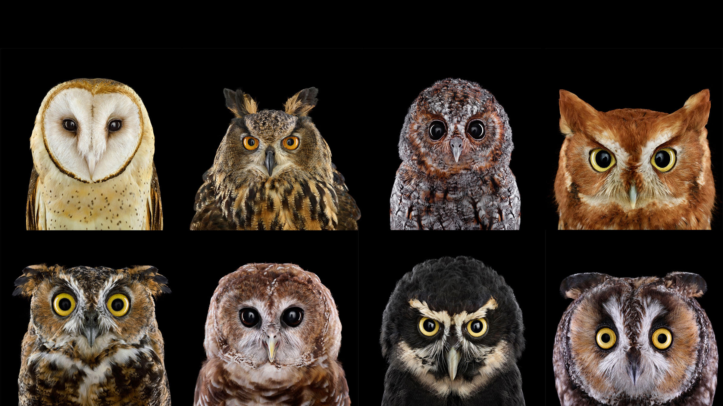
Personal Mastery
Commitment to lifelong learning
www.audabon.org
© 2016 Workplace Education Manitoba. All Rights Reserved.

Slide 32
Personal Mastery
Based on a personal vision
You face the current reality
Holding creative tension – the gap between reality and the vision we hold is creative tension
Commitment to the truth
Using subconscious – you don’t really need to figure it all out
Adopting a creative orientation about life
Expressing a personal vision and seeing current reality
Choosing to commit
Balancing work and home life
The capacity to use our intelligence to the fullest
Notes:
Intelligence – what is this? Are the different kinds of intelligence? Yes there are!!

Slide 33
5 Demons of Personal Mastery
Fear of not being good enough
- you have untapped capacities within yourself
Fear of losing control
Letting go makes new things happen
Life is always a struggle
If you look, there is generosity all around, all you have to do is ask.
Notes:
Fear – you have untapped capacities within yourself
Fear – letting go make new things happen
It’s a cruel world but if you look around there is generosity all around, all you have to do is ask

Slide 34
5 Demons
I’m in this all alone and I can’t count on anyone but myself
There is help everywhere
Fear of losses to great to bear, fear of our own mortality
- Leaving something behind creates space for something new

Slide 35
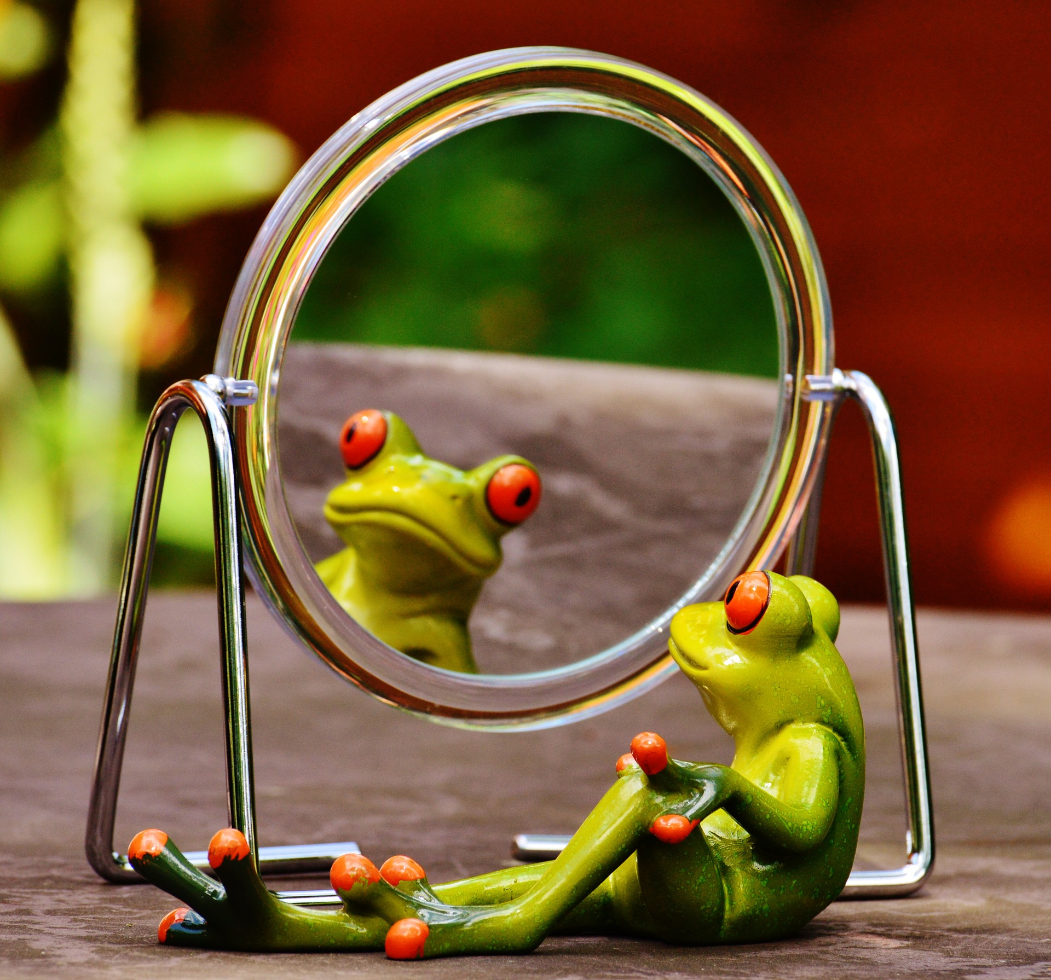
Mental Models
Self-reflection
© 2016 Workplace Education Manitoba. All Rights Reserved.

Slide 36
Mental Models
Images, assumptions and stories we carry in our minds of ourselves, other people, institutions, and every aspect of the work
They subtly distort our vision
They determine what we see
They are cognitive maps of the world people hold in their long-term memory and short-term perceptions which build people up as a part of their everyday reasoning processes
Are powerful in affecting what we do because they affect what we see

Slide 37
Mental Models
The tools needed to practice this discipline are
Reflection and Inquiry

Slide 38
Mental Models
According to some cognitive theorists, changes in short-term every day mental models, accumulating over time, will gradually be reflected in changes in long – term, deep-seated beliefs.

Slide 39

5 Disciplines – Discussion Activity
© 2016 Workplace Education Manitoba. All Rights Reserved.

Slide 40

Questions?
© 2016 Workplace Education Manitoba. All Rights Reserved.

Slide 41
Change #3
Resilience
What is resilience?
How can we build resilience?

Slide 42
Thank You!
© 2016 Workplace Education Manitoba. All Rights Reserved.

