Slide 1

Workplace Education Manitoba
“Helping people to develop Essential Skills that are needed for work, learning and life.”
www.wem.mb.ca
© 2016 Workplace Education Manitoba. All Rights Reserved.

Slide 2
Our vision is that all Manitobans have access to the Essential Skills knowledge and training required to determine and pursue their goals related to learning, the workplace and life.
Vision
© 2016 Workplace Education Manitoba. All Rights Reserved.

Slide 3
Workplace Education Manitoba would like to express appreciation to the following for supporting the development of this Continuous Learning Skills curriculum:
Employment and Social Development Canada (ERSDC) and
Manitoba Education and Training.
This project was jointly funded through Human Resources Skills Development Canada and Entrepreneurship Training and Trade.
For more information, visit www.wem.mb.ca or contact info@wem.mb.ca
© 2016 Workplace Education Manitoba. All Rights Reserved.

Slide 4
Welcome to
Change Readiness
Building Resilience
© 2016 Workplace Education Manitoba. All Rights Reserved.

Slide 5
Today’s Agenda
Introduction and Housekeeping | 3 minutes
Ice Breaker | 5 minutes
What is Resilience? | 5 minutes
Resilience and Change | 20 minutes
Developing Resilience | 20 minutes
BREAK | 10 minutes
Managing change | 30 minutes
Conclusion/ Evaluation | 10 minutes
© 2016 Workplace Education Manitoba. All Rights Reserved.

Slide 6
Session Objectives
Discuss:
  Resilience
  How resilience is linked to change
  Ways to build a resilient team
Define organizational resilience
Explain the qualities of resilience
Strategies to manage change
© 2016 Workplace Education Manitoba. All Rights Reserved.

Slide 7

Remember?
What are the 5 building blocks?
© 2016 Workplace Education Manitoba. All Rights Reserved.
Notes:
Describe what change is.
Describe kinds of change.
Describe stages of change.
Why is it important to have a good attitude? Why are you here? Yesterday we talked about the fact that you can only change yourself and not others….what is in your control.
What are some of the benefits of change?
What are some challenges?

Slide 8

Icebreaker
© 2016 Workplace Education Manitoba. All Rights Reserved.
Notes:
Bouncing balls – did you ever doubt that the ball wouldn’t bounce?
This is what resilience is…the ability to bounce back…sometimes it may be more difficult and take a long time but if you continue to move forward you will bounce back.
OR
Opening fists – can you open the fist?
ASK participants to work in groups of two. One will be A and the other B. Ask Person A to make a fist and place it on the table in front of Person B. Tell B’s that they have 15 seconds to open the fist of person A without hurting them.
Afterwards, ask the following questions.
1. Who tried to use force?
2. Who used tickling or some other distraction?
3. What about bribery – money, food, doing their laundry etc?
4. How many people just asked person A to open their fist?
Research indicates that very few people use the last approach. Ask the group why that is. When you debrief, talk about team dynamics; that is, how many go straight to the “force” approach? How many prefer compromise? What about direct approaches – and indirect? Then, discuss any potential impacts on team interactions.

Slide 9

Brainstorm
What is resilience?
What are the qualities of resilience?
© 2016 Workplace Education Manitoba. All Rights Reserved.

Slide 10

Resilience is… the ability to bounce back from, or deal effectively with, adversity, adapt to sudden change, and remain optimistic about life. Being resilient doesn’t mean never experiencing stress or pain, it’s about our ability to cope with emotional upheavals. Resilience is not something that we’re born with – it develops over time as we acquire knowledge.
http://www.workingatmcmaster.ca/med/document/facilitating-resilience-in-the-workplace-1-37.pdf
© 2016 Workplace Education Manitoba. All Rights Reserved.

Slide 11

Resilience is…
© 2016 Workplace Education Manitoba. All Rights Reserved.
Notes:
Working under pressure
The ability to not dwell on failures and roadblocks, to move on..
Brainstorm – what are some qualities/characterisitcs that resilient people have?

Slide 12
Qualities of Resilient People
Optimistic
Altruistic
Have a moral compass
Have faith/spirituality
Have a sense of humour
Have a role model
Have social supports
Are able to leave their comfort zone and face fear
Have a mission or meaning in their life
Have developed resilience through experience, training etc.
Are physically fit
Adapted from presentation by: Shannon Polly and Louisa Jewell, Canadian Positive Psychology Association Conference (2012)
https://staroversky.com/blog/what-is-resilience-10-critical-characteristics-of-resilience
© 2016 Workplace Education Manitoba. All Rights Reserved.

Slide 13

How Resilient are You?
(assessment)
© 2016 Workplace Education Manitoba. All Rights Reserved.
Notes:
Were you surprised by your score?
What did you think of the questionnaire? Do you believe that all those elements are tied to resilience?
Did you think that it was accurate? Why or why not?
If not, what do you think would be a more accurate measure of resilience?

Slide 14

Resilience and Change
I have not failed. I've just found 10,000 ways that won't work.
Thomas Edison
© 2016 Workplace Education Manitoba. All Rights Reserved.
Notes:
How do you think resilience is linked to change?
Brainstorm answers.
What do you think would be the difference in the acceptance of change from a resilient versus non- resilient workforce?

Slide 15
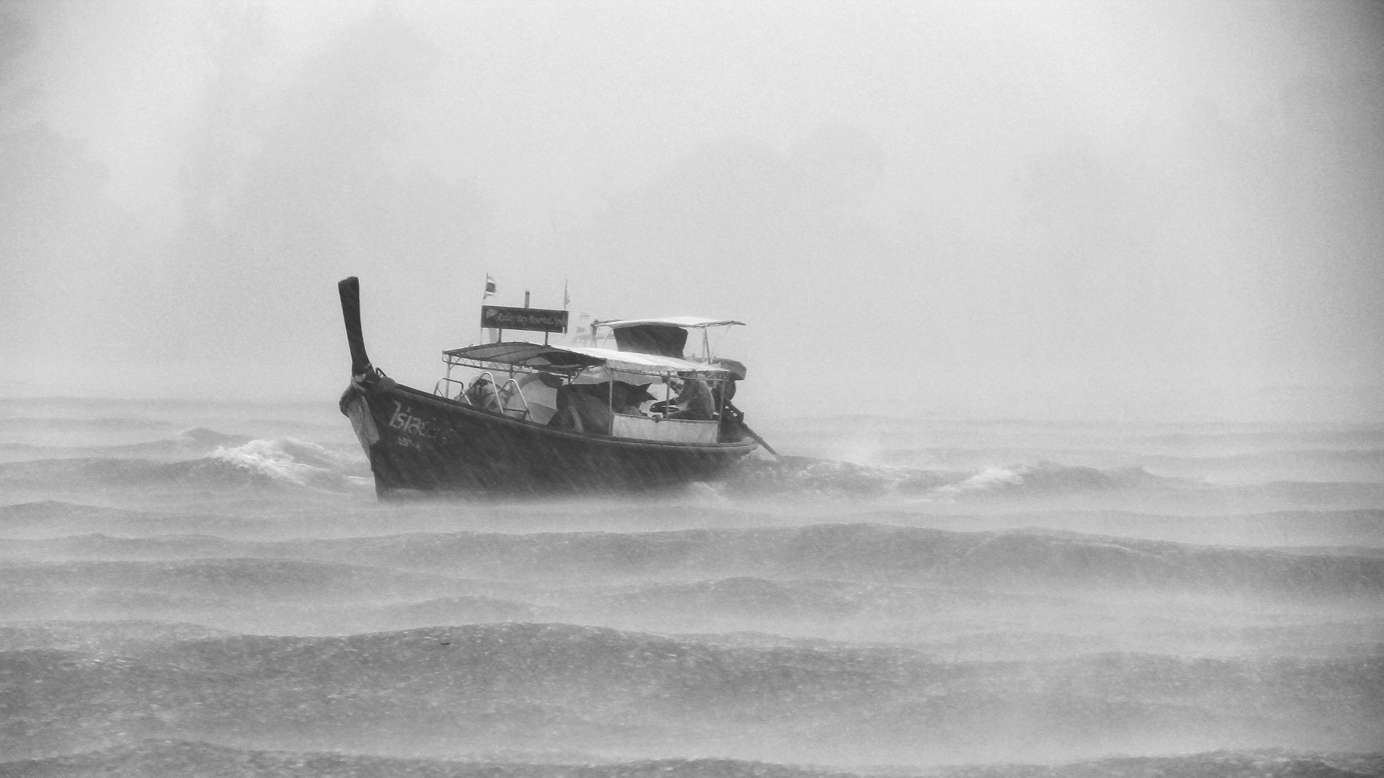
Adapting to change means recovering from a significant disruption in expectations.
© 2016 Workplace Education Manitoba. All Rights Reserved.
http://www.slideshare.net/MKelly2000/managing-change-with-resilience-7315745
Notes:
Can you think of a time when you had a significant disruption in expectations? (Example: maybe you were delayed at an airport, or there was a storm and you missed a meeting or an important family event.)
How did it make you feel?
Can you see how resilience might be closely linked to our ability to adapt to change? Where is the link?

Slide 16
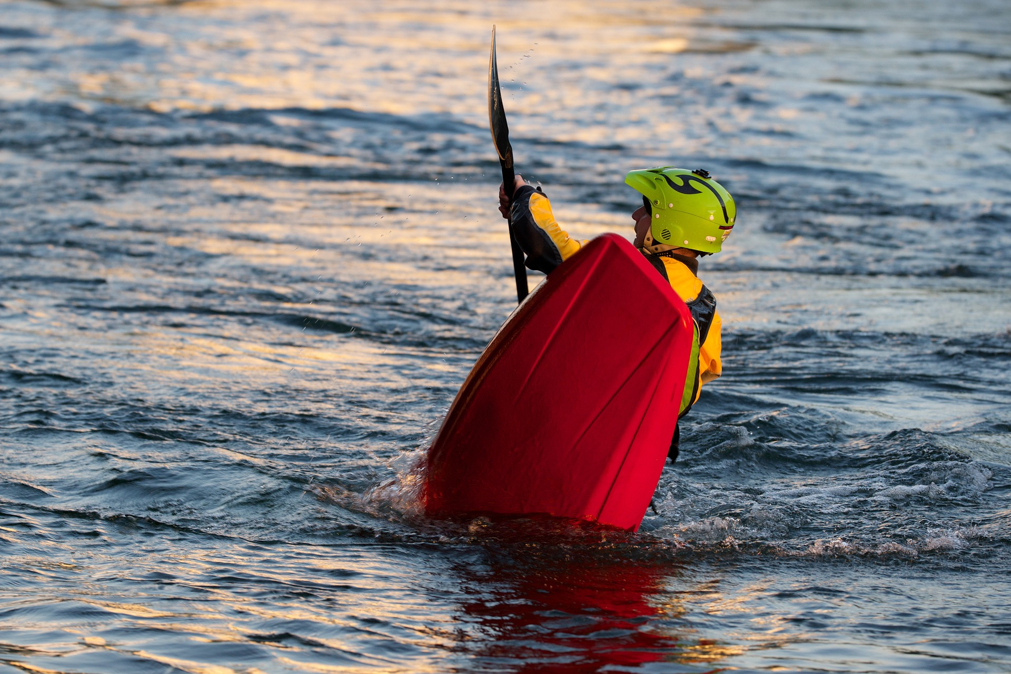
Resilience is the ability to absorb high levels of disruptive change while displaying minimal dysfunctional behaviour.
© 2016 Workplace Education Manitoba. All Rights Reserved.
http://www.slideshare.net/MKelly2000/managing-change-with-resilience-7315745
Notes:
Any thoughts you would like to share? Agree or disagree?
Any questions?

Slide 17

Surprise destabilizes! Being surprised disrupts your equilibrium and your sense of control.
© 2016 Workplace Education Manitoba. All Rights Reserved.
http://www.slideshare.net/MKelly2000/managing-change-with-resilience-7315745
Notes:
Thoughts? Give a personal story if necessary.

Slide 18

http://orig05.deviantart.net/c286/f/2011/179/c/b/swimming_with_shark_by_siijaay-d3k8fnq.jpg
Expect the unexpected so that you are rarely surprised that you are surprised.
© 2016 Workplace Education Manitoba. All Rights Reserved.
http://www.slideshare.net/MKelly2000/managing-change-with-resilience-7315745
Notes:
What are expectations?
noun
1. a strong belief that something will happen or be the case in the future.
"reality had not lived up to expectations"
2. a belief that someone will or should achieve something.
"students had high expectations for their future"
her expectations were unrealistic"

Slide 19
Brainstorm
How can you develop your resilience? How can you encourage resilience in your team?
© 2016 Workplace Education Manitoba. All Rights Reserved.
Notes:
Your team – this is meant to be a work team but it could be any kind of team, volunteer or family, etc.
Two columns – ind / team
Is there a lot of overlap between encouraging resilience

Slide 20
7 Questions to Help you Build your Stress Resilience
10 Tips to Build Resilience
© 2016 Workplace Education Manitoba. All Rights Reserved.
Notes:
Information for you only

Slide 21
BREAK – 10 minutes

Slide 22

Story of Adversity and Resilience (2 mins)
www.youtube.com/watch?v=VaRO5-V1uK0
© 2016 Workplace Education Manitoba. All Rights Reserved.
Notes:
Any comments?
VIDEO 1 - Story of Adversity and Resilience.
Did you know that JK Rowling’s book was inspired by adversity?
VIDEO 2 - The prison of your mind | Sean Stephenson – this is the one that I use!!

Slide 23

“It’s not the load that breaks you down. It’s the way you carry it.”
Lena Horne
© 2016 Workplace Education Manitoba. All Rights Reserved.

Slide 24
Five Characteristics of
Resilient People
Optimistic / Positive
Focused
Flexible
Organized
Proactive
Notes:
Resilient people are optimistic. They display a self-assurance that is based on their view that life is complex but filled with many opportunities. Optimists believe that defeat is temporary and its causes are not solely their fault, but rather due to unfortunate circumstances. The pessimist believes that defeat will last a long time and assigning blame to someone – including him or herself- is necessary. Here are some tips that may you further develop a positive characteristic:
Use a journal to maintain a list of daily accomplishments, no matter how small, related to your change readiness
Accept compliments and praise from others with a genuine ‘thank you’ instead of discounting them.
Concentrate on becoming better at a new task rather than perfecting it.
Practice using positive ‘self-talk’ phrases, such as ‘this too shall pass’ or ‘I will only ask myself to do the best I can rather than to make no mistakes.
2. Focused
The focused characteristic of resilient people has to do with having a clear vision of what they want to achieve. Focused people take the time to write down their goals, objectives, obstacles, and strategies they will need to use to find solutions for the problems facing them
Here are some ideas to help you become more focused:
Visualize yourself as you would like to be one year from now after successfully making the transition through the change. Put a sign or picture on you bathroom mirror or desk to remind you of your vision.
Set specific short, medium and long range goals for yourself relating to your change initiative.
Base your goals firmly on your personal values.
Ask someone you trust to review your goals and give you feedback and suggestions on how you can further target the steps needed for successfully making the transition through the change.
3. Flexible
Flexible people are those who demonstrate a special pliability or adaptability when responding to uncertainty. This resilient characteristic requires that you identify and compartmentalize your fears when facing new and intimidating situations.
Here are some suggestions to help you further develop flexibility:
Swap sides in a discussion where you disagree with someone – you argue their side and ask them to argue your side.
Identify someone who typically approaches things differently than you do and ask them for input on a particularly difficult aspect of your change initiative. Listen to their ideas without interrupting them or passing judgement.
Drive a new and unfamiliar route to a store or a friend’s house. Make note of what you see that’s different from you usual route.
Organized –
Organized people have the knack for developing structured approaches to managing ambiguity. They creatively plan, carefully set priorities and engage in deliberate action steps in order to accomplish tasks.
Here are some time of simple to dos to help you become more organized:
Use a day planner
Take a few moments to think through and list the key steps you need to take to accomplish a task before you tackle it.
Put pieces of paperwork and important information in clearly marked files and put them in an accessible place.
Break down a problem, any problem into smaller pieces – then tackle the easiest piece first.
Proacitve – The proactive characteristic of resilient people means that they engage change rather than simply defend against it. They are not reactive. They take the offense rather than the defense. They take calculated risks and then apply lessons learned from past experiences to similar challenges facing them.
Here are some suggestions that may help you in further developing your ability to be proactive:
Develop plans for managing the worst-case scenario that might result from the change.
Practice assessing the risks about a change initiative by listing all of the pros and cons you can think of. Ask yourself: What if?
Developing these resiliency characteristics takes time and practice. Give yourself the gift of time and reward yourself for your successes and efforts.

Slide 25
5 Ways to Build Resilience in Your Team
1. Build your own personal resilience.
2. Encourage autonomy and flexibility.
3. Help employees deal with adversity and manage change.
4. Provide opportunities for ongoing learning.
5. Help employees find a sense of meaning in their work and the value of their contributions.
https://portal.lifeworks.com/portal/viewers/HPSArticle.aspx?HPSMaterialID=14173
© 2016 Workplace Education Manitoba. All Rights Reserved.

Slide 26

Build your own personal resilience.
  1. You can’t build a resilient team unless you’re resilient yourself.
  2. Take care of yourself during stressful times.
  3. Be familiar with the symptoms of stress
© 2016 Workplace Education Manitoba. All Rights Reserved.
Notes:
1. You need to be physically as was well mentally prepared to weather the inevitable stressful events at work. It takes some effort to keep yourself physically ready, but your improved capacity for change will make it well worth the effort. Take care of yourself. Get regular checkups. Exercise often. Maintain a healthy diet.
2. Maintaining a sense of balance between work and personal like can be challenging, particularly for managers. But if you’re physically exhausted, or feel overloaded or overextended, it’s much harder.
3. These include sleep problems; trouble concentrating; headaches; stomacheaches; neck, shoulder or back pain; heart palpitations; lack of energy.
Identify the sources of stress in your personal and work life. Then let go of feelings of anger and frustration, pressure and tention, by practicing stress-reduction techniques, such as periods of deep breathing.
Does anyone have a technique they use for stress reduction?
You’ll want to be a roll model who shows people how to identify and solve problems; gather the right resources, people, and ideas; break big tasks into defined and managable steps; and find solutions. Your good management (example) will bring these traits out in people and give them an opportunity to practice them. You’ll also build resilience in your group by providing training and developing each employees sense of autonomy and control at work.
Questions or comments?

Slide 27
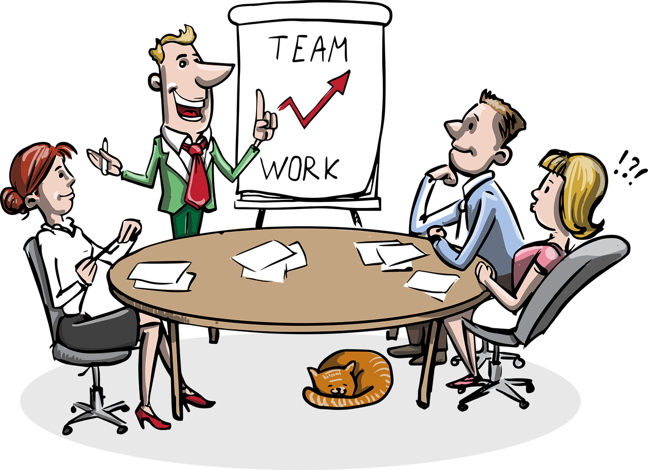
Encourage autonomy and flexibility.
  1. Encourage individual and team problem-solving.
  2. Encourage decision making.
  3. Encourage flexibility.
© 2016 Workplace Education Manitoba. All Rights Reserved.
Notes:
Review Five Disciplines:
Involve team members in finding solutions to work problems and challenges. Encourage employees to problem solve without you. Encourage suggestions.
Be sure employees have the information and resources they need to make and implement decisions. Ask yourself: “Do I need to make this decision or could someone else in my group make it?”
Flexibility and resilience go hand in hand. Flexibility may mean giving employees the freedom to plan their own work, set their own pace, have some control over their schedule, or take a break when they need it.

Slide 28

Help employees deal with adversity and manage change.
  1. Meet with employees when a change is taking place in the organization
  2. Be an effective and diligent listener and communicator during times of change.
  3. Help people take control of the situation.
© 2016 Workplace Education Manitoba. All Rights Reserved.
Notes:
The “ability to improvise” and adapt to change is one of the fundamental characteristics of resilient people and organizations, writes Diane L. Coutu in a Harvard Business review article, “How Resilience Works”.
Employees need to hear from their managers during times of change. Help them understand what the changes will mean for them. Try to put yourself in the employees shoes and to see things from their point of view. You might say, ‘ I know this restructuring is hard on all of us, but we’ll manage the changes and get through this together.”
Be clear, honest and timely in your communications with employees. Be an especially careful listener when people are stressed, have questions, or have complaints or criticisms.
One of the reasons that change is so challenging is that it makes us feel like things are out of control. Clarify roles and priorities during times of change. Encourage people to take control. Encourage people to take control of the situation by helping them get back to work. People need to see that while they can’t always control events around them, they are the ones in control of their own reactions to those changes.

Slide 29
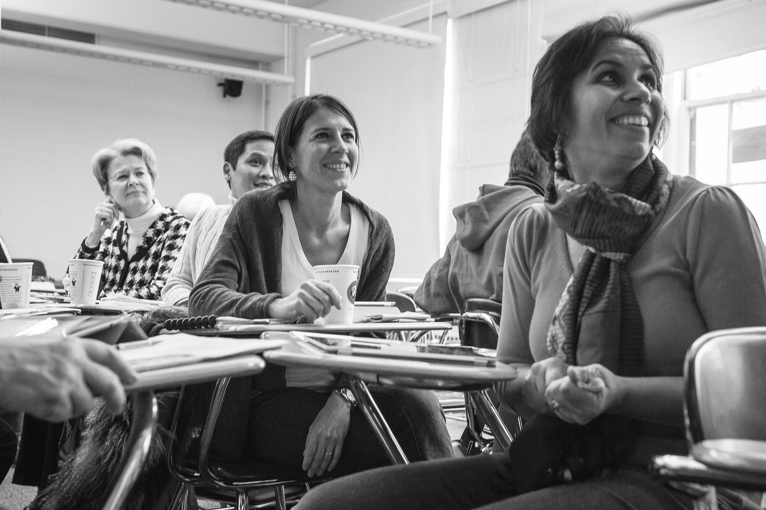
Provide opportunities for ongoing learning.
  1. Provide employees with learning opportunities.
  2. Help employees find mentors and a network of support within the organization.
  3. Provide opportunities for training and retraining.
© 2016 Workplace Education Manitoba. All Rights Reserved.
Notes:
A 2004 study by the Families and Work Institute showed that employees who have jobs that provide them more opportunities to continue to learn and whose supervisors support them in succeeding on the job are less likely to feel overworked. Learning makes us more resilient, too. We learn from our successes as well as our failures and mistakes.
Offer ‘stretch assignments’ and opportunities to take on new task, committees, projects, or jobs.
Employees of all ages welcome the opportunity to learn new skills.

Slide 30

Help individuals find a sense of meaning in their work.
  1. Help individuals and the group see the value they bring to the organization.
  2. Provide opportunities for people-time.
  3. Help people feel appreciated.
© 2016 Workplace Education Manitoba. All Rights Reserved.
Notes:
We all need to feel that our work matters and that we’re valued for the work that we do.
You can do this in individual performance reviews, one-on-one meetings, and team meetings. Help people see the connection between their work and the company’s success – how their work fits into the business plan or makes a difference to clients or customers.
Social connectedness is important
As a manager, you play an important role in helping people see meaning in their work. One way to do that is thanking and acknowledging them regularly and often.
People who develop and practice their resilience in advance will mobilize much more quickly in times of crisis and change. This will allow you to achieve your department’s goals and objectives with an efficiency that you and your team will be proud of.

Slide 31
Review
What is change?
Stages of change
Types of change
Benefits and Challenges of change
ADKAR
Continuous Learning/Culture of Learning
What is resilience?
Qualities of resilient people
Characteristics of resilient people
Notes:
What is change? – becoming different
Stages of change: shock and denial, the danger zone, acceptance and practice, motivation
Types of change: operational, strategic, cultural, political
ADKAR – awareness, desire, knowledge, ability, reinforcement
Resilience - Working under pressure
The ability to not dwell on failures and roadblocks, to move on..
Learning – systems thinking – awareness and understanding
personal mastery – choices / 5 demons (fears of not being good enough, losing control, life is always a struggle, I’m all alone, loss is too much
mental models – reflection (self) and inquiry
Qualities -
Positive, focused, flexible, organized, proactive
Benefits and challenges:

Slide 32
My Action Plan for Building Resilience
© 2016 Workplace Education Manitoba. All Rights Reserved.
Notes:
This is sent home for homework.

Slide 33

Questions?
© 2016 Workplace Education Manitoba. All Rights Reserved.

Slide 34
Thank You!
© 2016 Workplace Education Manitoba. All Rights Reserved.

