Slide 1
Change Happens
As per Jen’s on the fly

Slide 2
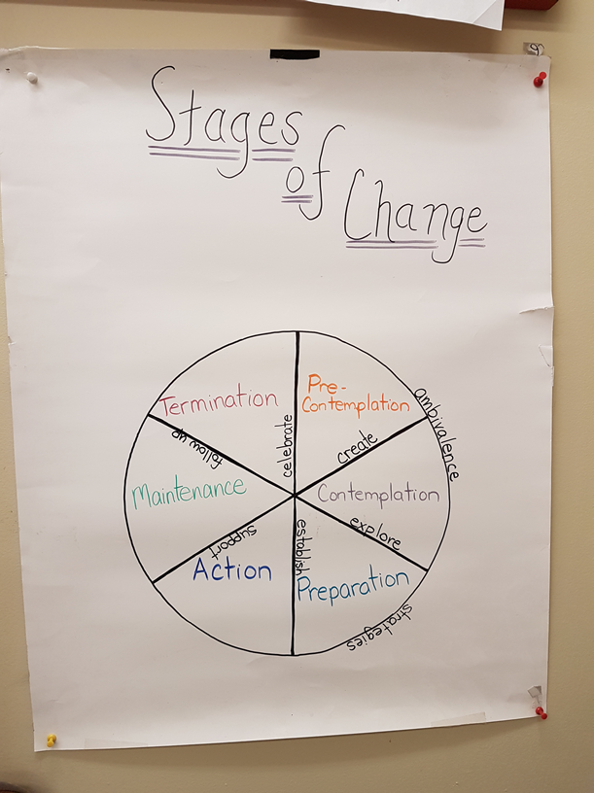
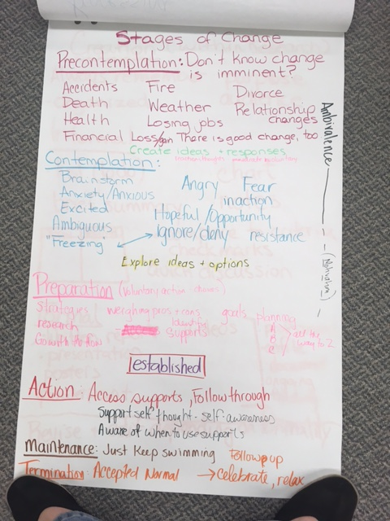
For stages of change – from MI materials

