Slide 1
https://www.youtube.com/watch?v=k2PJ6T7U2eU&list=PLeroZ-zM8IWti1HM0P5ktfTX97jPoFtB9

Slide 2


Interpersonal Skills
Validated Achievement in Essential Skills for Workplace

Slide 3
Interpersonal Skills
What are interpersonal skills?
  Interpersonal skills are the life skills we use every day to communicate and interact with other people, both individually and in groups.
Employers seek to hire staff with 'strong interpersonal skills' - they want people who will work well in a team and be able to communicate effectively with colleagues, customers and clients.

Slide 4
Foundations in Essential Skills
Outcomes – How You Will Use What You Learn
  Become aware of behaviours or attitudes that might be impacting their ability to cooperate with others.
  Use appropriate tone to communicate respect for others
  Recognize nonverbal and verbal cues and their meaning – their own cues and the cues of others

Slide 5



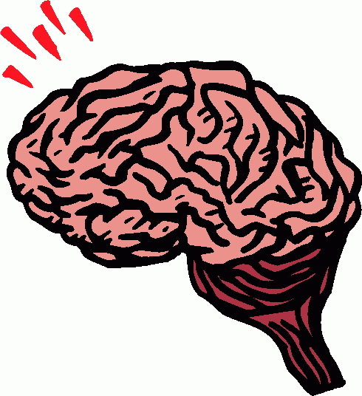
4 Types of Communication Styles
Visual Auditory
Kinesthetic Digital

Slide 6
Interpersonal Skills
Tips to improve:
  Listen and pay attention
  Smiling
  Good mannerisms
  Willingness to get involved

Slide 7
Interpersonal Skills
Listening Activity
  Pairs: A and B

Slide 8
Interpersonal Skills
Tips to improve:
  Listen and pay attention
  Smiling
  Good mannerisms
  Willingness to get involved

Slide 9
Interpersonal Skills
Conclusion: Self-Assessment and Group Review

