Slide 1
Brushing Up on My
Document Use Skills
Notes:
This workshop will be very interactive. We are going to work through things with intention. We will use think-alouds - making the thinking visible through explaining what we are thinking and doing. We will talk about making connections to what you already know and can do. It is about active and deliberate learning and practice. If you are unclear on anything, please ask. We can always learn from each other. You will be doing an ‘each – teach’ in pairs because we know that when you can explain something to someone else, you have the understanding and skills needed. We will finish things off with an opportunity to practice answering questions under ‘test-like’ conditions.
In this workshop we will be practicing something called ‘transfer of learning’. Transfer is moving something from one place to another. Transfer of learning is the thinking practice that supports a person in taking what they have already learned and being able to recognize how this learning is relevant and can be applied in different situations.
The goal is that when you walk out of this workshop you are confident in transferring and applying the thinking strategies that help you in the workplace and in daily life.
Let’s get started with Document Use.
When we talk about Document Use we are talking about visual displays of information. Visual displays of information are everywhere and because they are so much a part of what we do, we may not even be aware of how we use our Document Use skills.
They can be paper-base or electronic.
Document Use is often part of a reading, numeracy or writing tasks. For example, work instructions given in a numbered list or taking numbers out of a table to do a mathematical calculation.
Tips:
Remember it is the complexity of the task. Sometimes something can look very complicated but the task is simple, and vice versa. Before being overwhelmed, always ask yourself – what am I being asked to do here?

Slide 2
Skills vs. Tasks
Work
Tasks
Skills
School
Tasks
Everyday Tasks
Notes:
This is important to understand. Tasks are activities that require a skill or group of skills – tasks are performed in a particular context and generally do not transfer to other contexts – skills required to complete the task do transfer to other and different contexts
This is called transfer of learning. It is when we use the skills learned and used in one context and apply them in another context. For example, a person uses their reading skills to read a textbook, to read a newspaper and read work instructions. Same skills – different context and task.
Why do people sometimes have trouble doing this:
They have forgotten the skill
They have not mastered the skill completely in the first place
They may not realize that they need to or have permission to transfer
Apprehension and lack of confidence
Other learning gets in the way
If something looks a bit different, they may not easily see the opportunity
What can you do to enhance transfer of learning?
See the relevance of what is being learned
Focus on understanding (not memorizing)
Be able to explain to yourself and others
Practice until it becomes automatic to use

Slide 3
Everyday Document Use
Symbols, codes, icons
Lists
Charts, tables, schedules
Graphs
Maps
Pictures, diagrams, assembly drawings
Digital screens
Notes:
Activity:
Distribute booklet - Everyday Document Use – You Know More Than You Think
Read aloud questions page by page – individuals can answer on a spare piece of paper
Go over questions – have the answers come from the group
Note: The intent of this activity is as a normalizing activity – helping people to see connections to what they are already able to do and how they might transfer those skills and abilities easily to other tasks
Explain: Visual displays are designed to help us find information. It is important to understand that there aren’t an unlimited ways to display information visually. There are:
symbols, codes, icon
Lists (and these can be embedded in other things such as tables)
Graphs
Maps
Pictures, diagrams, assessment drawings,
Digital screen (the organization and content would include / be a combination of the pieces of the above, but because it is electronic it may seem different
Group discussion: Brainstorm tasks from everyday that would fall under each (quick activity)

Slide 4
Workplace Document Use
Symbols, codes, icons
Lists
Forms
Charts, tables, schedules
Graphs
Maps
Pictures, diagrams, assembly drawings
Digital screens
Notes:
Explain that we use the same type of visual displays of information at work
Group discussion:(quick activity)
Brainstorm examples from work that would fall under each
Brainstorm the types of tasks people have had to do in previous jobs

Slide 5
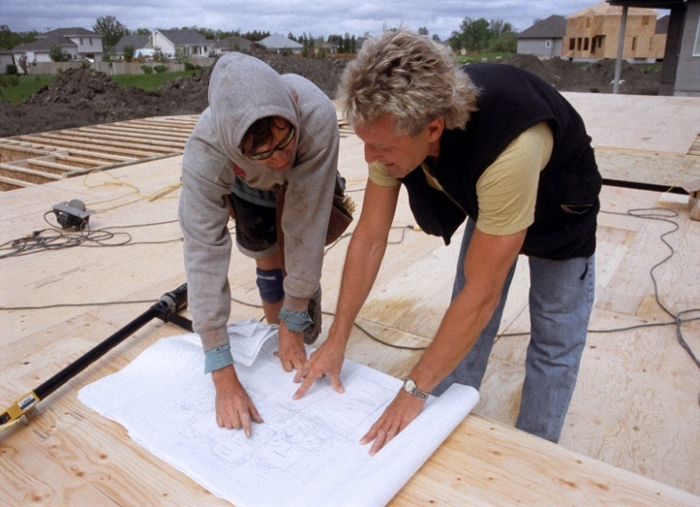
Navigating Workplace Documents
Thinking About The Thinking
Notes:
Navigating workplace documents – finding the way to the place in visual displays of information where you will find and use information / fill in information. What is the route we take? What is the thinking or self-talk that we transfer between different types of visual displays of information and different types of tasks.
We know that people who are successful at doing this:
Skim to understand how something is organized
Set questions for what is needed and identify key words to look for
Predict where the information will be found
Scan and follow a systematic path to find the information needed
Match key words / read and understand
Always confirm the correct and complete information has been found – filled in
If you think about it, you would be using similar thinking and self-talk if you were walking to a place you had not been before:
You would be getting a picture of where you are and where you need to go in your mind
You would be asking yourself what you need to think about to get there – street names, etc.
You would be predicting the best way
You would follow the path you set, but always checking to see if it is the right thing
You would be matching street names, addresses , building names
You will confirm the name and address of where you arrive at
Workplace Education Manitoba has been delivering this for the last 20 years. It started when we were asked to come in and help a manufacturing company where workers were failing certification tests. The first step was for our instructor to sit in on one of the tests. She ended up getting 100% even though she did not know anything about the topic. In putting her thoughts together she came to realize that she knew how to think through to find needed information and answer the questions – she could easily draw on this and the others writing the test didn’t have that same strategy. That is how Navigating Workplace Documents was developed – focusing on the thinking process – and how it began to be consistently taught in workplaces.

Slide 6
Document Navigation Skills
Skim to gain an understanding of how the visual display of information is organized
Identify key words
Predict where the information will be found and the most efficient process for finding the information
Scan to locate the needed information – Systematically follow a path
Match key words – read and understand
Confirm the correct and complete information has been found
If at any point you are having trouble, go back and start over
Notes:
This isn’t just about workplace. You use this thinking with the everyday Document Use activities, you may not have realized that you did. What we are doing here is organizing the thinking into clear steps that are easier to remember and follow
Review slide
Explain: The definition of insanity is doing the same thing over and over and expecting a different result. If you are not getting to where you need to get to: stop – go back and start over.

Slide 7
Questions to Ask Myself
How is this document organized and how can this help me find the information I am looking for? Is there anything similar that I have used before?
What information am I given? What information am I looking for? What key words are important?
How does this connect to what I already know? Where will he information most likely be found? What can I use to help be more efficient in finding what I am looking for?
What am I scanning for? What do I need to read more carefully? How does this fit with what I already know?
Am I able to match all the key words? Is there anything else missing? Do I need to link this information to something else to get the answer?
Does this information accurately and completely answer my question?
Notes:
There are questions that we ask ourselves / self-talk that we use that will help us. It is an on-going conversation in our head. If we learn the steps and the self-talk we should be using, then we have a tool that we can use no matter the task. This is the skill we will transfer.
Review slide

Slide 8
Document Navigation:
Self-Talk
Skim to understand organization
Identify key words
Predict
Scan – Locate
Match – Read and understand
Decide
Confirm
Notes:
We can boil down the self-talk down to ‘cueing’ words that are an easy mental checklist to remember.
Review slide
Explain: This is what we are going to be practicing. But before we do that, there are some things that we need to understand.

Slide 9
Reading Styles
Skimming – reading quickly for the main idea
Scanning – reading quickly to find a specific piece of information
Intensive reading – reading text for detailed information
Extensive reading – reading text for overall meaning (usually for pleasure)
Notes:
When we have a task that involves reading we need to be able to adjust our reading style to fit what is needed
Ask: Why is understanding and be able to use different reading styles important?
Sometimes we just need to skim something to get the main idea or structure and sometimes we need to read carefully for details. If we skim when we should be reading for detail, we can miss some important information and if we read carefully when we should be skimming, we can take to long to complete the task
Review slide. Explain: The first three reading styles are used in a workplace. We will now go over these three in a bit more detail

Slide 10
Skimming
Purpose is to gain a general impression, identify important information and understand the main idea
General rule: identify how the information is organized - Skimming is reading 3 or 4 times faster than normal
Look for and make a mental note of key words and phrases / format used – create an outline of how the information is organized in your mind
Notes:
Review slide
We skim when we read – we can skim an article in a newspaper.
We also skim when looking visual displays of information. We skim to recognize what it is and see how is organized.
Activity: Distribute the booklet of examples. Discuss the different ways that information can be displayed visually. For each – ask: What is this? How is it organized? Where have you seen something like this before? How can its organization be used to predict where information will be found?

Slide 11
Scanning
Purpose is to locate a specific piece of information
Eyes move quickly across the page looking for specific words or phrases that signal to the reader that the information has been found
Ask yourself questions to cue the scanning process
Notes:
Review slide
Useful tips: Sometimes people like to use their fingers to track as they scan and some people like to use a piece of paper and uncovering things as they move down the page
(it would be help to some if you demonstrated using each strategy) Ask if anyone else uses a different strategy

Slide 12
Intensive Reading
Purpose is to read closely for detail, understanding the information that is given
Making connections between what you know and what you are reading
Summarizing in your own words
Making inferences (what might this mean?)
Monitoring comprehension
Confirming understanding
Notes:
Review slide
Explain: Sometimes with a Document Use task there can be longer pieces to read inside of something else. For example there could be a paragraph with instructions in a form to be filled in
We may need to make an inference from what is being read in order to answer a question. An inference involves understanding meaning when not all the information has been spelled out - using background and clues given to reach a logical conclusion.
For example, understanding that one would not eat near where poisonous materials are stored even though it is not explicitly stated.

Slide 13
Self-Talk
Skim to understand organization
Identify key words
Predict
Scan – Locate
Match – Read and understand
Decide
Confirm
Notes:
Activity: Distribute an index card size Post-It note to each person. Have them copy the seven self-talk steps to be used as their own job aid.

Slide 14

Practice: WHMIS Poster
How is the document organized?
What are the key words in the question? (Given / Requested information)
Where can I predict I will find the information?
QUESTIONS:
What does the acronym WHIMIS stand for?
What harm can corrosive materials have on your eyes?
What is the symbol for materials that could cause a skin irritation?
If you worked with materials labeled with this symbol, what precautions would you take?
Notes:
Distribute the Workplace Document Use Practice booklet

Slide 15
Practice: Material Safety Data Sheet
How is the document organized?
What are the key words in the question? (Given / Requested information)
Where can I predict I will find the information?
Match the questions to where you predict you will find the answers in a MSDS
QUESTIONS:
What is the name of the product and what is it used for?
You are using this product for the first time. Are there any personal protection precautions you need to take?
Can this product be stored near food?
Once you have finished washing the floors, how can you dispose of what is in your bucket?

Slide 16
Navigating the Test Taking Process
Thinking About The Thinking
Notes:
Navigating the Test Taking Process: Again it is about navigating, planning the route / finding the way.
Distribute Strategies for Writing Tests handout
Review handout
Tips:

Slide 17
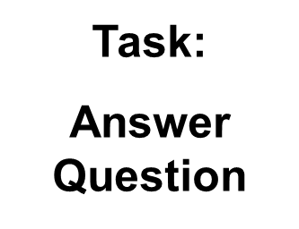
Transferring My Skills
Skills
Task:
Answer Question
Notes:
REMINDER: We have learned that tasks are activities that require a skill or group of skills – tasks are performed in a particular context and generally do not transfer to other contexts – skills required to complete the task do transfer to other and different contexts
Before we talked about how skills are used to complete tasks in different contexts – workplace, everyday, school.
Just by looking at things a little differently we can see that your Document Use and Test Taking skills (the thinking strategies) are what you will draw. Same skills – just a different application.

Slide 18
Remember:
Practice Makes Permanent
Notes:
Explain: We used to say that ‘practice makes perfect’. Instead we know that practice makes permanent. This is important to understand because if we are practicing the wrong thing or in the wrong way, then that is what will become permanent.
Make sure that you are practicing all of the steps of the thinking process – using the cues to self-talk.
Practice will make this automatic.

Slide 19
Relax: You Are In Control
Be well rested
Eat before - Drink water to be hydrated
Be confident
Expect some anxiety – it is normal
Slow deep breathing
Calmly talk yourself through any problems
Don’t stay stuck on any one question – move on to the next and come back to it later
Mentally yell STOP if your thoughts are spinning out of control
Be aware of your body - tense and then release any muscles that are feeling tight
Praise yourself – think positive thoughts
Notes:
These ideas can be applied in the workplace, daily life and during an interview.

