Slide 1



Resilience, Responsibility and Respect in the Workplace

Slide 2

Vision:
Our vision is that all Manitobans have access to the Essential Skills knowledge and training required to determine and pursue their goals related to learning, the workplace and life.
WORKPLACE EDUCATION MANITOBA
© 2020 Workplace Education Manitoba. All Rights Reserved.
Notes:
This program is provided by Workplace Education Manitoba which supports the province through their vision that all Manitobans…read from the slide.
WEM provides education and training for all industry in Manitoba

Slide 3
Module 2
Resilience in the Workplace

Slide 4
Check-in
What is Resiliency?
How do you demonstrate you are resilient?
How can one build their resiliency skills?
© 2020 Workplace Education Manitoba. All Rights Reserved.
Notes:
Before we start going through the content, I would ask you to reflect on these questions on the slide. You may want to write your responses down as well to be able to review after the section is complete. WEM provides education and training for all industry in Manitoba.

Slide 5
Definition of Resilience
the power or ability to return to the original form, position, etc.,
after being bent, compressed, or stretched; elasticity.
ability to recover readily from illness, depression, adversity, or the like;buoyancy.
Ability to “bounce back” and “roll with the punches” •
To transform challenge into an opportunity
The ability, in the face of difficulty, to retain flexible cognitive, behavioural and emotional responses
Neenan and Dryden 2002
Notes:
Review definition of resilience.

Slide 6
It’s not the strongest of the species that survive, nor the most intelligent, but the most responsive to change.” (Charles Darwin)
“What doesn’t kill me, makes me stronger” (Nietzsche)

Slide 7
What is resilience?
Bouncing back
Adapting under pressure
Thriving despite or because of pressure
Being strengthened or improved by adversity
Positive emotions (buffer against depression)
Emotional flexibility
Positive response to change
Ability to foster good relationships
Control over own workflow
Ability to establish a sense of community at work
Source: Chichetti, 2010
Notes:
The quality or fact of being able to recover quickly or easily from, or resist being affected by [stress/stressful events]. The word “resilience” is derived from the Latin verb “salire,” which means to jump. The prefix “re-“ means “back” or “again.” Thus, “resilience” is literally about jumping back.
Resilience is NOT a stable trait but rather a dynamic state that can change between situations and over the lifespan
Mental health is the emotional and spiritual resilience which enables us to enjoy life and to survive pain, disappointments and sadness. It is a positive sense of well being and an underlying belief in our own and others dignity and worth.

Slide 8
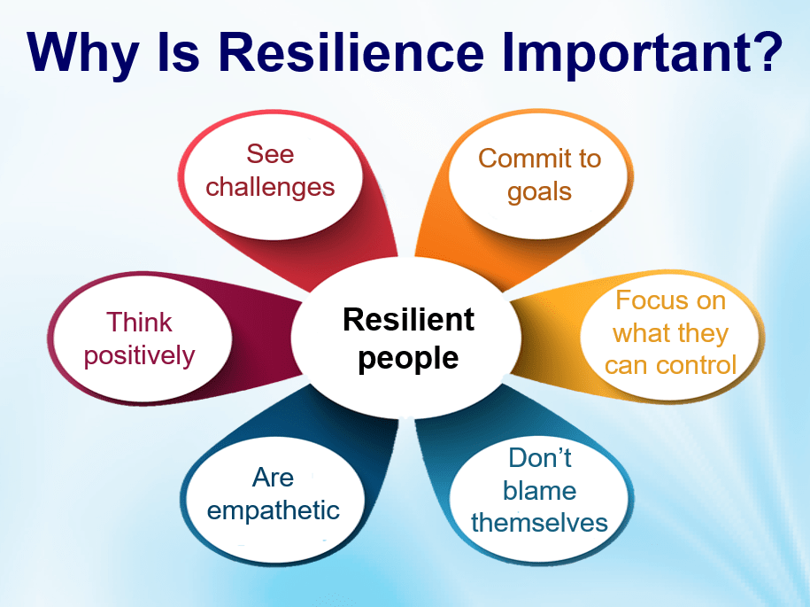
Listening for Effective Collaboration
Notes:
Why is resilience important?
Here are potential workplace issues to match with the reasons why resilience is important.
SAY: Keep in mind that there are really no right or wrong answers. This activity is to start connecting the dots between problems and the importance of not giving up and staying resilient.

Slide 9
Why is Resilience Important?
People are very gossipy at my job.
Resilient People:
Answer: Focus on what they can control

Slide 10
Why is Resilience Important?
2. I really don’t like my job. It is very boring.
Resilient People:
Answer: Commit to goals

Slide 11
Why is Resilience Important?
3. I am having trouble getting along with my co-worker.
Resilient People:
Answer: Are empathetic

Slide 12
Why is Resilience Important?
4. People make racist jokes about my culture.
Resilient People:
Answer: Focus on what they can control

Slide 13
Why is Resilience Important?
5. Customers can be really horrible – I usually get one or two a shift.
Resilient People:
Answer: Think positively

Slide 14
Why is Resilience Important?
6. I don’t even want to go to work tomorrow.
Resilient People:
Answer: Commit to goals

Slide 15
Why is Resilience Important?
7. I want more hours. I’m not getting enough work.
Resilient People:
Answer: See challenges

Slide 16
Why is Resilience Important?
8. I didn’t get the promotion that I wanted.
Resilient People:
Answer: Think positively.

Slide 17
Sharing Resilience…
Exercise …
Think of two people you know who are very resilient and one who is not
What do the two have in common that makes them different from the third in this respect?

Slide 18
Exercise 2 …
What do you do, or what do you suggest that others should do, to help build resilience?

Slide 19
Work-Life Balance
Social Support – friends, family & colleagues
Spirituality
Be decisive
Acceptance
Self soothing
Realistic Goal Setting
Hobbies & Interests
Meaningful Activities
Opportunities for learning after adversity
Generate Helpful thoughts
Relaxation Meditation
Self Care: Sleep, Nutrition, Exercise

Slide 20
Resilience Skills
Emotional resilience
Resilient thinking
Balance & recovery
Flexible thinking
Optimism
Notes:
Research sows there are 3 main domains to building resilience skills – ER, RT and B&R
We will be focusing on RT

Slide 21
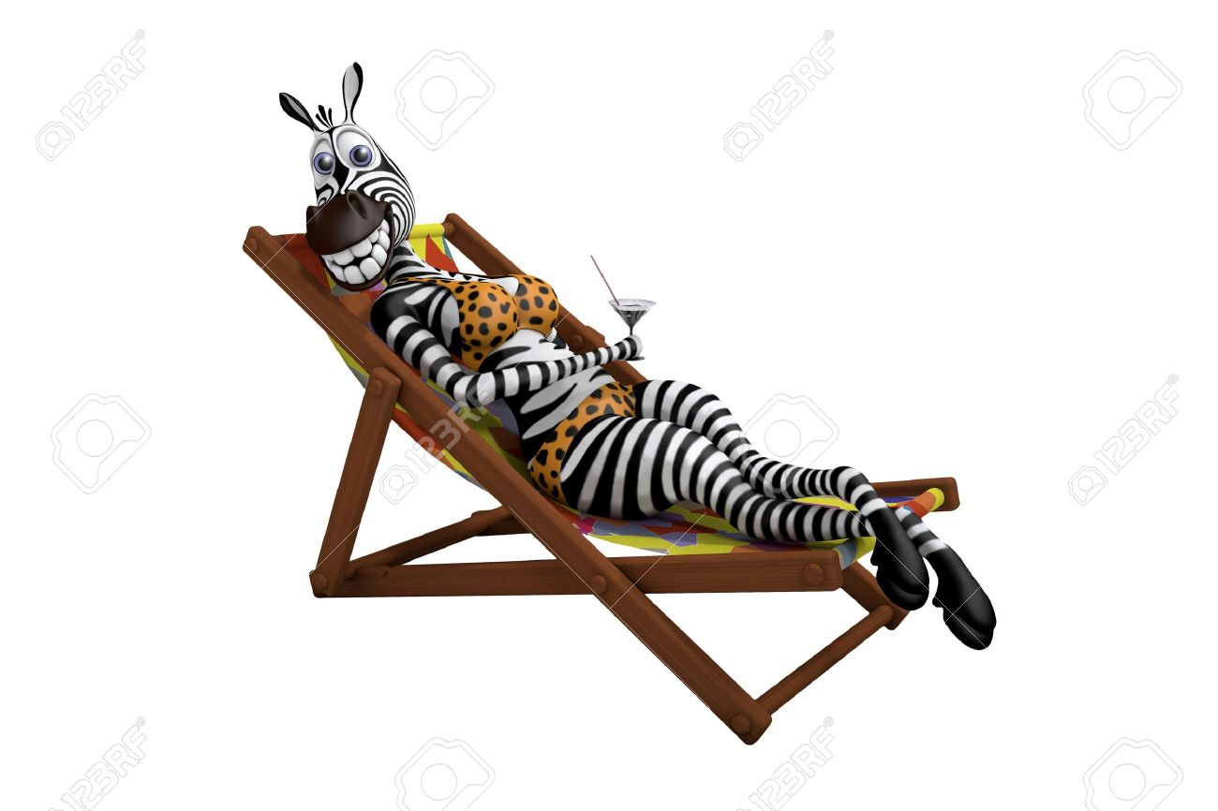
Why zebras don’t get ulcers
Zebras don’t respond to thoughts of lions, they respond only to real lions
Humans respond to thoughts of lions
Humans experience stress response in relation to thoughts as well as real experiences of threat
Source: Robert Sapolsky
Notes:
So in answer to the Q, “Why zebras don’t get ulcers”, it is because zebras don’t respond to thoughts of lions, they respond only to real lions. Humans respond to thoughts of lions – in other words, humans can experience symptoms of stress in relation to thoughts as well as in relation to real experiences of threat.
The effect of these thoughts is to increase the risk of stress becoming chronic which can lead to longer term mental and physical health problems and ultimately impact work engagement, performance and organisational outcomes.
So it’s important to develop an awareness of what we think – to start thinking about what we’re thinking
This is just a nod to the title of this session – blatantly plagiarised from this book by Robert Sapolsky (now in its 3rd edition) which gives an excellent review of the latest research and understanding of the interaction between stress and mental and physical health and development of chronic conditions e.g. heart disease, colitis etc. Importantly, it also provides guidance on evidence-based interventions and practical advice on what we can do to positively impact the biopsychosocial interaction.

Slide 22
The importance of thinking
(Cognitive-Behavioural Model)
Thoughts
Feelings
Behaviours
Physical response(s)
Source: Beck, A. T. (1967). Depression: Causes and treatment. Philadelphia: University of Pennsylvania Press
Notes:
Our brains are programmed to constantly evaluate and think about the situations we encounter, about past experiences and future events.
Our thoughts play a pivotal role in how we perceive a situation and…What we think affects how we feel and ultimately what we do – something happens, we think about it and then respond
For example – if we think about being faced with a lion right here, right now, what might we think? How would we feel? What would we do? What would be going on physically in our bodies?
So thinking impacts us physically, emotionally and behaviourally

Slide 23
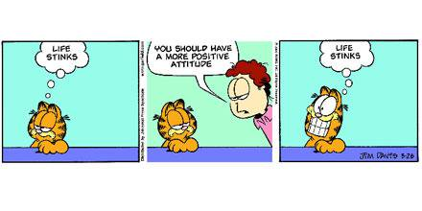
Developing Resilience
THINKING – ATTITUDES
We can’t always control what happens to us but we can control how we think and respond
Notes:
Attitude = the basis for a decision about how a person thinks and feels about an event or another person
We tend to believe that what we think is true – but thoughts aren’t facts – there are usually many ways of viewing (thinking about) a situation, not just one ‘true’ way.

Slide 24
Attitudes towards new challenges
Face up to, overcome the event
Face up to but do nothing about the event
We can do nothing about the event as it’s too big for us to deal with (withdraw until the event has passed vs. ‘act out’)
Correlated with distress/stress
Flight or fight response
And ultimately benefit
& still benefit
It is not just “think positive”; it’s about recognizing our responses & developing “flexible thinking”
Notes:
And if we do experience stress, how can we deal with it?
By developing thinking skills – particularly if we experience a strong physical and/or emotional reaction, we can find ways to think and ultimately respond differently
This is called FLEXIBLE THINKING

Slide 25
Testing negative thoughts & predictions
Thoughts
Feelings
Behaviours
Physical response(s)
Notes:
Scenario – you’re walking down the hallway where you are working or in your school when you see your friend/coworker David in the distance…you look over to make eye contact and say ‘hello’ but….he looks past you with a frown on his face and then walks off in the opposite direction to you…
What might you think?
Feel?
Do?

Slide 26
Exercise:
Testing negative thoughts & predictions
Ask yourself the following Q’s
  Is [thought] true, in fact?
  What is the worst that can happen?
  What does this say about me?
  What does this say other people think of me?
  These Q’s help us get to the bottom of what we find threatening in a situation.

Slide 27
Thinking Errors
Refer to the handout: Unhelpful Thinking Styles
Take some time to read the thinking errors and ask yourself these questions:
Are these thoughts helpful or useful?
Are they true?
Are they helping me stay resilient?
Are they making me more stressed?
Notes:
Make this a handout

Slide 28
Resiliency and Stress
When we feel unhelpful thoughts and feelings, they often cause us stress.

Slide 29
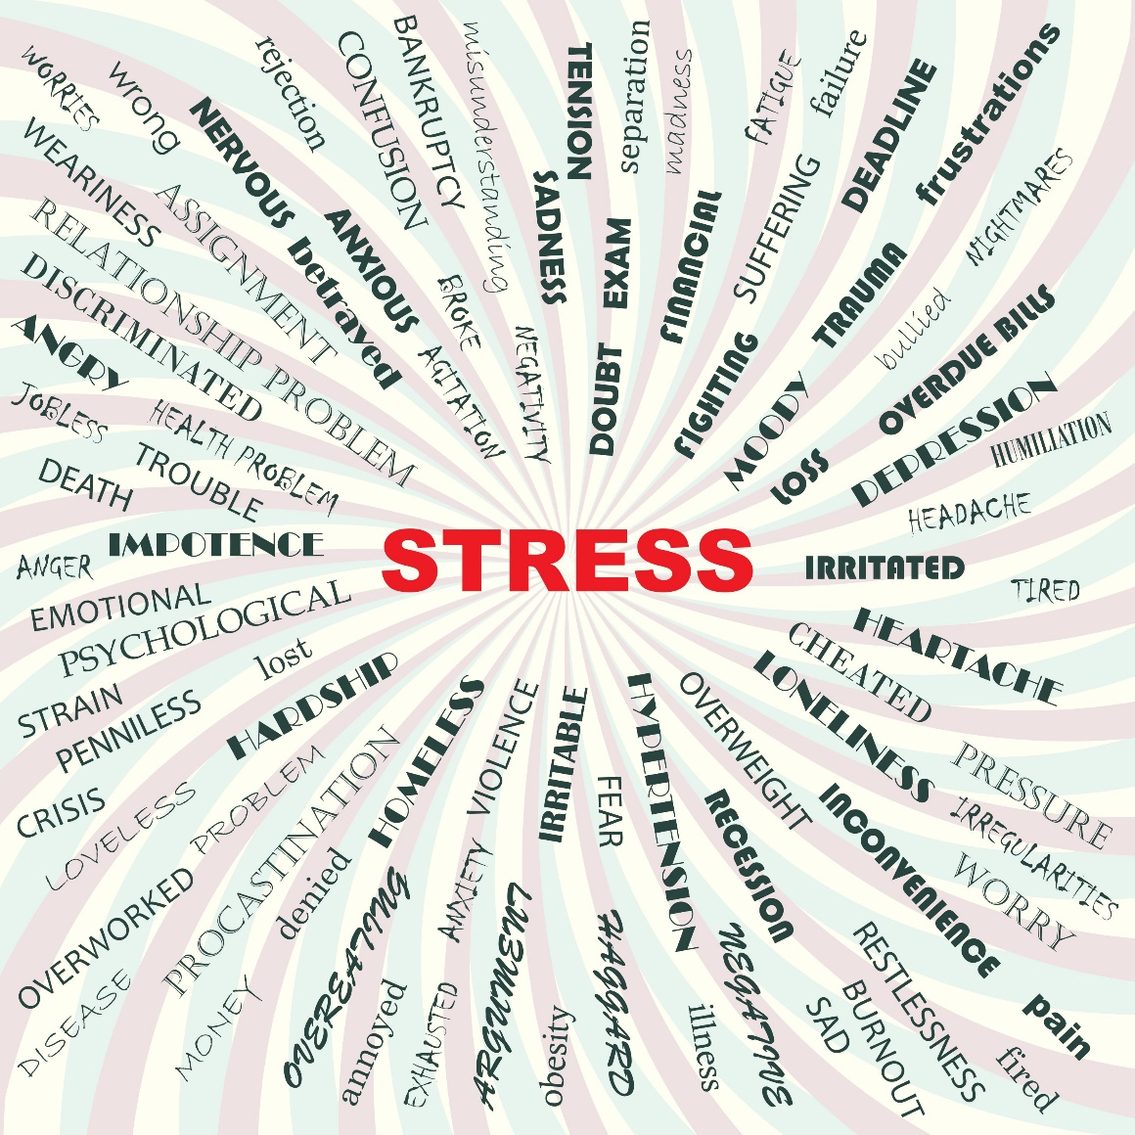
A Continuum of Stress
Is stress good or bad?
What would happen if we had no stress in our lives?
Notes:
.

Slide 30
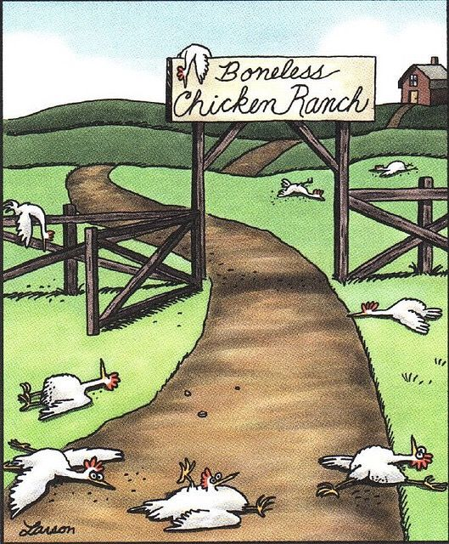
Notes:
Show this comic that demonstrates that we would be like this is we had no stress at all.

Slide 31
Stress
Stress is any outside force or event that has an effect on our body or mind.
Stress is a normal part of life that can help us learn and grow. Conversely, stress can cause us significant problems.
Notes:
Read through the next two slides.

Slide 32
Stress releases powerful neurochemicals and hormones that prepare us for action (to fight or flee). If we don't take action, the stress response can lead to health problems. Prolonged, uninterrupted, unexpected, and unmanageable stresses are the most damaging types of stress.
Self-care is one component of early intervention and maintaining functioning.

Slide 33
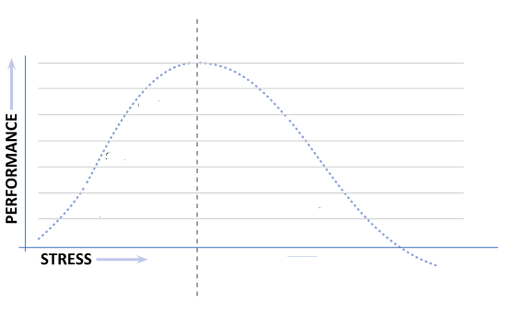


Strain: After two months you realize that you are getting behind. You’ve missed a few deadlines.
Dysfunction: You start to skip classes to work on your assignments, but sitting in your apartment, you are finding it hard to concentrate.
Challenge: There are many things to get down now, but you’ve managed. You’ve hopped on the plane and now you are in your new apartment in your favorite city. The first courses are very interesting.
Stimulation: You are now starting to prepare. You’ve been encouraged to apply for a full scholarship and this is taking some effort.
Burnout: You’ve stopped going to classes altogether. You can’t stop crying and you are having trouble sleeping. Your family sends you a plane ticket and you head home.
Anticipation: You are very excited. You get to move to a city you’ve always wanted to live in and there is lots of anticipation.
You see a doctor and you are diagnosed with depression.
Notes:
Click through this animation. Share the following scenario. (It’s animated so you can read it.)
In this diagram, we are going to take a look at when stress increases and when our performance goes up.
Has anyone heard of Eustress? Eustress is beneficial stress. Just like those boneless chickens, we need eustress in our lives.
Imagine that have been accepted to do university training in a course that you are very interesting in.
Anticipation: You are very excited. You get to move to a city you’ve always wanted to live in and there is lots of anticipation.
Stimulation: You are now starting to prepare. You’ve been encouraged to apply for a full scholarship and this is taking some effort.
Challenge: There are many things to get down now, but you’ve managed. You’ve hopped on the plane and now you are in your new apartment in your favorite city. The first courses are very interesting.
Strain: After two months you realize that you are getting behind. You’ve missed a few deadlines.
Dysfunction: You start to skip classes to work on your assignments, but sitting in your apartment, you are finding it hard to concentrate.
Burnout: You’ve stopped going to classes altogether. You can’t stop crying and you are having trouble sleeping. Your family sends you a plane ticket and you head home.
You see a doctor and you are diagnosed with depression.

Slide 34
If we were that university student, what can we do when we cross the line into distress, or even before we cross the line into distress to help ourselves?
What can we do to help ourselves in our current situation when we cross the line from eustress into distress?
3. Find tips in the handout “Stress Management Tips” that you like for the student in our scenario and for you right now.
Notes:
Go through the first 2 discussion questions on slide. They are in the continuum handout.
Hand out “Stress management tips”. Find helpful tips for you as the university student in the scenario we just shared, and also helpful tips for you right now. Ask each person to share.

Slide 35

Take a look at some of the stress management tips more closely.

Slide 36
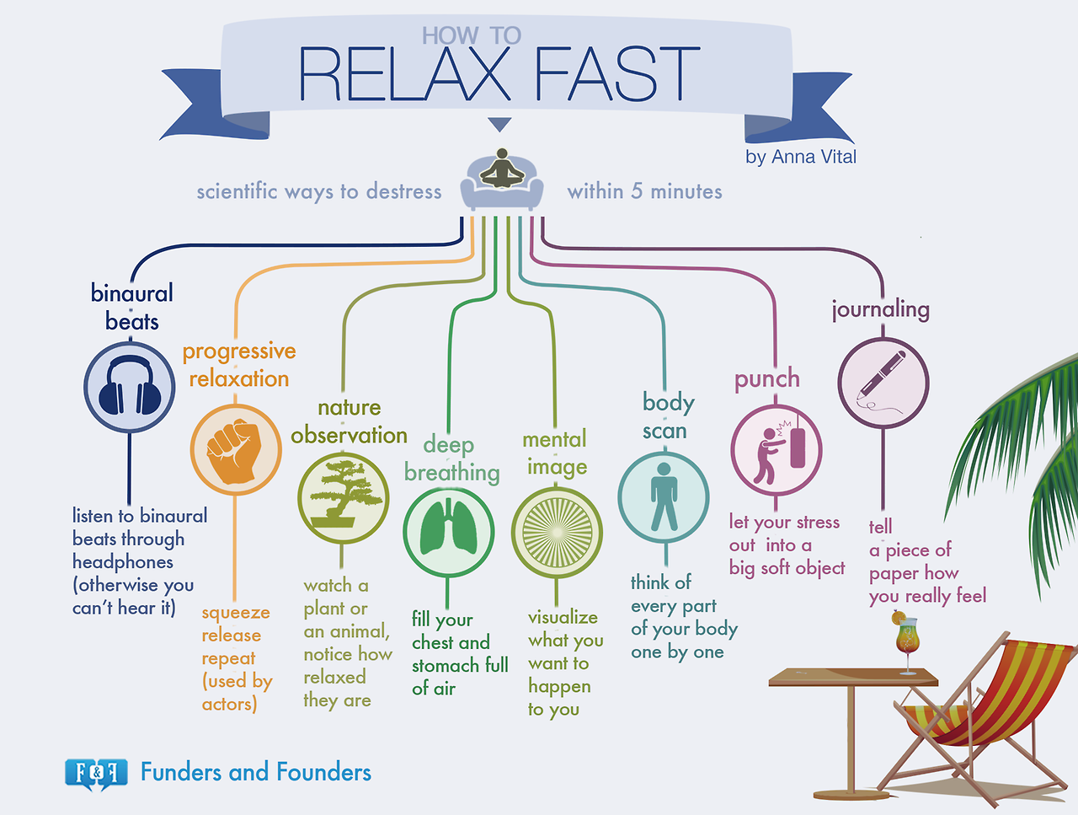
Notes:
1. Go over handout and ask each person to pick on that they do as well as one that they would like to start doing. You can do this as a “think, pair, share” or whole group, depending on the energy.

Slide 37
What’s the big deal about a Positive Attitude?
Negative attitude
https://www.bing.com/videos/search?q=keep+a+positive+attitude&&view=detail&mid=701044E397B5079A5D8B701044E397B5079A5D8B&&FORM=VRDGAR (Up to 26 seconds)
Positive attitude
https://www.bing.com/videos/search?q=22+minutes+love+winter&&view=detail&mid=54ADE21AE3EAF0D6F58454ADE21AE3EAF0D6F584&&FORM=VRDGAR
Homework Questions
Would you say that you are more of a positive person or more of complainer?
The positive person in the second video is obviously an extreme, but do you think it makes a difference in the workplace if you are more positive?
How do you think that having a positive attitude affects your resilience?
Can a zebra change its stripes? Can you be less of a complainer and more positive?
Notes:
Show videos, introducing them as examples of negative and positive attitudes.
In groups or pairs, have participants explore the discussion questions.
Discuss as a whole group.

Slide 38

The Serenity Prayer
Give me grace to accept with serenity
the things that cannot be changed,
Courage to change the things
which should be changed,
and the Wisdom to know the difference.
How can the serenity prayer help with resilience?
Notes:
Ask group if they know the serenity prayer and then show it.
Ask the question, “What would the serenity prayer have to do with resilience?” (You can guide them if they are struggling with answers such as, “when you accept the things you can’t change, you are more likely to not rely an addictive substance.”) Ask group if they know the serenity prayer and then show it.

Slide 39
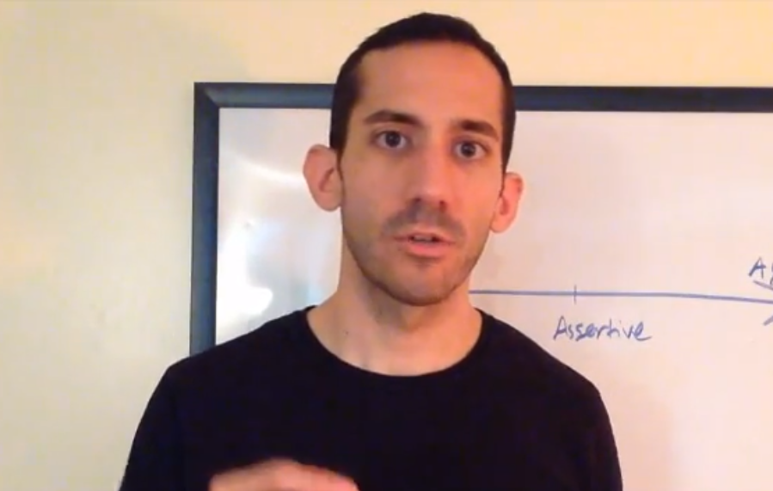
What is the difference between assertive and aggressive?
passive
assertive
aggressive
https://www.youtube.com/watch?v=D7uREuGq5rA
Where do you think you are on the spectrum?
If you want to change, what do you think you can do to be more assertive?
Notes:
“What is the difference between assertive and aggressive?”
Introduce group to spectrum on slide.
Play video.
Where do you think you are on the spectrum?
If you want to change, what do you think you can do to be more assertive?
Tie it back to the course title by asking, “How does this connect to resilience?” (Suggested answers. We are more likely to be resilient if we are not a door mat by being passive and if we are not destroying relationships by being too aggressive.)

Slide 40
Summary
Resilience:
  Is a psychological strength
  It can help us adapt & grow from challenges
  It is NOT a fixed state
  Can be developed & enhanced
  Practical strategies and flexible thinking can be helpful

Slide 41
10 Ways to Build Resiliency
Make connections.
Avoid seeing crises as insurmountable problems.
Accept that change is a part of living.
Move towards your goals.
Take decisive actions.
Source: American Psychological Association
6. Look for opportunities for self-discovery.
7. Nurture a positive view of yourself.
8. Keep things in perspective.
9. Maintain a hopeful outlook.
10. Take care of yourself.
Notes:
10 Tips to Build Resilience
By American Psychological Association
1. Make connections.
Good relationships with close family members, friends, or others are important. Accepting help and support from those who care about you and will listen to you strengthens resilience. Some people find that being active in civic groups, faith-based organizations, or other local groups provides social support and can help with reclaiming hope. Assisting others in their time of need also can benefit the helper.
2. Avoid seeing crises as insurmountable problems.
You can’t change the fact that highly stressful events happen, but you can change how you interpret and respond to these events. Try looking beyond the present to how future circumstances may be a little better. Note any subtle ways in which you might already feel somewhat better as you deal with difficult situations.
3. Accept that change is a part of living. Certain goals may no longer be attainable as a result of adverse situations. Accepting circumstances that cannot be changed can help you focus on circumstances that you can alter.
4. Move toward your goals. Develop some realistic goals. Do something regularly — even if it seems like a small accomplishment — that enables you to move toward your goals. Instead of focusing on tasks that seem unachievable, ask yourself, “What’s one thing I know I can accomplish today that helps me move in the direction I want to go?”
5. Take decisive actions. Act on adverse situations as much as you can. Take decisive actions, rather than detaching completely from problems and stresses and wishing they would just go away.
6. Look for opportunities for self-discovery. People often learn something about themselves and may find that they have grown in some respect as a result of their struggle with loss. Many people who have experienced tragedies and hardship have reported better relationships, greater sense of strength even while feeling vulnerable, increased sense of self-worth, a more developed spirituality, and heightened appreciation for life.
7. Nurture a positive view of yourself. Developing confidence in your ability to solve problems and trusting your instincts helps build resilience.
8. Keep things in perspective. Even when facing very painful events, try to consider the stressful situation in a broader context and keep a long-term perspective. Avoid blowing the event out of proportion.
9. Maintain a hopeful outlook. An optimistic outlook enables you to expect that good things will happen in your life. Try visualizing what you want, rather than worrying about what you fear.
10. Take care of yourself. Pay attention to your own needs and feelings. Engage in activities that you enjoy and find relaxing. Exercise regularly. Taking care of yourself helps to keep your mind and body primed to deal with situations that require resilience.
Additional ways of strengthening resilience may be helpful. For example, some people write about their deepest thoughts and feelings related to trauma or other stressful events in their life. Meditation and spiritual practices help some people build connections and restore hope.

Slide 42
Resilience Building Plan
Using the Worksheet: Resilience Building Plan, create a plan for yourself and practice these skills. Be open to not doing all of them perfectly and curious about what you are going to learn about yourself and others in the process.

Slide 43
Post-Training Assessment
How will you use what you have learned in this session?
What are the benefits of learning this knowledge and skills?
© 2020 Workplace Education Manitoba. All Rights Reserved.

Slide 44
“Life doesn’t get easier or more forgiving, we get stronger and more resilient.”
― Steve Maraboli, Life, the Truth, and Being Free

