Slide 1



Resilience, Responsibility and Respect in the Workplace

Slide 2

Vision:
Our vision is that all Manitobans have access to the Essential Skills knowledge and training required to determine and pursue their goals related to learning, the workplace and life.
WORKPLACE EDUCATION MANITOBA
© 2020 Workplace Education Manitoba. All Rights Reserved.
Notes:
This program is provided by Workplace Education Manitoba which supports the province through their vision that all Manitobans…read from the slide.
WEM provides education and training for all industry in Manitoba

Slide 3
Module 3
Responsibility in the Workplace

Slide 4
Check-in
What is Responsibility?
What is the relationship between responsibility and excuses?
How can you be responsible in the workplace?
© 2020 Workplace Education Manitoba. All Rights Reserved.
Notes:
Before we start going through the content, I would ask you to reflect on these questions on the slide. You may want to write your responses down as well to be able to review after the section is complete. WEM provides education and training for all industry in Manitoba.

Slide 5
Learning Objectives
Acquire of clear understanding of Responsibility and why it is important in the workplace
Demonstrate responsible behaviours at work and the impacts if people are not responsible
Practice reacting to specific workplace situations where a high level of responsibility is required

Slide 6
Definition of Responsibility
  The state or fact of being responsible, answerable, or accountable for something within one's power, control, or management.
Notes:
Review definition of resilience.

Slide 7
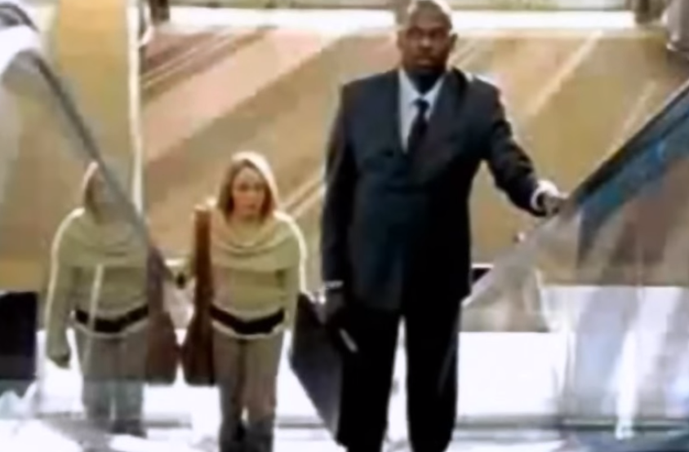
Video
https://www.youtube.com/watch?v=Mv2D8KEbXPk
What are your initial thoughts about the video? What are your thoughts about the people stuck on the escalator?
Notes:
Watch video – “stuck on an escalator”

Slide 8
Which are Elements of Responsibility?
Being dependable | Keeping promises | Accepting the consequences for choices
Developing one’s potential | Make excuses for one’s actions (or inactions) | Blaming others
Using good judgment before taking action | Taking charge of one’s life | Setting goals

Slide 9
Which are Elements of Responsibility?
ANSWERS:
Being dependable
Keeping promises
Accepting the consequences for choices
Developing one’s potential
Using good judgment before taking action
Taking charge of one’s life
Setting goals

Slide 10
Sometimes instead of taking responsibility for our actions, we make excuses.
Excuses are rationalizations we make to ourselves about people, events, and circumstances. They are invented reasons we create to defend our behavior, to postpone taking action or simply as a means of neglecting responsibility. - Source: Wikipedia

Slide 11
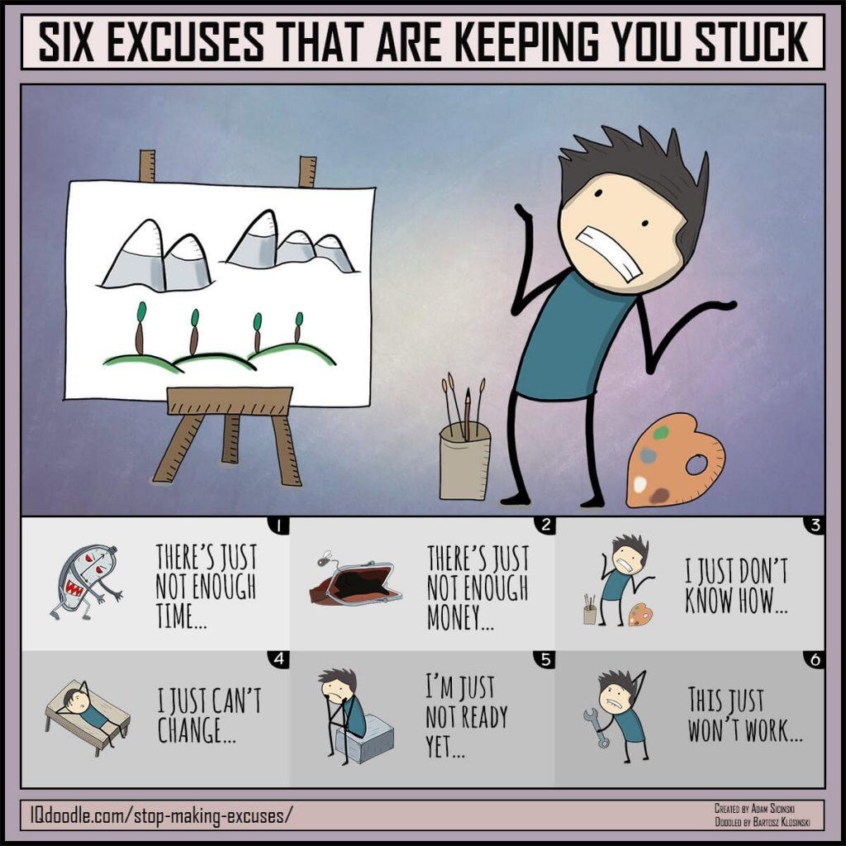

Slide 12
Excuse: It broke.
Taking Responsibility: I broke it. How can I fix it?
Excuse: I can’t find it.
Taking Responsibility: I haven’t found it yet. I need to look harder.
Excuse: She was doing it, so I did it too.
Taking Responsibility: I won’t do it.
Notes:
After each excuse, respond with an action that demonstrates taking responsibility.

Slide 13
Video
Mind Map: A Life of Excuses
https://blog.iqmatrix.com/a-life-of-excuses

Slide 14
Worksheet #1
Complete Participant Worksheet #1: Work Attendance – Excuse or Reason
Notes:
Highlight the following key points:
Employees are expected to show up for all scheduled shifts
Most employers understand that unforeseen circumstances can result in an employee being absent from work. It is important for employees to have open and honest communication with their employers on such matters.
Employees are expected to notify employers of their absence in advance if an employee will be absent for consecutive days.
Employees are expected to notify employers prior to start of each day’s shift asap.
Third party documentation may be required for extended periods of absence.

Slide 15
Worksheet #1
Complete Participant Worksheet #1: Work Attendance – Excuse or Reason
DEBRIEF
Notes:
Highlight the following key points:
Employees are expected to show up for all scheduled shifts
Most employers understand that unforeseen circumstances can result in an employee being absent from work. It is important for employees to have open and honest communication with their employers on such matters.
Employees are expected to notify employers of their absence in advance if an employee will be absent for consecutive days.
Employees are expected to notify employers prior to start of each day’s shift asap.
Third party documentation may be required for extended periods of absence.

Slide 16
What are we responsible for in the workplace?
Some examples:
- being on time
- getting our tasks completed
- admitting to mistakes and learning from them
- communicating to our co-workers and supervisors
- practising safe work
- respecting others
- maintaining cleanliness

Slide 17
Being responsible means being ___________, keeping ___________ and honouring our commitments. It is accepting the ______________ for what we say and do. It also means ____________our potential.
People who are responsible don't make _________for their actions or ________ others when things go wrong. They think things through and use good ___________ before they take action. They behave in ways that ___________others to trust them.
People who are responsible take _________ of their lives. They make plans and set ______ for nurturing their talents and skills. They are __________ in finding ways to overcome adversity. They make __________, taking into account _____________ to family and community.
blame
judgment
dependable
encourage
decisions
promises
excuses
goals
obligations
plans
developing
resilient
consequences

Slide 18
Being responsible means being ___________, keeping ___________ and honouring our commitments. It is accepting the ______________ for what we say and do. It also means ____________our potential.
People who are responsible don't make _________for their actions or ________ others when things go wrong. They think things through and use good ___________ before they take action. They behave in ways that ___________others to trust them.
People who are responsible take _________ of their lives. They make plans and set ______ for nurturing their talents and skills. They are __________ in finding ways to overcome adversity. They make __________, taking into account _____________ to family and community.
Being responsible means being ___________, keeping ___________ and honouring our commitments. It is accepting the ______________ for what we say and do. It also means ____________our potential.
People who are responsible don't make _________for their actions or ________ others when things go wrong. They think things through and use good ___________ before they take action. They behave in ways that ___________others to trust them.
People who are responsible take _________ of their lives. They make plans and set ______ for nurturing their talents and skills. They are __________ in finding ways to overcome adversity. They make __________, taking into account _____________ to family and community.
dependable
Being responsible means being dependable, keeping promises and honouring our commitments. It is accepting the consequences for what we say and do. It also means developing our potential.
People who are responsible don't make excuses for their actions or blame others when things go wrong. They think things through and use good judgment before they take action. They behave in ways that encourage others to trust them.
People who are responsible take charge of their lives. They make plans and set goals for nurturing their talents and skills. They are resilient in finding ways to overcome adversity. They make decisions, taking into account obligations to family and community.
promises
consequences
developing
excuses
blame
judgment
encourage
charge
goals
resilient
decisions
obligations

Slide 19
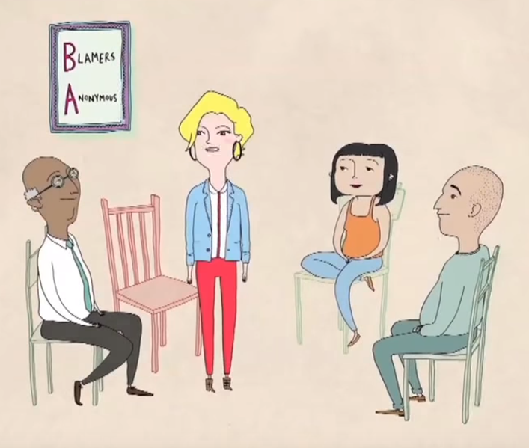
Accepting Blame
Why is this important? Or is it?
https://www.youtube.com/watch?v=RZWf2_2L2v8
Notes:
Discuss accepting blame. Why is it important? Or is it?
Show video
Invite group to respond to the video: “What do you think of the video” “What does this make you think of?”

Slide 20
Worksheet #2
Complete Revisiting Case Studies

Slide 21

Revisiting the Case Studies
Marcy worked at a retail store. She started off with a bang. Things were going very well. After a while, her friend got a promotion and was now her supervisor. After that, Marcy is the first one to admit that she stopped putting 100% into her job. Eventually she was let go, and to add insult to injury, it was her friend who fired her. She fell into depression and did not look for work for one year.
What were the ramifications for blaming?
How might this story have turned out different if she didn’t spend her energies focused on feeling betrayed by her friend?
Notes:
Potential answers: Ramifications for blaming her friend was her losing interest and responsibility in her role. Then of course losing her job was a significant ramification and result of the scenario.
Marcy’s story could have turned out differently by being happy for her friend’s promotion and respecting her new position & responsibilities. Marcy would have continued being employed and having a good relationship with her new supervisor. Perhaps Marcy would have been the next supervisor in line.

Slide 22
2. Tina worked in a manufacturing environment for over 15 years. She had a health problem with her eye and had to have an operation. She had some time off work, and she was hoping that when she returned that she could work in the office at her job. She asked her doctor for a doctor’s note, stating that she could not be in a dusty environment. He said that dust would not be a problem and that she could keep working in the shop, but she was so relentless that he gave in and he wrote the doctor’s note. The company gave her an entry level office position.
She found the office to be very different. All of her career with the company, she had only worked with men. After a short time, she confessed to someone that she already hated these women. One day, one of the women asked her to do some paperwork (part of the job) and she said no. The environment got worse and worse and eventually she took a stress leave. She did not work again anywhere for 10 years.
Do you think that blaming was an issue in this case? Why or why not?
Notes:
Potential Answers: One perspective to this scenario is that blaming could certainly be an issue based on what is written. Tina did not accept the fact that she could continue working in the “dusty” environment as it would not affect her eye. After the doctor and employer accommodated her request to work in the office, Tina blamed the “women” for not doing well in her job. She needed to take responsibility for her new office position and do what was expected of her in this role. The sad part is that she did not go back to any position/job for a very long time.

Slide 23
Worksheet #2
Complete Revisiting Case Studies
DEBRIEF

Slide 24
Worksheet #3
Complete Participant Worksheet #3:
To prepare for future work opportunities, practice writing out your responses on the Interview Questions on Responsibility - Worksheet.

Slide 25
Interview Questions on Responsibility
Describe a time when you went out of your way to demonstrate dependability. (These can be small examples. It is the small things that, over time, count the most.) Who benefited from your efforts?
Have there been times in the past three months when you did not deliver as you promised? (e.g., you missed a deadline, you were late, you failed to follow through, etc.) Who did your behaviour impact and how can you do better in the future?
Do you know what your reputation is in the area of responsibility? Do others believe they can consistently count on you? How do they know?

Slide 26
Interview Questions on Responsibility
Do others seem to have confidence in your ability to deliver? When someone asks you to complete a task, do they then "let go" and assume that it will be taken care of by you?
Working on potential is part of being responsible. Describe something that you are doing right now that is helping you to reach your potential.
Do you tend to be a blamer or someone who takes responsibility for mistakes? Share an example.

Slide 27
Worksheet #4
Using the Worksheet: Building Responsibility, answer the questions on workplace responsibility.
Be honest with yourself on the areas of improvement you may have.
Set a goal for yourself on how to build these areas and skills.

Slide 28
Worksheet #5
Complete Worksheet #5:
More Responsibility Case Studies

Slide 29
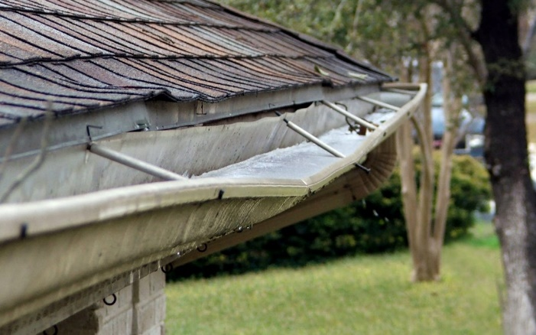
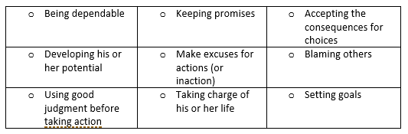
Case Study #1 –
A panel of business owners told an audience that “employees not taking responsibility” was one of their biggest complaints. As an example, an owner of a roofing company said that a person who is getting to get up on the roof may not take the time to think about where the ladder should be placed. As a result, the rain gutter has now been wrecked and the company has to incur the cost of fixing the rain gutter.
Would you say that these actions are responsible?
Yes or no? Which elements of being responsible comes into play?

Slide 30
Case Study #2 –
Marnie has worked at the same grocery store for 15 years. She hates her job. She is doing the same thing over and over and is getting a repetitive strain injury. Furthermore, this store does not give employees full time hours, so she doesn’t make enough money to live on and falls further and further behind every month. Her friends ask her if she ever thought of applying for a management position. She said, “Ya, I thought of it, but then I might have to work on Sundays and I don’t want to work on Sundays.”
Her friends also suggested that she get a 2nd job, such as serving since she has experience in that as well. She says, “Ya I know, I just don’t feel like I should be working more than one job. I feel like all my income should come from one job only”.

Slide 31
Years ago, when she was already miserable in her new job, she did take a step. She went to an organization that helps with writing resumes. She had very few computer skills and the teacher basically did the whole resume for her. After she got a copy of the resume, she called the teacher and left a message. She said that she didn’t like the resume and wanted her to start over. The teacher did not return the call.
Would you say that Marnie is responsible? Yes or no?

Slide 32
An example of people who do not take responsibility.
An example of someone who takes responsibility in an elevator.
https://www.youtube.com/watch?v=7_5yKacBnjA

Slide 33
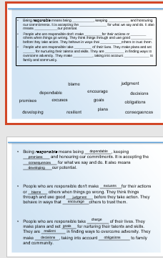


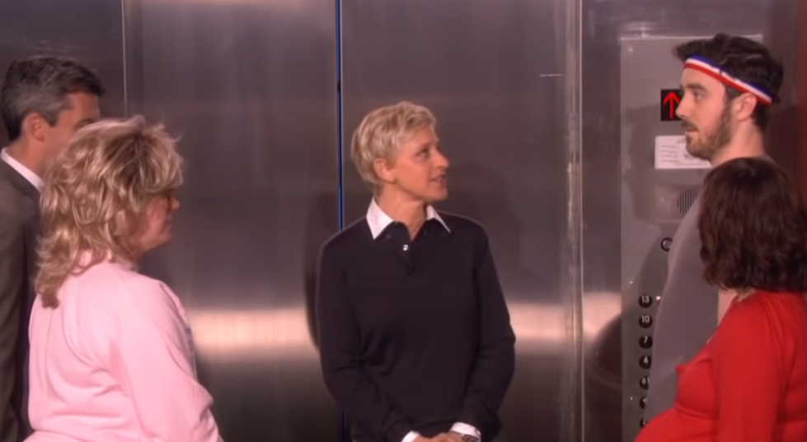
Taking responsibility is important.
Brainstormed what we are responsible for in the workplace and then filled in the blanks.
Accepting Blame
Case studies
The ladder and the rain gutter.
The woman with all the excuses at the job she hates.
Interview Questions on Responsibility and prepared your responses.
Marcy – slacked and was fired by her friend
Tina – spend her day being offended by the women she was working with instead of doing her job.
Notes:
Go through the animations on the slide to review what was covered.
Do a group check out by asking each person to share an important moment for them today.

Slide 34
Summary
Responsibility:
  What Does It Mean To Take Responsibility For Your Actions?
  Essentially, this means acknowledging the role you play in your own life – the good bits and the bad bits. Rather than looking around for someone or something else to blame, you must accept that you are in charge of what is going on.

Slide 35
Post-Training Assessment
How will you use what you have learned in this session?
What are the benefits of learning this knowledge and skills?
© 2020 Workplace Education Manitoba. All Rights Reserved.

Slide 36
“‎Hold yourself responsible for a higher standard than anybody else expects of you. Never excuse yourself. Never pity yourself. Be a hard master to yourself-and be lenient to everybody else.”
― Henry Ward Beecher

