Slide 1


Workplace Education Manitoba
www.wem.mb.ca

Slide 2
Vision
Our vision is that all Manitobans have access to the Essential Skills knowledge and training required to determine and pursue their goals related to learning, the workplace and life.
© 2021 Workplace Education Manitoba. All Rights Reserved.

Slide 3
Workplace Education Manitoba would like to express appreciation to the following for supporting the development of this Continuous Learning Skills curriculum:
Employment and Social Development Canada (ERSDC) and
Manitoba Education and Training.
This project was jointly funded through Human Resources Skills Development Canada and Entrepreneurship Training and Trade.
For more information, visit www.wem.mb.ca or contact info@wem.mb.ca
© 2021 Workplace Education Manitoba. All Rights Reserved.

Slide 4
Workplace Education Manitoba – Safety Mindset

Slide 5
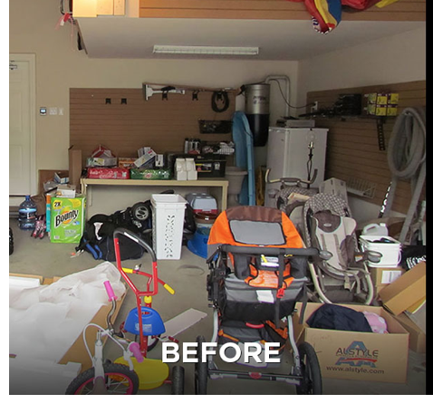
Where would you start if you were to clean up this garage?

Slide 6
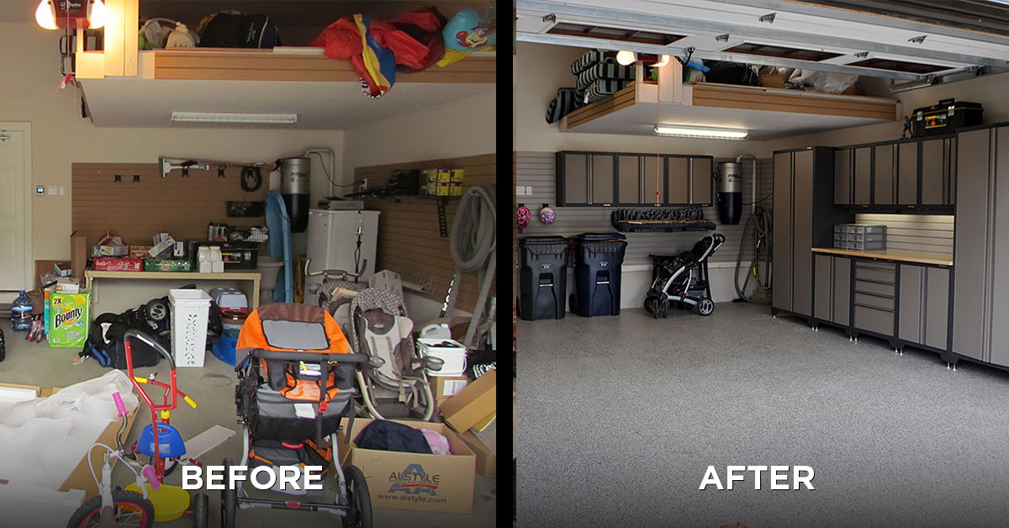

Slide 7
Knowing is not enough; we must apply. Willing is not enough; we must do.” by Johann Wolfgang von Goethe
He who would do great things should not attempt them all alone. By Seneca
Be brave to stand for what you believe in even if you stand alone.” by Roy T. Bennett
“Commitment is an act, not a word.” by Jean-Paul Sartre
“One finger cannot lift a pebble.” by Hopi
Notes:
Chat box –
How do these quotes relate the your idea or beliefs around safety?
What is your personal why for being interested in safety in the workplace?

Slide 8
What is your personal why for being interested in creating a safe work culture?

Slide 9
Whiteboard activity – What behaviours or attitudes do you see when safety is front of mind?

Slide 10
Our Behaviours
Rushing
Frustration
Fatigue
Complacency
Notes:
Ask: How do these four behavious things show up in the workplace?

Slide 11
Workplace Community – Essential Skills
Our documents
The way we communicate
How we use technology
Our comfort and ability to work with numbers
Providing learning opportunities

Slide 12
Small groups - How do these 4 behaviours influence the way we work with documents, the way we communicate, how we use technology, accuracy with the numbers we are working with and writing down, and taking an interested in learning new things?

Slide 13

Our Response

Slide 14
Impact on our Ability to Working Together
They wave you off, sneer roll their eyes, or avoid eye contact
Talking to them feels like taking to the walls
They talk about you behind your back and isolate you
They steal your ideas and take credit for them
They take credit for your work and never acknowledge it
They do not value your time
They expect you to work with broken tools
They tell you one thing and then when you get to the job it is almost always different
They say a job will take X time, when every one knows it will take Y
They make mistakes on your pay cheque. I always have to check it over
They ignore your needs, but not those of your colleagues (others)
They overload you with work and keep things from you
Unrealistic timelines

Slide 15
Anger
---------------------------------------------------------------------------------------------------------------------------------------
Lower Control High Control

Slide 16
White board – LO – Not being present at work
We are looping back – a)What are signs you are not present at work? b) Any surprises c) What is the value in understanding when you are not present at work? d) What are some techniques you use when you are nor present at work?

Slide 17

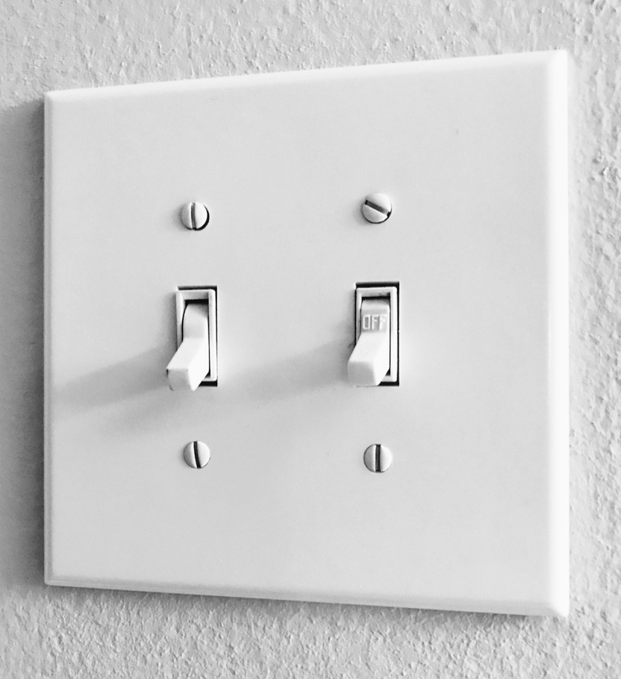
What causes you to get upset with people at work or on the job site?
What happens to you when this occurs?

Slide 18
Impact on our Ability to Working Together
They wave you off, sneer roll their eyes, or avoid eye contact
Talking to them feels like taking to the walls
They talk about you behind your back and isolate you
They steal your ideas and take credit for them
They take credit for your work and never acknowledge it
They do not value your time

Slide 19
Impact on our Ability to Working Together
They expect you to work with broken tools
They tell you one thing and then when you get to the job it is almost always different
They say a job will take X time, whenever one knows it will take Y.
They make mistakes on my pay cheque. I always have to check it over
They ignore your needs, but not those of your colleagues (others)
They overload you with work and keep things from you

Slide 20
What if we did more of these things?
Correct hazards immediately when it is safe to do so
Remove defective tools (Tag them)
People understood their roles and responsibilities
Shared information or the plan for the day with the entire crew
Spoke to each other on the job site, instead of ignoring each other
Being pro-active versus reactive

Slide 21
Situation A – You hear about something and ask questions – How will the other person likely respond?
Situation B – You see something and start making assumptions as you are talking with the person? How will the other person likely respond?
Situation C – You hear something (call or phone) and your next step is a text with a bunch of unkind words, emoji, lol? How will the other person likely respond?

Slide 22
Situation D - You hear someone name and automatically infer – X (Good or bad) - How will that influence how you respond to someone?
Situation E – You know person X needs to use a tool next or get into the spot to load up - and you do not care for person A – What will you potentially do? How will the other person likely respond?
Situation F – You have inappropriate screen saver on your phone - How will the other person likely respond?

Slide 23
Our Behaviours
Rushing
Frustration
Fatigue
Complacency
Reflection
Notes:
Ask: How do these four behavious things show up in the workplace?

Slide 24

Situational Awareness
What do you see in this picture?

Slide 25
3 Levels of Situational Awareness
Perception of the situation
Assessment of the situation
Decision Making

Slide 26
Breakout Groups – Situational Awareness
Perception - How have your perception of a situation impacted you?
Assessment - How are you processing the situations you find yourself in?
Decision making - How are you making a decision about what will happen in the future?

Slide 27
What Causes our Situational Awareness to be Reduced?
Cognitive overload
Emotional Overload
Notes:
Rushing – Frustration – Fatigue - Complacency

Slide 28
Situational Awareness –Perception of the Situation
How do I feel right now?
What things are influencing this emotional state?
Is there an immediate threat in the environment?
What hope do I have?
Notes:
Fit for work….

Slide 29
Whiteboard or group -
What if you were to ask yourself these questions when you start your day?

Slide 30
Situational Awareness – Finding a Meaning
How did I get here?
What things have changed around me?

Slide 31

What goal do I want to achieve?
How likely are the worst omens to come true?
How can I avoid or minimize the danger that I see on the horizon?
What have I done in similar situations in the past?

Slide 32
Situational Awareness - Strategies
Learn to predict Events
Identify Elements Around You
Trust Your Feelings
Limit Situational Overload
Avoid Complacency
Be Aware of Time
Begin to Evaluate and Understand Situations
Actively Prevent Fatigue
Monitor Performance of Others

Slide 33
1 - Ability to project the future actions of elements around you.
2 – Start to notice the threats around you and then expand to the non-threating elements.
3 – Go with your gut feeling (tension in the room)
4 – Are you overloaded… Prioritizing and delegating task and minimizing distractions can improve survival…

Slide 34
5 – We cannot assume everything is under control. We need to be active and in the right mindset.
- Time - Pace of your environment is constantly being changed – Unplanned events.
- Recognize patterns, interpretation, and evaluation - This information will determine how you will act.
- Adjust your schedule to reduce fatigue
- Continuously assess and reassess
- Be aware of those around you – Overload, stress and mistakes

Slide 35
Transferability to the Job/Community

Slide 36
Opportunities
Offering additional 2 day workshops
Customized Workshops

Slide 37
Share 2 ideas you can implement or bring back to your workplace.
What value will these ideas bring?

Slide 38
Feedback Form

Slide 39

Notes:
Send Jot Forms at this time.

Slide 40
Dana Rebello
Workplace Project Coordinator – Thompson
Workplace Education Manitoba
(431) 354-0215
drebello@wem.mb.ca
Office Hours: Monday, Tuesday, Friday

Slide 41

Workplace Education Manitoba – Safety Mindset

Slide 42
Pictionary – Whiteboard
Boat
Skateboard
Shoe
Bird
Dog house

Slide 43
Day 2

Slide 44
Workplace Education Manitoba – Safety Mindset
Day 2

Slide 45
Dana Rebello
Workplace Project Coordinator – Thompson
Workplace Education Manitoba
(431) 354-0215
drebello@wem.mb.ca
Office Hours: Monday, Tuesday, Friday

Slide 46
Jelly Beans

Slide 48
What could you be doing more of?
Following rules, policies, and procedures
Respect
Aware of one another
Plan all work with risk assessment
Care for one another
Lead by example
Reliable
Communication
  leader and employee (Follow up is important) - Why you can and cannot move forward? - Strategy – Log Book
  Trickle down that information – Communicate with them what communications would be useful.
Accountability
Trust within the group
Dependability
Sense of Pride
Trust within the group
Communication
Cautious
  Explore all possibilities (look at all angels – wear many hats)
  Communication and one the same page
Accept boundaries
  Within my role or change of roles
Approachable
Aware of our surroundings

Slide 49
Feedback Recap

Slide 50
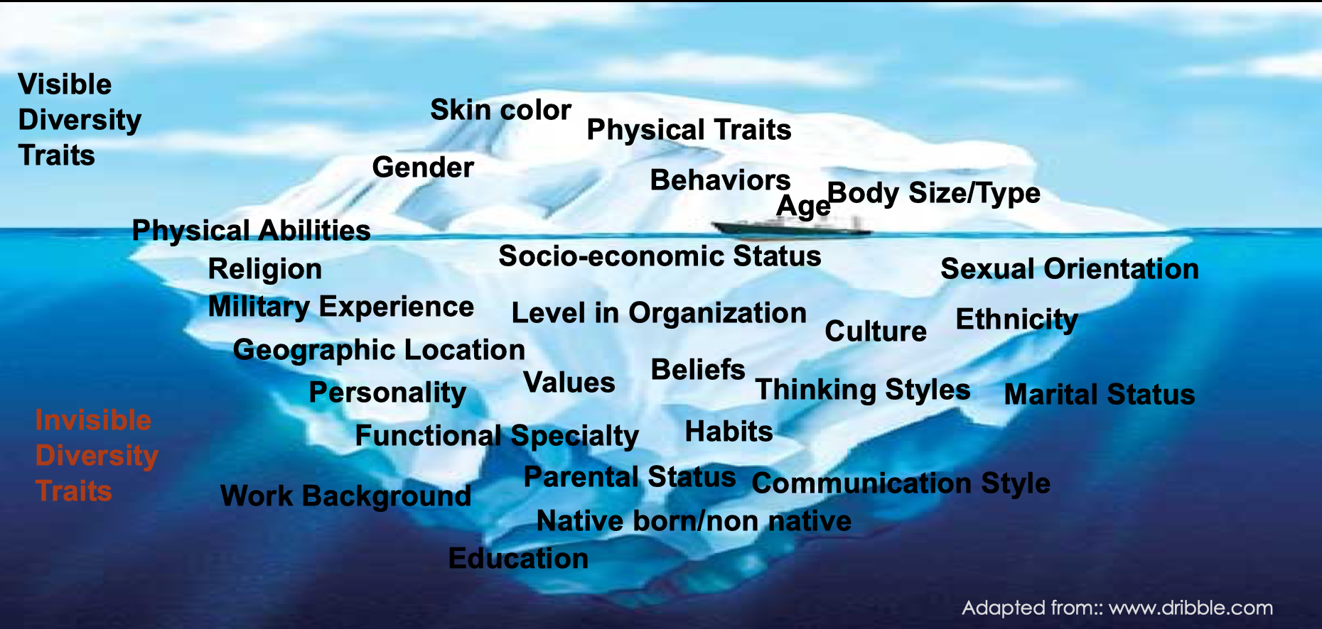
Notes:
How do the things on this chart influence our ability to create a safety culture?

Slide 51
Trust
What roles does trust play in the workplace?
How would I build trust with you?
How is trust built in the workplace?
What gets in our way of building trust?

Slide 52
Ideas take away – Communication session written or verbal
Start from the top – Leaders lead
Various ways and encourage positive growth – in small steps –
Slow positive build – Give it time and your will get there.
Safer and better at work….
Mental health awareness – Your own mental health and your co-workers (Ex: Bell let’s talk day).
Positive attitude setting the tone for the day. Projecting yourself in a positive way.
You reflect on your employees day.

Slide 53
ADKAR
Awareness
Desire
Knowledge
Ability
Reinforcement (Supporting)

Slide 54
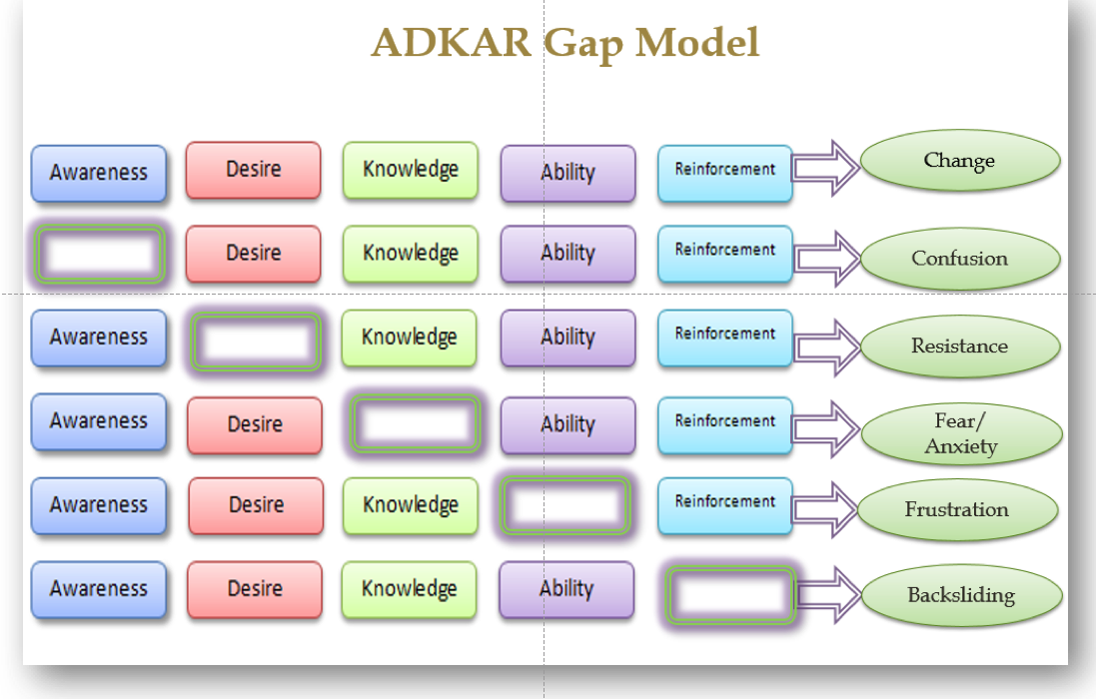

Slide 55
ADKAR
Awareness
Desire
Low awareness - What questions might an employee ask?
What might we see when an employee has low desire?

Slide 56
ADKAR - Knowledge
How can we ensure our employees have the knowledge to do the job?
As the employee how can we ensure we have the knowledge to do the job?
Are we certain we understand the knowledge needed to do the job?
How can we learn more about the work we are doing?

Slide 57
ADKAR - Ability
If we are uncomfortable to do something, what can we do?
What can the company do to ensure the employees have the ability to do the work?

Slide 58
ADKAR – Supporting
How are we supporting our employees?
How could we be showing our employees more support as it relates to a safety culture and mind set?

Slide 59
Show more support by….
Image you portray (dress image) – Leading by example (wearing PPE equipment & how you work)
  If you work safe then your employees will do the same thing
  Your image after work
A safety image becomes your company
Safety known across the entire organization
Routine audits
Training resources

Slide 60
Our Behaviours
Rushing
Frustration
Fatigue
Complacency
Our documents
The way we communicate
How we use technology
Our want to continue to learn
Notes:
Ask: How do these four behavious things show up in the workplace?

Slide 61
Where do you go from here?
What makes that important to you?

Slide 62

Feedback Form
Notes:
https://form.jotform.com/210614560466250
Safety Mindset form

Slide 63
Dana Rebello
Workplace Project Coordinator – Thompson
Workplace Education Manitoba
(431) 354-0215
drebello@wem.mb.ca
Office Hours: Monday, Tuesday, Friday

Slide 64
Whiteboard - Scrabble
Blackjacks

