Slide 1

TOOL IDENTIFICATION TEST
LIFT
Portage La Prairie

Slide 2
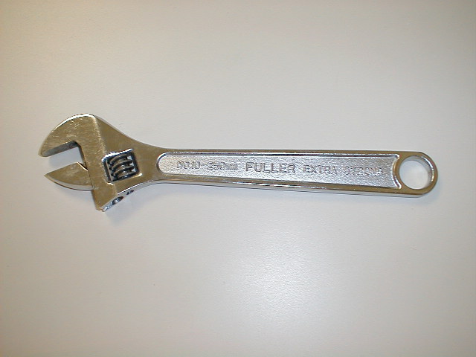
1. Adjustable Wrench
Adjustable Wrench

Slide 3
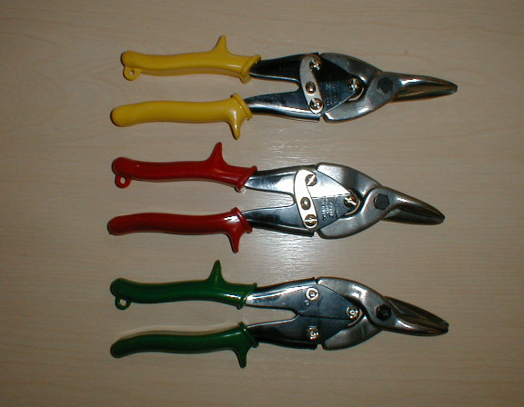
3. Aviation Snips
Aviation Snips

Slide 4
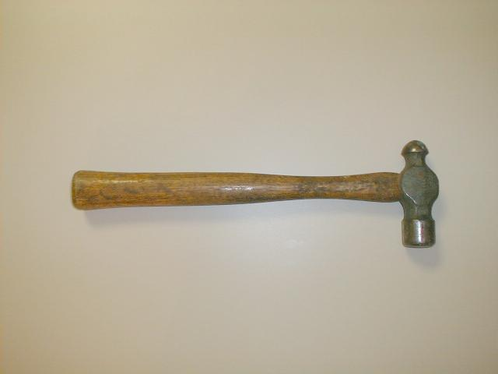
4. Ball Pein Hammer
Ball Pein Hammer

Slide 5
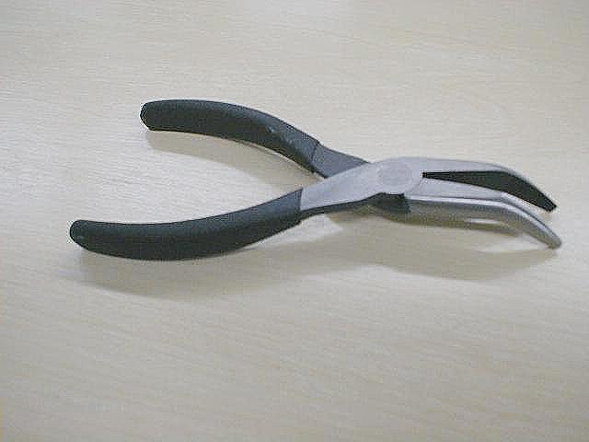
6. Bent Nose Pliers
Bent Nose Pliers

Slide 6
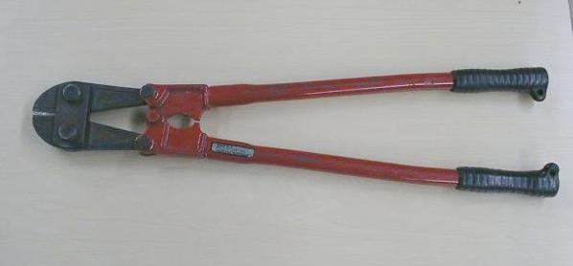
7. Bolt Cutters
BOLT CUTTERS

Slide 7
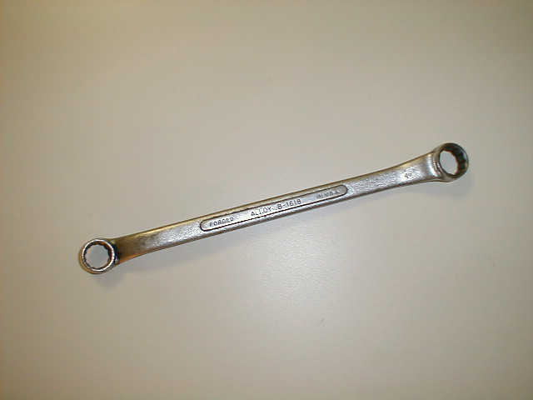
11. Box End Wrench
Box end Wrench

Slide 8
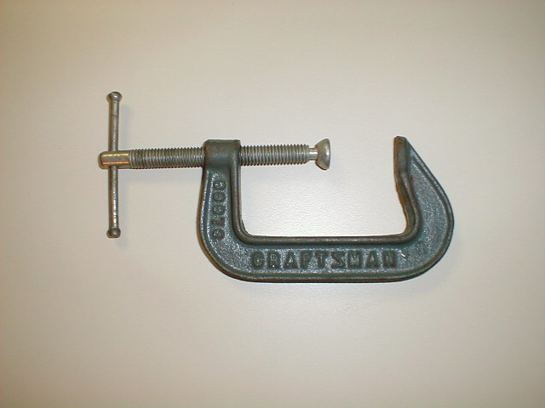
17. C Clamps
“C” Clamp

Slide 9
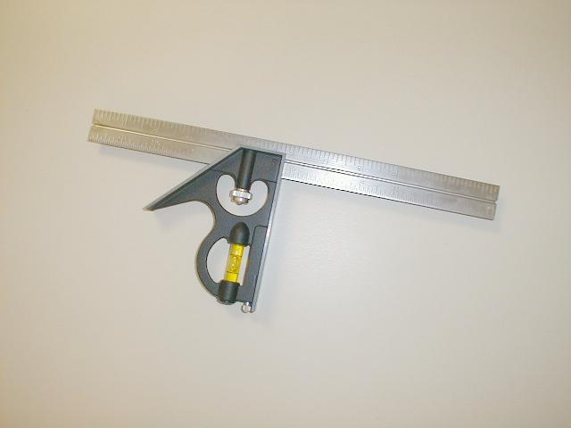
28. Combination Square
Combination Square

Slide 10
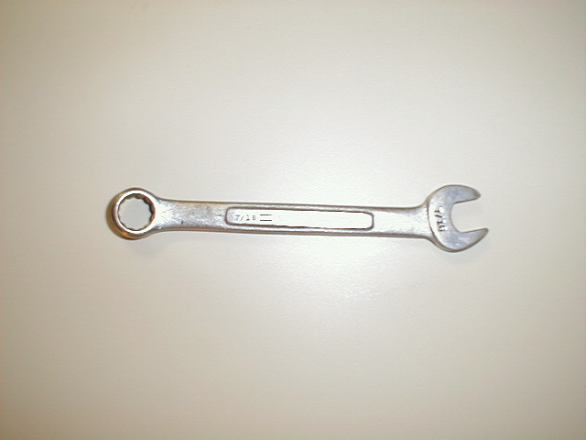
29. Combination Wrench
Combination Wrench

Slide 11
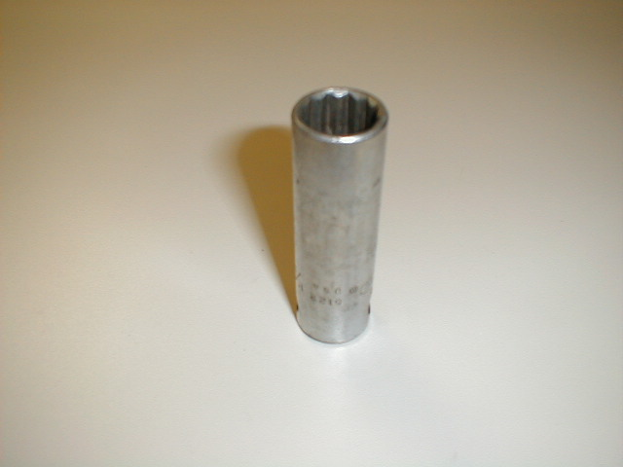
39. Deep Socket
Deep Socket

Slide 12
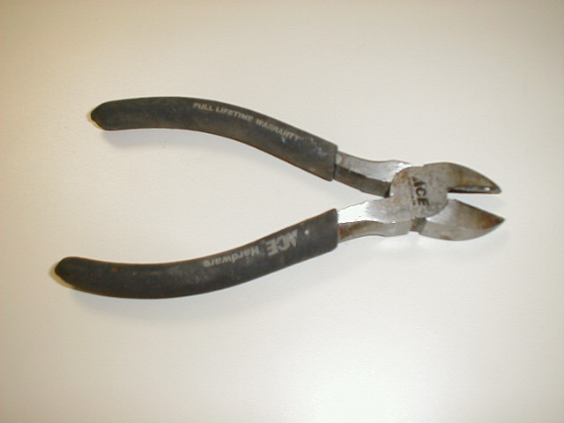
41. Diagonal Cutting Pliers
Diagonal Cutting Pliers

Slide 13
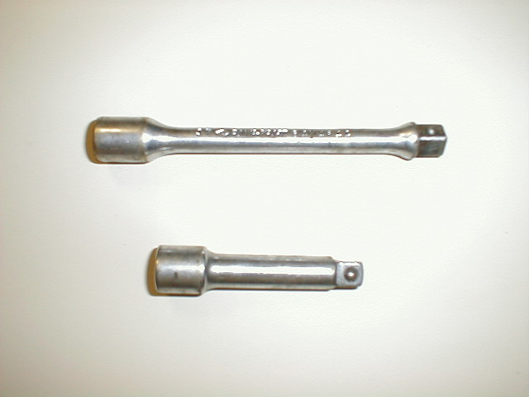
51. Extension
Extension Sockets

Slide 14
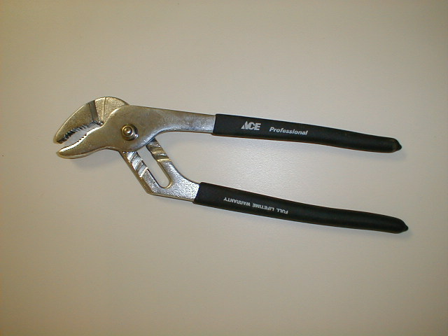
66. Groove Joint Pliers
Groove joint pliers

Slide 15
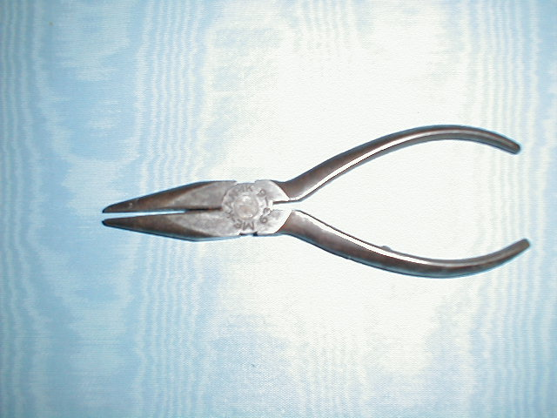
82. Long Nose Pliers
Long Nose Pliers

