Slide 1
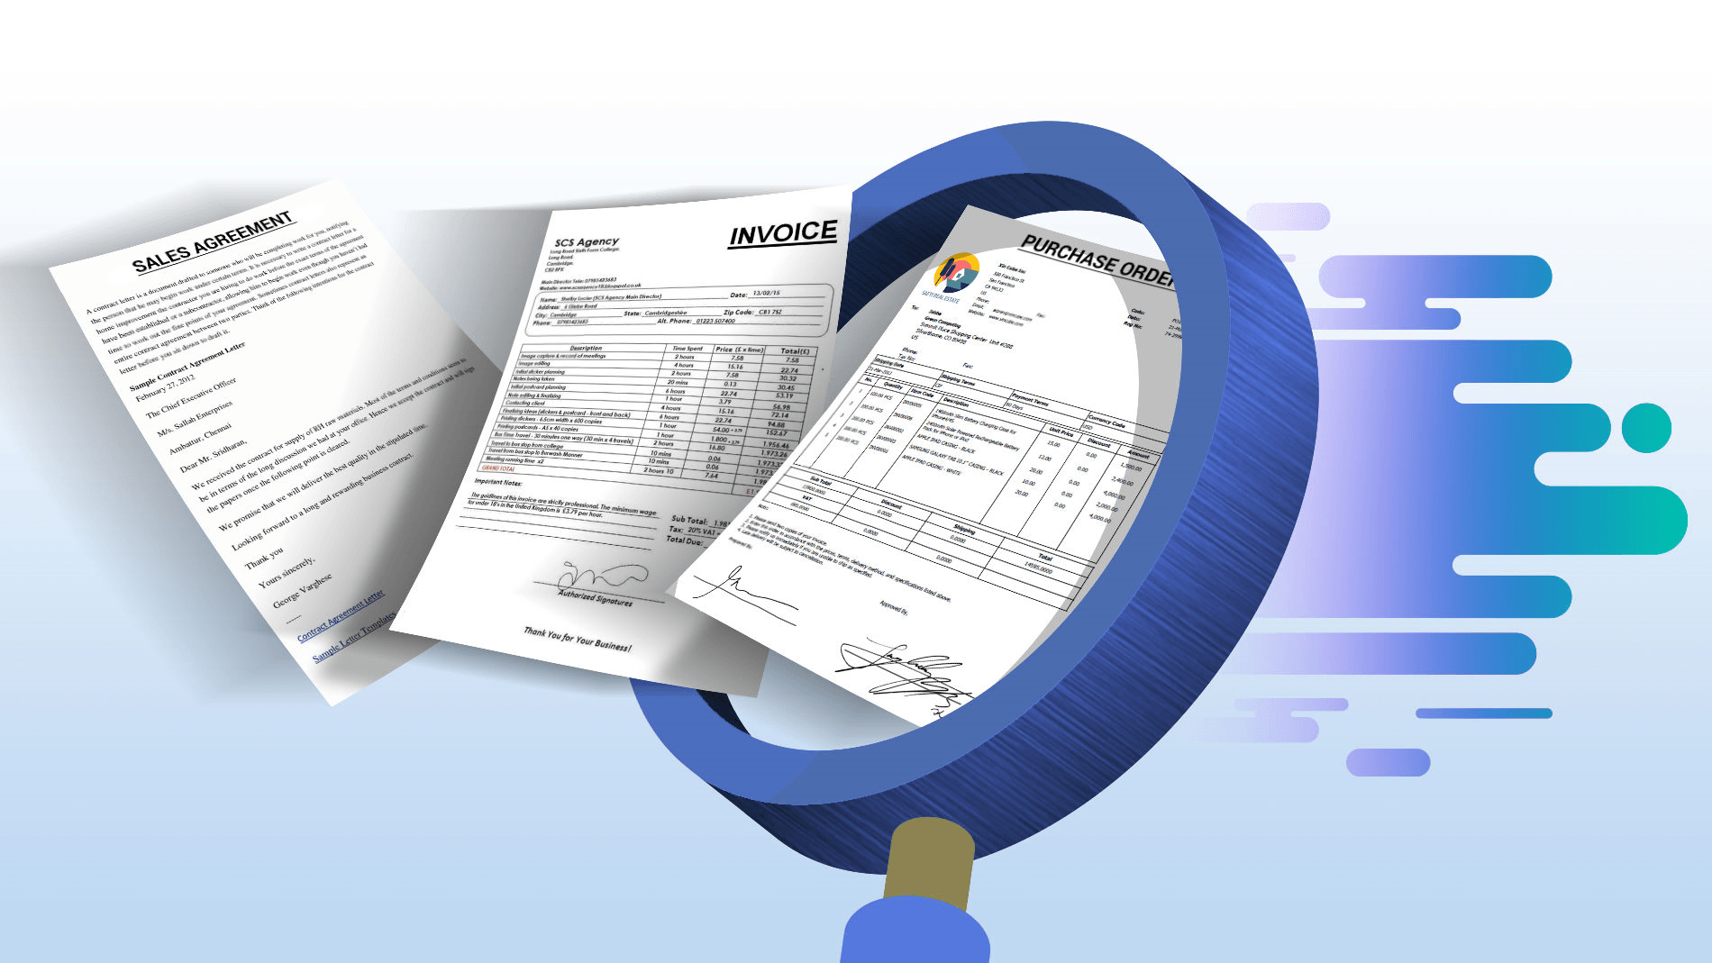

Document Use Workshop
SESSION 1
Interlake west centre

Slide 2
Thank you to our funders:
Workplace Education Manitoba would like to express appreciation to the following for supporting the development of this Continuous Learning Skills curriculum:
Employment and Social Development Canada (ERSDC) and
Manitoba Education and Training.
This project was jointly funded through Human Resources Skills Development Canada and Entrepreneurship Training and Trade.
For more information, visit www.wem.mb.ca or contact info@wem.mb.ca

Slide 3
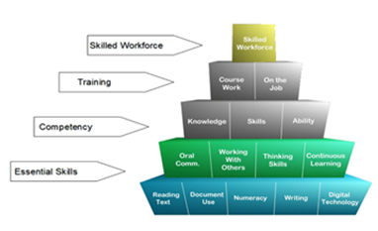
The Essential
Skills

Slide 4
Learning Outcomes
Demonstrate understanding of Document Use as an essential skill and how it applies in the workplace.
Navigate the document process in a step-by-step manner.
Recognize the importance of accurately entering and locating information in a variety of document templates such as forms, tables, lists and schedules.
Identify various symbols, signs and legend markers.
Recognize the importance of following instructions and reporting details in an objective fact-based manner

Slide 5

What to Expect from this Workshop
Gain familiarity with different types of documents.
Learn how to effectively navigate documents.
Look at how documents are organized.
Practice special reading skills such as skimming and scanning.
Learn about and practice filling in / completing documents with short and long responses.
Consider the effective organizing and designing of documents.

Slide 6
Introduction
A document is a written, printed, drawn, photographed or electronic piece of information that provides evidence or proof, and is viewed as an official record.
Examples of documents are drivers’ licence, passports, employment contracts, bills of sale, mortgage documents and the list goes on.
Documents are set up in structured templates, have exact wording and require factual information.
Legal documents are used as evidence to verify identity, credentials, education, ability, etc.
Workplace documents may be used in court and other legal situations to support or defend the organization’s position on legal matters.

Slide 7
Document Types
Documents are the medium for many workplace reading and writing tasks.
Document types include:
  Entry forms (fillable forms)
  Lists
  Graphs and charts
  Mimetic documents (drawings, diagrams, plans)
Documents can be paper based or digital.
Many workers will use documents in the course of their work:
  Retrieving information from a variety of forms, directories, maps, databases, code books, etc.
  Entering information in logbooks, entry forms, and computer terminals
What are some forms you have recently completed at work, school in community?

Slide 8

Document Use is on the Rise
Information exists in a variety of formats which use a combination of text, numbers, drawings and schematics.
The variety and complexity of documents is increasing as more information is gathered and used in work processes.

Slide 9
Document Use is on the Rise
Legislative requirements including safety are some common drivers of document collection in the workplace.
  Human resources – employee performance, hiring and promotion decisions, discipline and termination.
  Safety – safe work procedures
  Project management – planning and organizing, obtaining regulatory approval, scheduling
  Customer service – policies and procedures to meet customer needs, managing client/customer data
  Privacy and confidentiality – information gathered and maintained in a safe and responsible manner respecting privacy

Slide 10
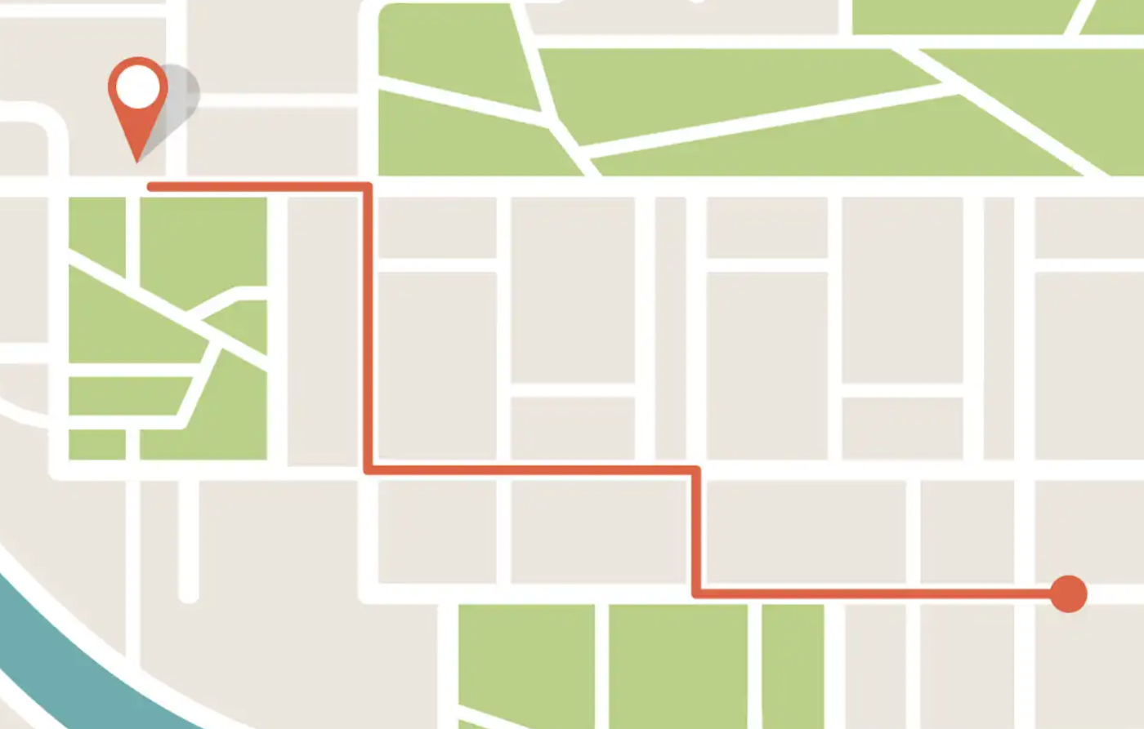
Document Navigation (page 4)
Being able to find your way around a document is called navigation.
Navigation is a process that allows the user to source out the information they need in a structured way.
There are four steps to effective document navigation:
Understand document structure
Skim
Scan
Use Information

Slide 11
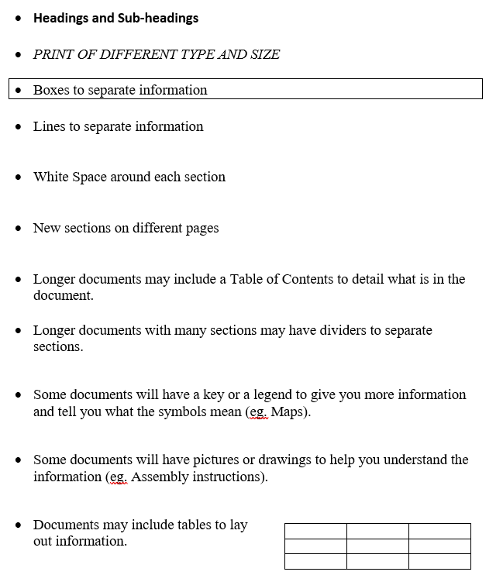
1. Understand Document Structure
Ideally, documents should be set up to make navigation by the reader as easy as possible – the goal is to help guide the reader to the information they need.
Some things you may see in a document to facilitate use by the reader/user are laid out on page 5 of your manual.
Notes:
Document Navigation Step #1

Slide 12
Activity: Sample Documents
Look at how each document is structured. See how the sections are separated and how the information is organized.
On page 6 of your student manual, answer the questions.
Refer to the four sample documents on pages 7 – 10.

Slide 13
2. Skimming
Looking over a document to get the main idea – a quick reading strategy.
Skimming involves reading some parts and missing others (e.g. flipping through a magazine).
When you skim, you should be reading 3 or 4 times faster than you do when reading word for word.
Some people skim by looking at the centre of the page while others skim by moving their eyes in an “S” pattern on the page.
Notes:
Document Navigation Step #2

Slide 14

2. Skimming
Good document structure can make skimming easier.
When skimming, consider things like:
  Title
  Headings
  Key words
  Charts, pictures, diagrams
As you are skimming consider the reason the document was created (the purpose) and who is expected to read/use it (the audience).

Slide 15
Activity 2: Skimming
Found on Page 11
Read the sample documents 1 – 4
Answer the questions

Slide 16
3. Scanning
Scanning is a kind of reading where you look for specific information. When you scan, you read some parts and miss or ignore others.
When you scan, you should ask yourself these questions:
What information do I need?
  What are the key words or phrases I can look for?
  In what section or on what page will I probably find this information?
  How will I know when I find the information?
Example: Looking through a chapter in a text book to find the answers to an assignment.
Notes:
Document Navigation Step #3

Slide 17
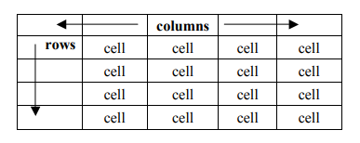
Scanning: Charts & Tables
A spreadsheet is information in the form of a table (aka grid).
Information is contained in columns and rows
Each space on the grid is called a cell
Cells contain data

Slide 18
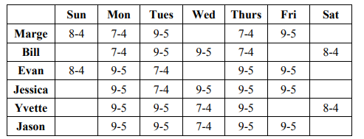
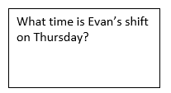
Example: Employee Shifts (p. 13)
9 - 5
Imagine you are Evan. You want to find out when you work on a Thursday.
Notes:
Place a finger from your left hand on your name (Evan)
Place a finger from your right hand on Thursday.
Move the finger on your left hand across the row.
Move the finger on your right hand down the column.
You will find the data you want where your two fingers meet.

Slide 19
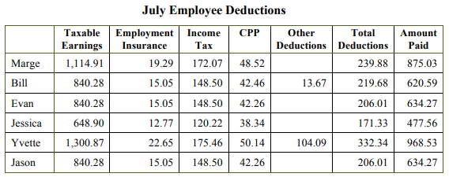
Activity 4 – Employee Deductions (p. 15)

Slide 20
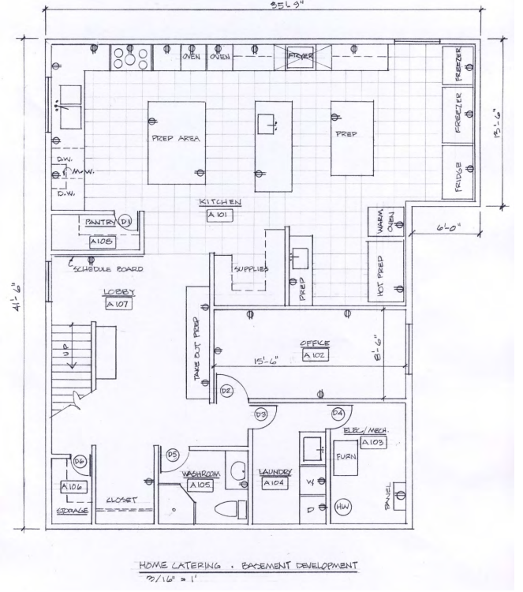
Scanning: Technical Drawings
Technical drawings are documents that are labeled. A floor plan is one type of technical drawing.
Numbers and symbols are keys to understanding information on this type of document.
Go to page 15 to complete Activity #5. The drawing you will refer to is on page 16.

Slide 21
4. Use Information
Ways in which you may use workplace documents:
  Read to locate information
  Complete forms with facts and figures
  Review information provided by others such as Supervisors, HR, co-workers, etc.
When you first start working with a document in the workplace, try to understand what its purpose is, the intended audience, why the data is being collected, and who else will be required to use this document or its data.
Note this information to increase your understanding of the broader process or procedure.
Notes:
Document Navigation Step #4

Slide 22
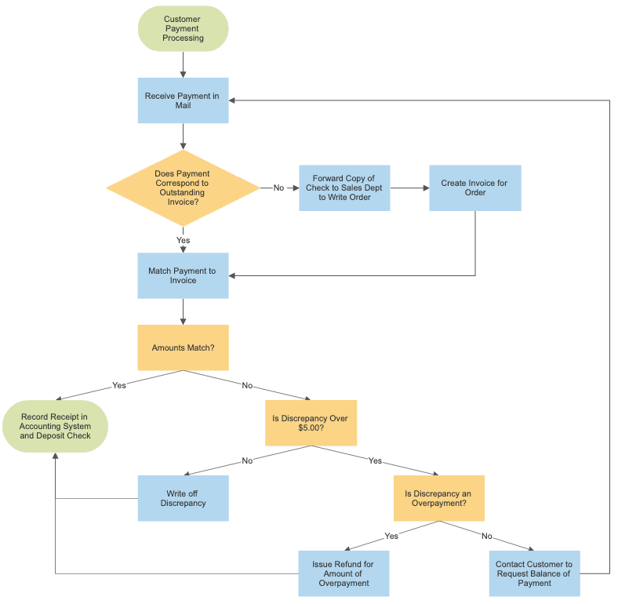
Flowchart
Lays out a process in graphical form.

Slide 23
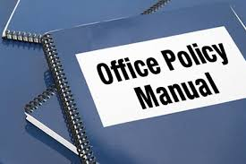
Policies and Procedures
Policies
  Policies are organization’s written guidelines for what to do in certain situations and can range across all business areas. Some common policy areas include risk management, finance, communications and human resources.
WHO WHAT WHERE WHEN WHY
HOW
Procedures
  Procedures are the step by step instructions for carrying out the policies.

Slide 24
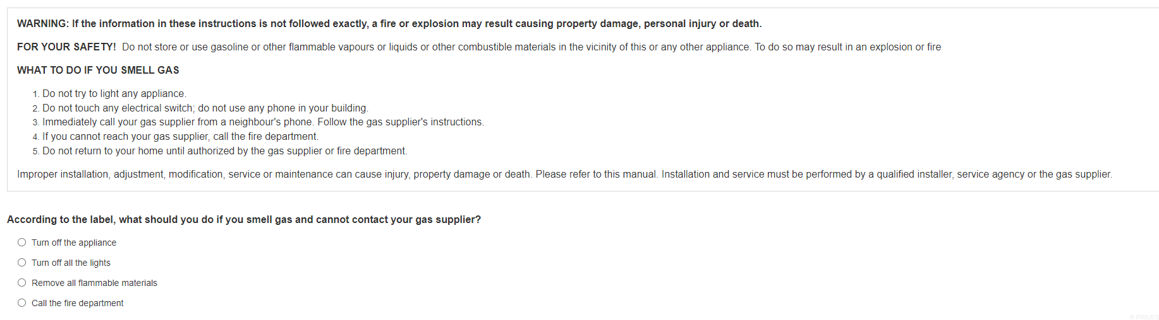
Multiple Choice Tests
You may encounter tests designed to assess specific skills such as reading comprehension or numeracy.
Test takers may be presented with a paragraph, drawing or some information followed by a question and several possible answers.

Slide 25
Strategies for MC Tests
On your first pass through the test, don’t guess on questions. Answer questions you know, mark the ones you don’t know or are unsure of – come back to them later
Look at the answers first to know what information you are trying to find in the passage / drawing
Eliminate answers you believe are likely to be untrue
Skim the passage to get a quick idea of what it is about
Scan the passage to find the information needed to answer the question
Manage your time – ensure you know how much time you have and estimate your half-way point
Go back through the questions for those that you were unable to answer initially – if you are still not certain of the answer, make your best guess

Slide 26
Reading Comprehension Tips
Integrate Prior Knowledge – think about wha you already know about the topic. Identify personal experiences or second-hand knowledge that relates to the topic.
Preview the text – give an initial glance, read the topic sentence and then try to predict an answer (mentally try filling in the blank). Then read the full text before answering. Was your initial prediction correct?
Connections – what’s the key idea? Read all the topic sentences first on the page. Look for key words and phrases that supportthe topic sentence.
Self-monitor – Get your rest. Turn off cell phone. Stretch. Drink water. Be comfortable. Pay attention to the test, not what’s your next agenda item for the day.
Source: Red River College Degrees of Reading Power Workshop

Slide 27
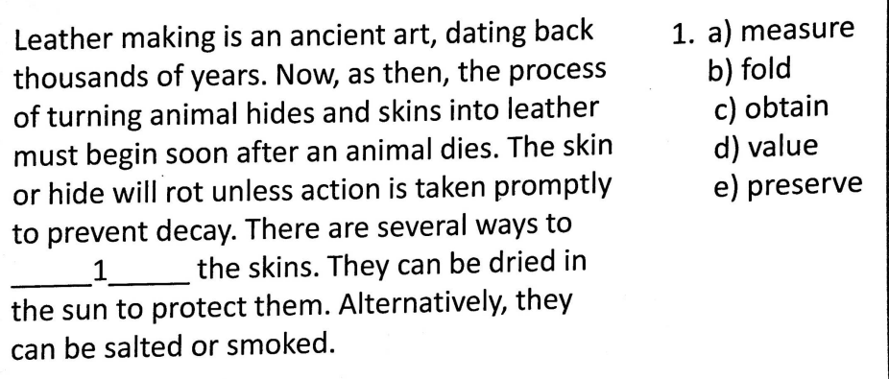
Reading Comprehension Test - Sample
____1_____
Preserve

Slide 28
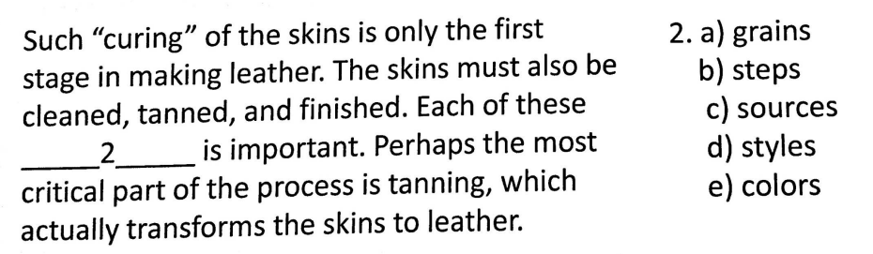
Reading Comprehension Test - Sample
______2_______
Steps

Slide 29
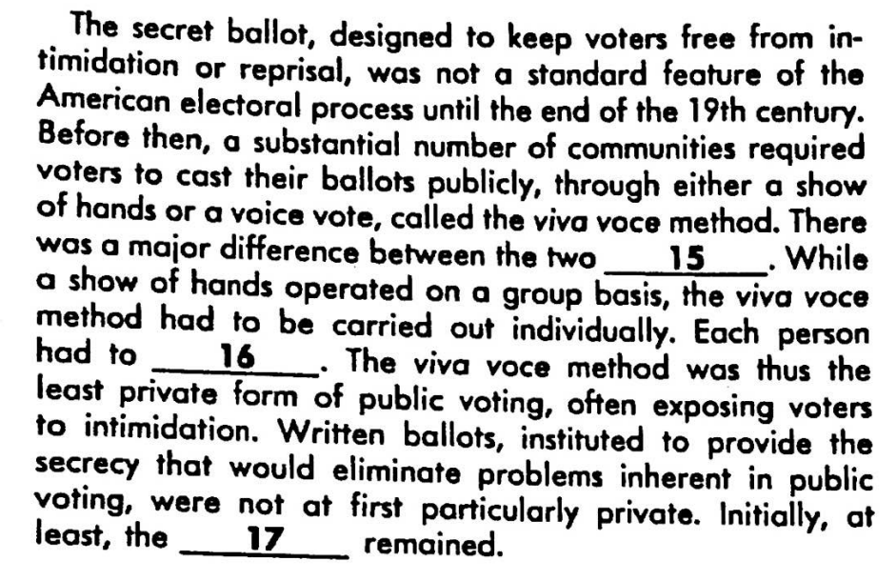
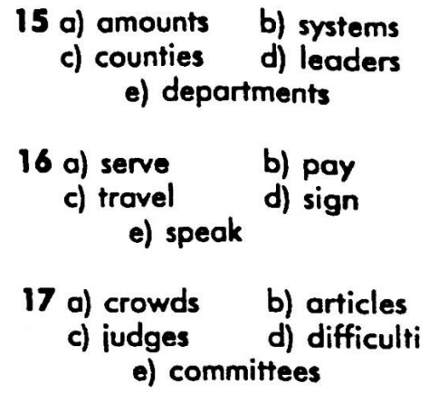
Reading Comprehension Test - Sample
systems
____15_____
speak
____16_____
es
difficulties
____17_____

Slide 30
Session 1: Summary
A document is a written, printed, drawn, photographed or electronic piece of information that provides evidence or proof, and is viewed as an official record.
Documents are set up in structured templates, have exact wording and require factual information.
Different types of workplace documents include:
  Entry forms (fillable forms)
  Lists
  Graphs and charts
  Mimetic documents (drawings, diagrams, plans)

Slide 31
Session 1: Summary
Document use is on the rise as we try to manage more and more information, make business decisions, support business goals, meet customer needs, meet regulatory and legislative requirements, etc.
Being able to find your way around a document is called navigation - allows the user to source out the information they need in a structured way.
4 Steps:
  Understand document structure – titles, headings, tables, charts, instructions
  Skim – looking over the document to get a general idea, seek out key words
  Scan – looking over the document for specific information
  Use Information

Slide 32
Next Class:
Lists
Completing Entry Forms
Graphs and Charts
Drawing, diagrams and plans

