Slide 1
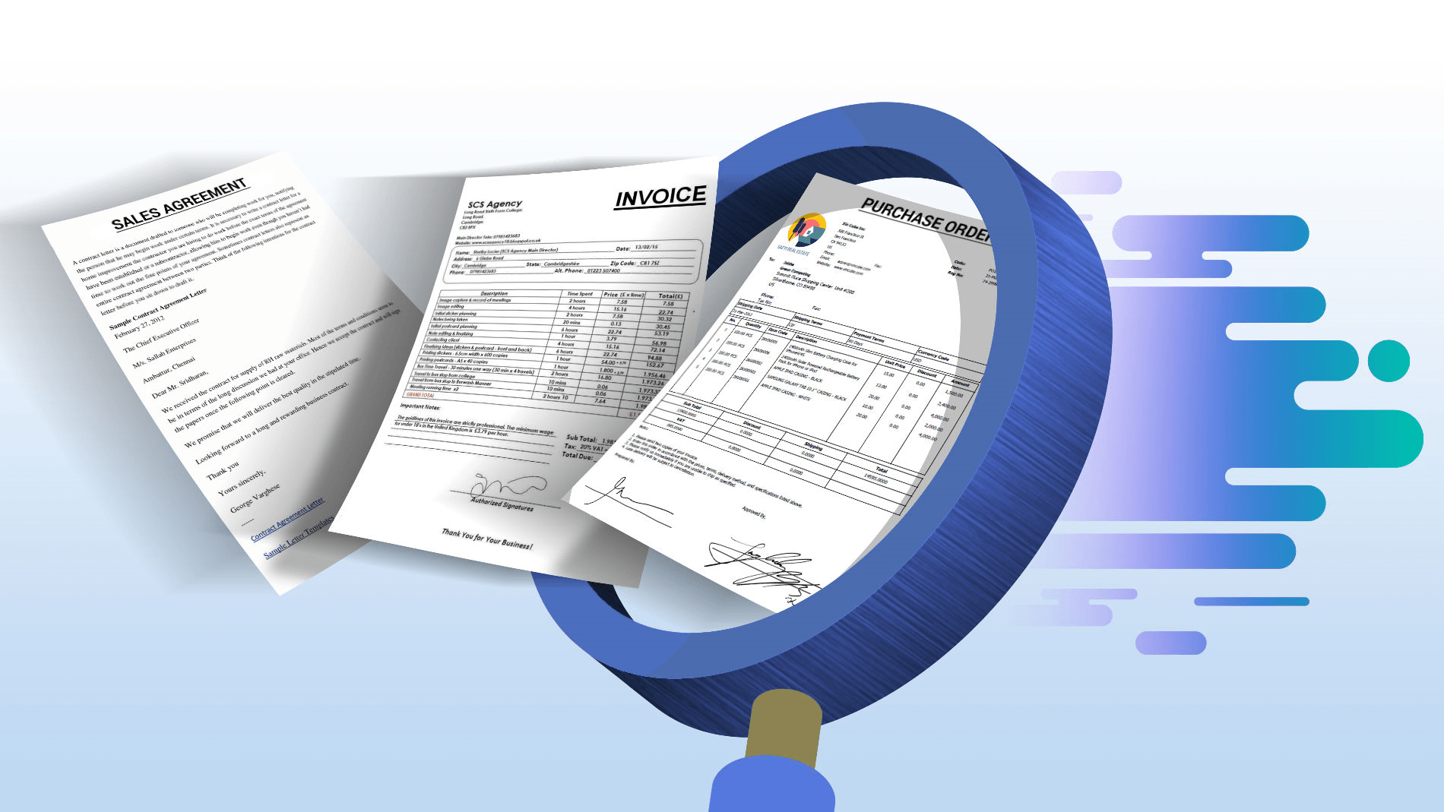

Document Use Workshop
SESSION 2
Interlake west centre

Slide 2
Learning Outcomes
Demonstrate understanding of Document Use as an essential skill and how it applies in the workplace.
Navigate the document process in a step-by-step manner.
Recognize the importance of accurately entering and locating information in a variety of document templates such as forms, tables, lists and schedules.
Identify various symbols, signs and legend markers.
Recognize the importance of following instructions and reporting details in an objective fact-based manner

Slide 3

Review from Session 1
A document is a written, printed, drawn, photographed or electronic piece of information that provides evidence or proof and viewed as an official record.
Documents are also used by workers to find information needed to get their jobs done, and for the collection and reporting of information needed elsewhere in the work process.
Some common types of documents: lists, entry forms, graphs & charts, mimetic documents such as drawings, diagrams and plans.

Slide 4
Review from Session 1
Document Navigation
  Understand document structure
    Headings, white space, lines, boxes, pictures and drawings, tables
  Skim
    Type of reading where you look over the document to get the main idea
    Read parts and miss others
  Scan
    Type of reading where you look for specific information
    Read parts and miss or ignore others
  Use Information
    Understand what information you need from the document
    Some documents require you to complete with fact and figures that you know
    Understand the overall process that the document is included in – why is the information collected and used?

Slide 5

Lists
Lists are the “building blocks” of documents
Used to organize information to make it easier for users to understand, identify and analyze.
In school you might have learned about putting information in lists alphabetically or chronologically.
What are some lists you can think of?

Slide 6
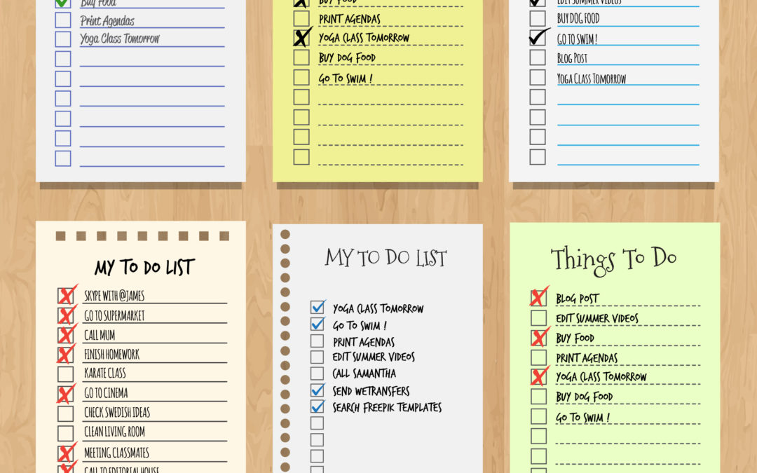
Lists
To do list
Countries from richest to poorest
Provinces with highest vaccine rates
Shopping list
Courses required in a diploma program
Table of contents
Checklists

Slide 7
Types of Lists
Simple lists
Combined lists
Intersecting lists

Slide 8
Simple Lists
Series of items which are related in some way.
Title of the list usually indicates the nature of that relationship.
All the items in the list have one shared feature – usually the shared feature is the reason they have been grouped into a list (eg employees, groceries, equipment).
Each item in a well-formed list must be equivalent to the next. All items in the list must be the same type of example.
Lists can be laid out vertically or horizontally.
Items in the list may be organized according to a particular convention (most important to least important, alphabetical, chronological, etc.)

Slide 9
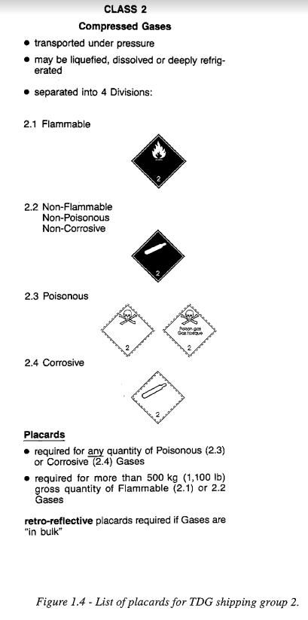
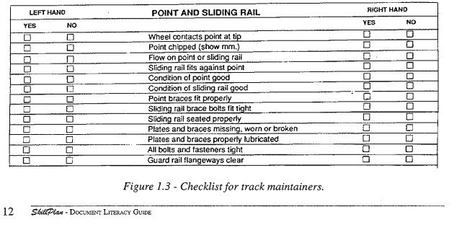
Workplace Examples

Slide 10
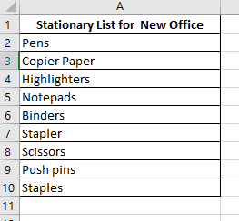
Workplace Examples

Slide 11
Combined Lists
When two or more simple lists are combined, the resulting document is recognizable as a table.
A table displays information in columns and rows and can be used to present data / information or can be an entry form which users will enter data or information.
Examples of combined lists might be an inventory sheet that shows the items by quantity and price.
Combined lists provide more information than separate lists alone.
Items in combined lists or tables may be organized by a common convention (e.g. alphabetically, chronologically, etc.)

Slide 12
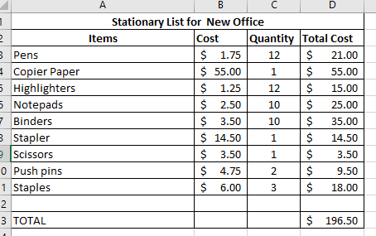
Workplace Examples
Price List
Stationery List

Slide 13

Activity: Create a Combined List
Create a combined list using the information provided in the learner’s manual (page 7)

Slide 14
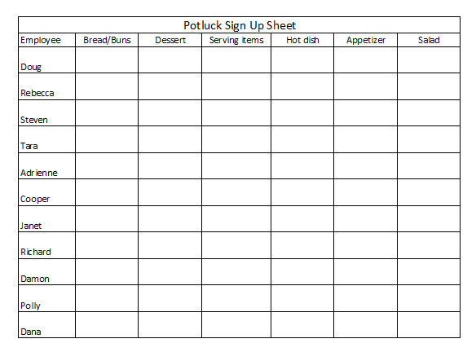
Activity: Possible Solution
Combined List – Part 1

Slide 15
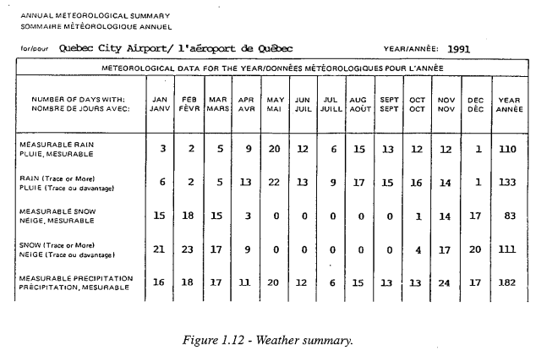
Intersecting Lists
An intersecting list consists of three related lists.
Both axes of the intersecting list are searched to match search terms and find information in the third list.
Required information is found at the intersection of the two search lists.
Two of these lists are arrayed along the horizontal and vertical axes.
List in vertical axis is weather conditions – no particular order
List on horizontal axis is months of the year – in time order
Intersection is the measure of the weather condition for a specific month

Slide 16
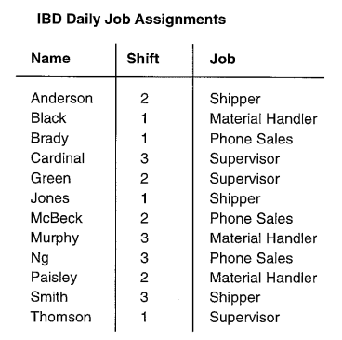
Intersecting List Example
Page 8 – Judy, Office Manager for IBD is responsible for setting the shift schedule for the shipping office.

Slide 17
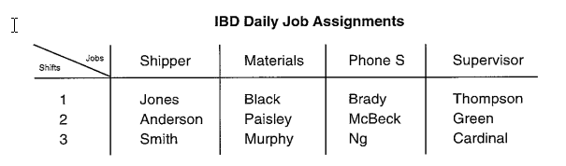
Intersecting List Example
Use and Intersecting List to better display this information.

Slide 18
Activity: Create an Intersecting List
Activity on page 9
Using the combined list you created in the last activity, now convert it to an intersecting list by adding information that connects the horizontal axis (item categories) with the vertical axis (staff members)
Imagine you have been told that Dana is going to bring dinner rolls, Tara is bringing perogies and Polly is bringing Caesar salad. Update your table with this information.

Slide 19
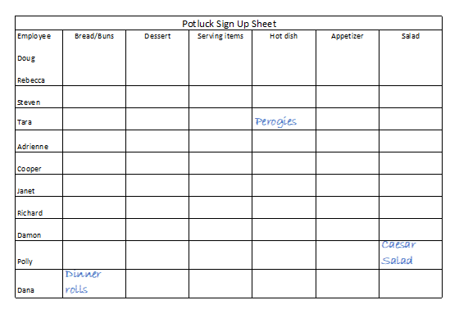
Activity: Possible Solution
Intersecting List

Slide 20
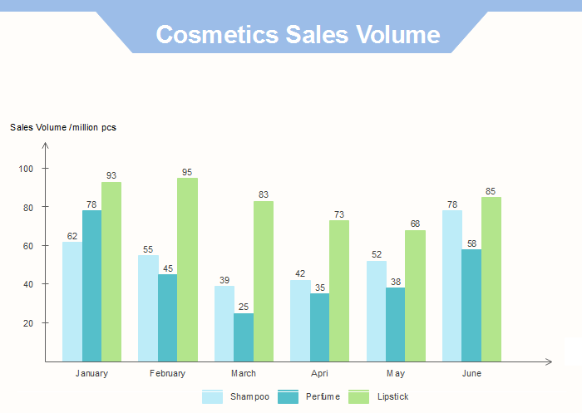
Charts and Graphs
Graphs are a way of summarizing numerical data and displaying information quickly.
Graphs are used in a wide variety of work settings by workers in many different occupations:
A store manager compares last year’s sales figures to this year’s to find out whether sales are up or down.
A hospital administrator reviews trends in emergency room admittance rates to understand how new policies may affect patient care.
A machinist compares graphs that record machining output to learn when parts are machined outside acceptable tolerances.

Slide 21
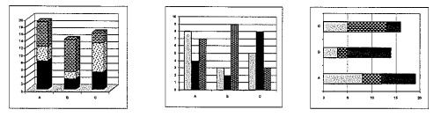
Common Charts – Bar Charts
Bar Graphs represent amounts. Typically display several bars so workers can compare numbers across different categories. The length of each bar represents a quantity. When read together the bars show how quantities relate to eachother.
Some uses:
  Display the dollar value of sales in different months in the sales and services sector.
  Show how much was produced in a manufacturing setting.
  Bar charts can extend vertically (up and down) or horizontally (sideways)

Slide 22
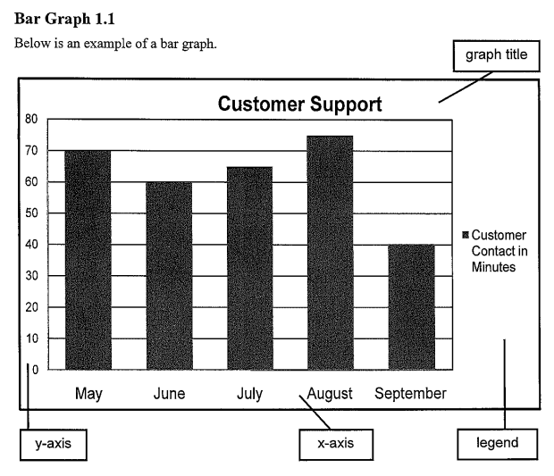
Reading Bar Charts
  Scan the graph to locate the title.
  Locate the y-axis (vertical) and the x-axis (horizontal).
  Locate the legend to identify categories or subcategories for the graph.
  Identify any additional information, such as data labels, found in the graph.
  Activity → Practice reading a bar chart (page 10)

Slide 23
Common Charts – Pie Charts
Pie charts are mainly used to represent proportions (parts) or percentages. The circle represents the whole and the proportion or parts of the whole are represented as pieces or segments of the pie or circle.
Some workplace situations where you may encounter pie charts are:
Sales associates read pie charts to see which products consumers buy most.
Administrative assistants create pie charts to show the proportion of time they spend completing different activities each day.

Slide 24
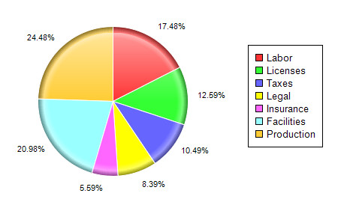
Reading Pie Charts
Scan the pie chart to identify the title.
Locate the legend, if presented, to identify the categories displayed.
Examine the sections of the circle to identify any additional information contained in the chart. In some cases, the data labels for the segments of the circle contain a great deal of information. Any combination of the following can be included: percentage, number or category name.
Activity → Practice reading a pie chart (page. 13)
THERE ARE ADDITIONAL PRACTICE ACTIVITIES FOR YOUR USE FOLLOWING THIS SESSION (pp 15 – 17)

Slide 25
Session 2: Summary
Lists are the “building blocks” of documents
Used to organize information to make it easier for users to understand, identify and analyze.
We looked at 3 different types of lists: simple, combined and intersecting.
Graphs are a way of summarizing numerical data and displaying information quickly.
We looked at 2 different types of charts: bar charts and pie charts
Some strategies for reading charts include examining:
  Title
  Labels
  Legends
  Chart parts (axes, segments, etc.)

Slide 26

Next Class:
Entry forms
Mimetic Documents (drawings, blueprints, schematics, diagrams)
Document reading skills

