Slide 1
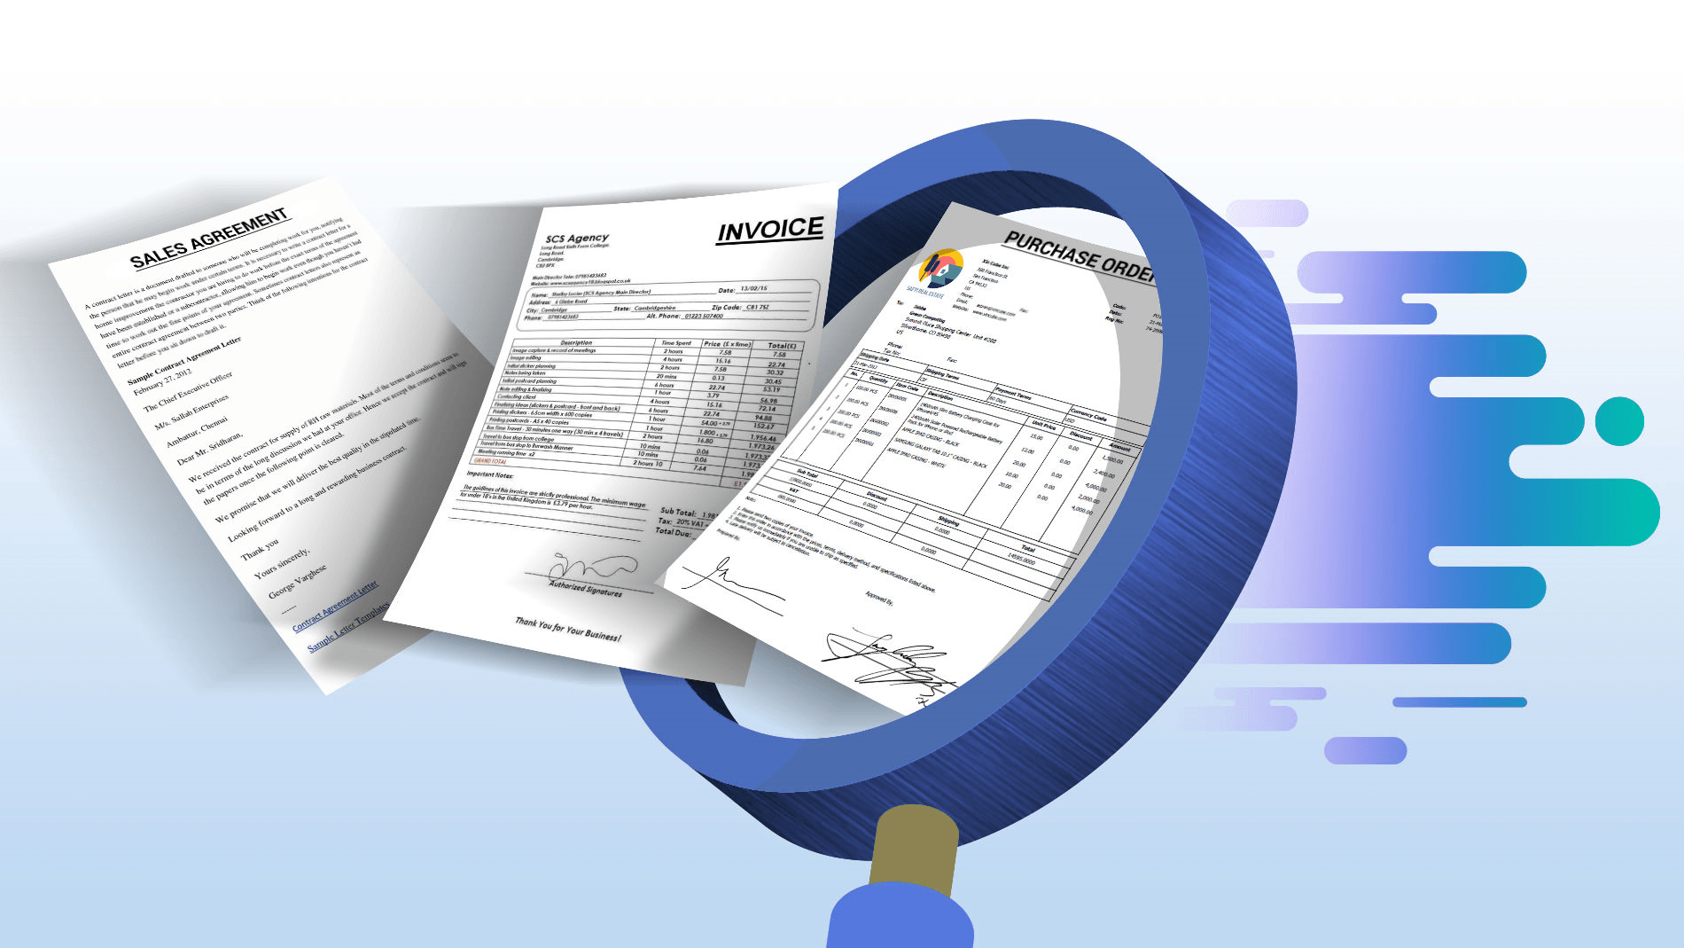

Document Use Workshop
Session 3
Interlake west centre

Slide 2
Learning Outcomes
Demonstrate understanding of Document Use as an essential skill and how it applies in the workplace.
Navigate the document process in a step-by-step manner.
Recognize the importance of accurately entering and locating information in a variety of document templates such as forms, tables, lists and schedules.
Identify various symbols, signs and legend markers.
Recognize the importance of following instructions and reporting details in an objective fact-based manner

Slide 3
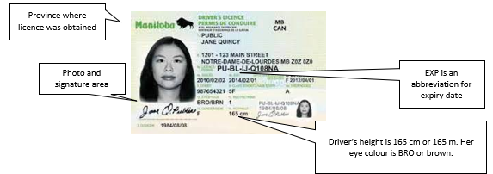
Different Types of Forms
Driver’s Licence

Slide 4
Strategies for Completing Entry Forms
Read the whole form through to understand what it is asking for.
Be sure you understand what is being requested.
Give thought to why this data is being collected and how it will be used (ask the requestor)
Take your time completing it.
Check over for completion.

Slide 5
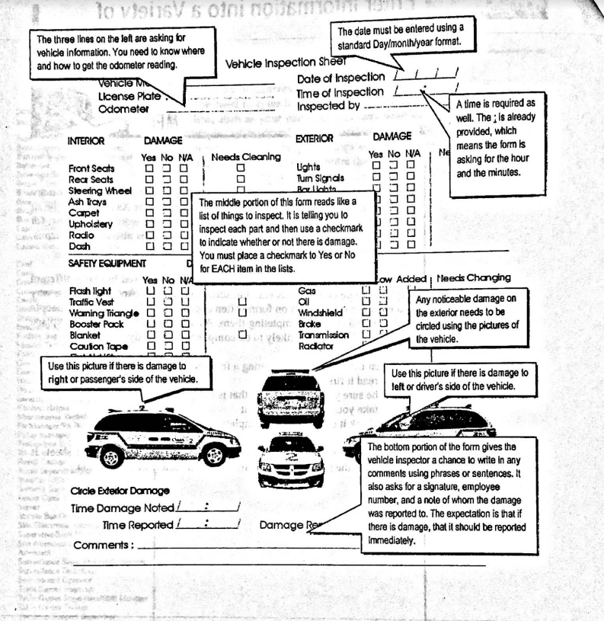
Example: Vehicle Inspection Form (page4)

Slide 6
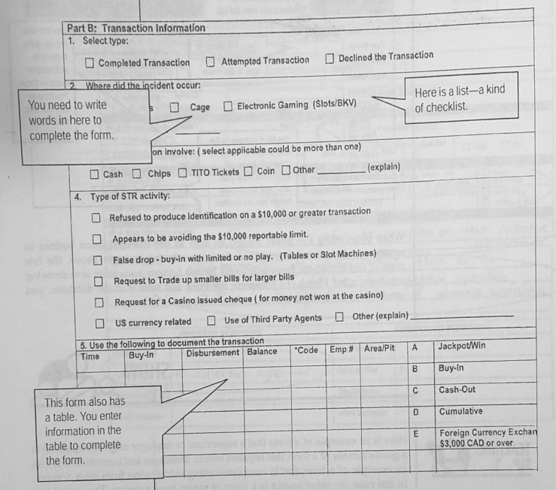
Breaking Forms Down
Page 5
Another strategy to understanding a form and what it is asking for is to break it down into sections.
Look at each section to see what information is being requested.

Slide 7
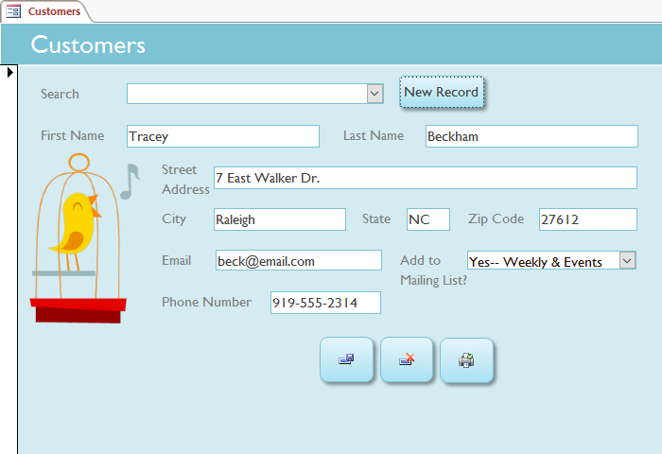
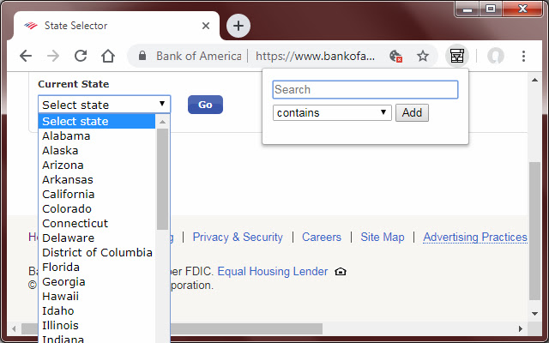
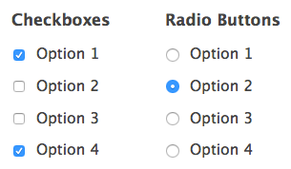
Electronic Forms
Forms can be electronic.
Data entered into a form is collected in a database.
A record is a collection of fields (e.g. name, address, date, etc.)
Databases are made up of records.
Data can be “queried” or reported

Slide 8
Practice Time!

Slide 9

Next Class:
Identify various symbols, signs and legend markers
Following instructions
Document reading strategies

