Slide 1

LIFT to Work Program

Slide 2
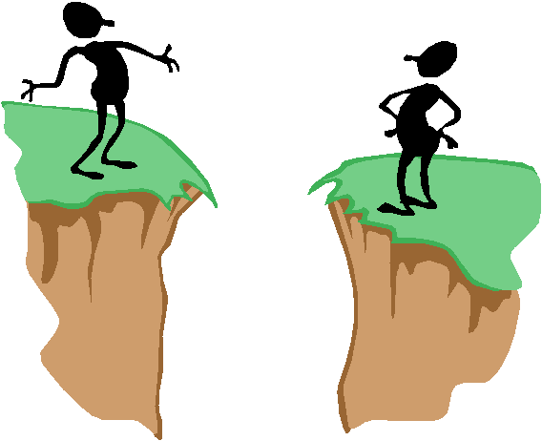
TEAM WORK SKILLS

Slide 3
OVERVIEW
RATIONALE: In today’s work force employees need the skills to participate in group projects to complete the required work
OBJECTIVE: to introduce the concept of team work and enhance the learners’ understanding of what is meant by team work
PROCESS: Small group tasks, de-briefs, and reflections, as well as mini-lectures

Slide 4
TEAM WORK TASK #1
2 Truths and a lie
On slip of paper write down 3 amazing “facts” about your self- 2 true and 1 not true
Find a classmate you don’t know and share your “facts”
Classmate asks questions to determine which fact is not true and then guesses what “fact’ is not true
Reverse roles and repeat

Slide 5
INTRODUCTIONS
Introduce your class mate by telling the 2 amazing facts about them.
Call for a volunteer to name (by first name) all the members of the class.

Slide 6

TEAM WORK TASK #2
PAPER BALL CONTEST
Have volunteer demonstrate the proper technique in throwing a paper ball over hand.
Learners observe demonstration, noting key points of the technique
Pair up with a learner with whom you have not worked
One member of the pair is “A” and the other “B”
“A” will be the coach; “B” will the athlete
The coach will instruct the athlete on how to throw the paper ball with their not dominate arm
Reverse roles and repeat
Compete in trash can competition

Slide 7

DE-BRIEF #1
When you were the athlete, what did the coach do to improve your understanding & performance?
When you were the coach, what did the athlete do to make your job easier?
How do these learners apply to our work as class mates? Employees?

Slide 8
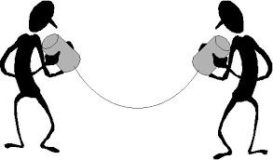
TEAM WORK
ACTIVE LISTENING:
Hear- focus on the message (avoid interrupting), while showing interest
Interpret- check for understanding by summarizing the message or asking a question
Reflect- think about the what you have heard- do you need more information
Respond- show you have understood the message by paraphrasing the conversation

Slide 9
TEAM WORK TASK #3
PRACTICING ACTIVE LISTENING:
Form new pairs
One person in the pair be “A”, the other “B”
“A” describes the scene on the slide in detail
“B” listens intently, asking questions of clarification
“B” summarizes what they think they heard
Compare summary with scene on the slide
Exchange roles & repeat with new slide

Slide 10
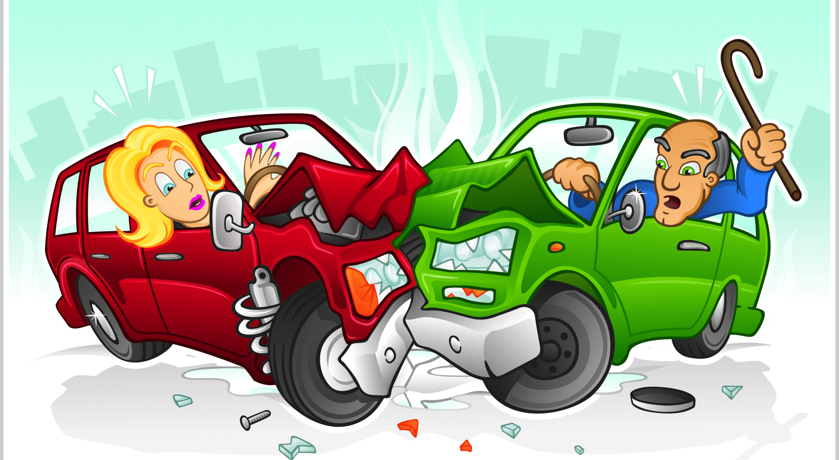
TEAM WORK TASK #3

Slide 11
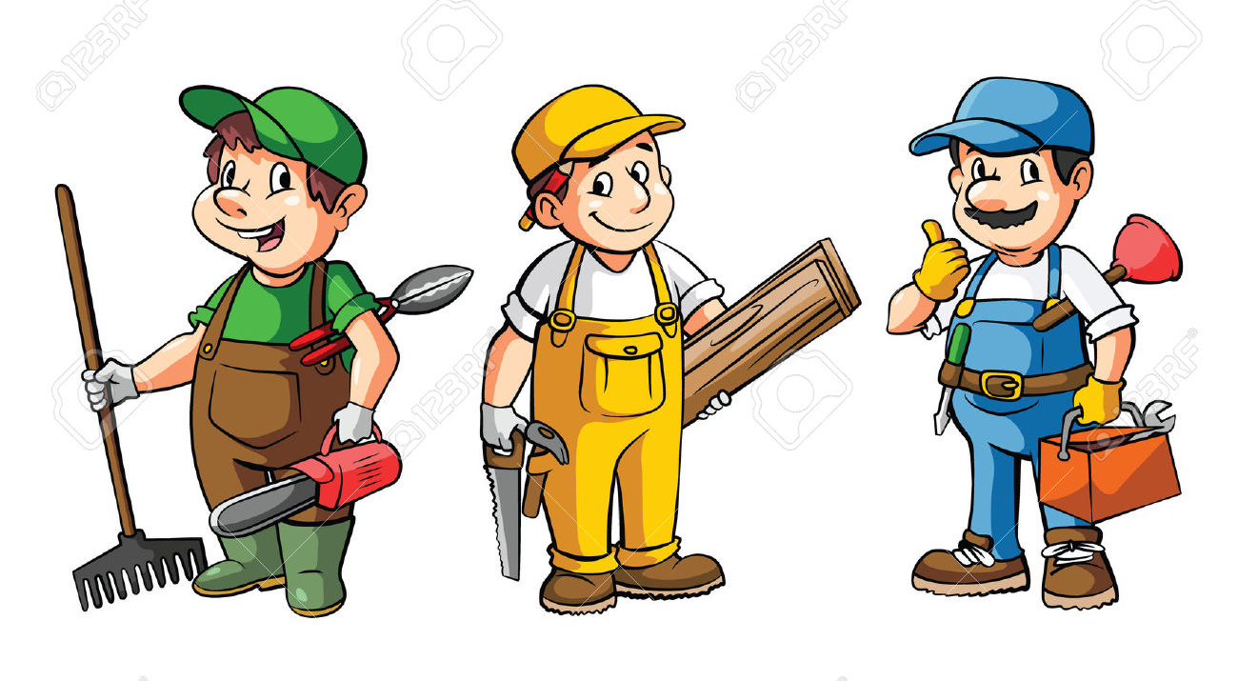
TEAM WORK TASK #3

Slide 12
TEAM WORK TASK # 4
PRACTISING ACTIVE LISTENING
Form new pairs
One person in the pair be “A”, the other “B”
“B” SUMMARIZES the instructions
“A” listens intently & may ask 2 questions
“B” paraphrases what they think they heard
Compare paraphrase with the instructions
Exchange roles & repeat with new slide

Slide 13
TEAM WORK TASK #4
Preheat oven 350 degrees F (175 degrees C).
Cream together the butter, white sugar, and brown sugar until smooth.
Beat in the 2 eggs one at a time, then stir in the vanilla.
Dissolve baking soda in hot water & add to mix
Bake for about 10 minutes in the preheated oven, or until edges are nicely browned

Slide 14
TEAM WORK TASK #4
Squeeze about 4 ounces of glue into a glass bowl.
Mix in 1 1/2 bottles of warm water.
Add your food coloring, if desired.
Mix 1 teaspoon of Borax into 1/2 cup of water, & slowly add the solution to the glue mixture.
Stir in the Borax solution until the slime started to come together.
Knead the Flubber.

Slide 15
DE-BRIEF # 2
How did it feel to be the speaker?
How did it feel to be the listener?
How does communications relate to being part of a team?
How does being able to communicate relate to work?
Things related to communication/ team work you wish to enhance during the training?

