Slide 1

OAK TREE
STRONG
RIGID
RESISTS CHANGE
“I won’t let this happen to me!”

Slide 2
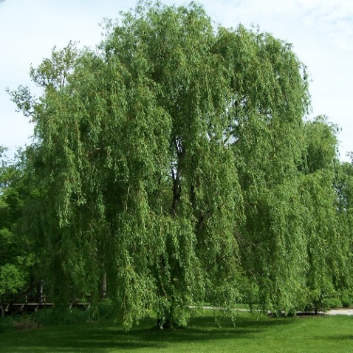
WILLOW TREE
FLEXIBLE
ADAPTS TO CHANGE
WILLING TO CONSIDER OPTIONS
“How can I make this change work well for positive outcomes?”

Slide 3
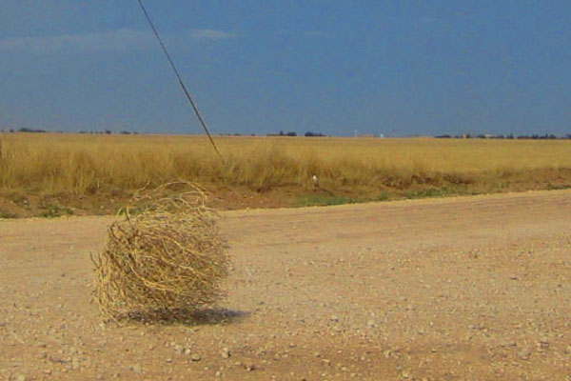
TUMBLEWEED
SHORT-LIVED
ROOTLESS
MOVES CONSTANTLY
“This isn’t fun anymore…I’m out of here.”

Slide 4
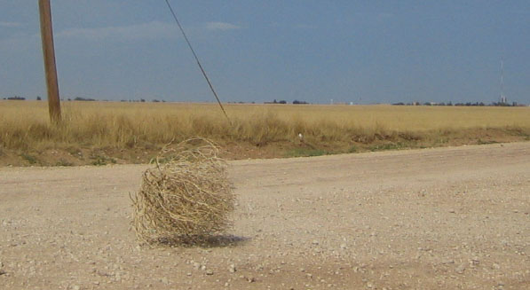
When dealing with change which response style is your immediate “go to”?
Does this immediate response benefit you?
Each situation needs to be thoughtfully considered and a response style chosen that best suits the positive outcome that you desire.

