Slide 1

LIFT
Local Initiative For Transition to Work
WORKSHOP: Success in the Workplace

Slide 2
OVERVIEW
RATIONALE- Getting a job is just the start. You must work to keep the job and to build your career.
OBJECTIVES- To understand:
The 5 rules for starting your job right
What is meant by workplace culture
How we learn the unwritten rule of the job
The role that attitude plays in you being successful on the job
What to do when things go wrong
The types of workplace problems & how they could be resolved
The role communications plays in being successful in the workplace
The 4 stages of development in a new job
PROCESS- Mini-lectures, small group, and individual tasks

Slide 3

SUCCESS IN
THE WORKPLACE
DEFINITIONS OF SUCCESS
Doing the least amount of work for the most money
Success is spending the majority of my time focused on work or tasks that are fulfilling, maximizing my potential and helping other people
Making a living that provides me the freedom, lifestyle, and experiences that I desire
Professional success can be defined by everything you do at work that makes you happy.
Personal success can be defined by everything you do outside of the workplace that makes you happy.
Success means to have a goal, plan the steps to achieve the goal, implement the plan, and finally achieve the goal

Slide 4

SUCCESS IN
THE WORKPLACE
DISCUSSION
Share times in your life when you have experienced success at work, in school, at home, or with your friends and family.

Slide 5

SUCCESS IN
THE WORKPLACE
INDIVIDUAL TASK:
Skim the article entitled “Five Rules for Starting your Job Right” (Task #1) and highlight the headings and subheadings.
Scan the body of the article highlighting the words that summarize each rule

Slide 6

SUCCESS IN
THE WORKPLACE
SMALL GROUP TASK:
In your group summarize your assigned rule/s into one sentence.
Write sentence/s on flip chart paper
Each small group will present their summarize/s to the group

Slide 7


SUCCESS IN
THE WORKPLACE
DISCUSSION:
How do both the employer and the employee benefit when the employee follows these rules.

Slide 8

SUCCESS IN
THE WORKPLACE
INDIVIDUAL TASK:
Skim and scan your assigned situation (Task #2)
Read the instructions and complete the task for your assigned situation

Slide 9


SUCCESS IN
THE WORKPLACE
PAIRS TASK:
Pair up with another learner and take turns summarizing your assigned situation and explaining what rules are in play.

Slide 10


SUCCESS IN
THE WORKPLACE
DE-BRIEF:
What rule is most important?
What rule do you do most naturally?
What rule is the most difficult to follow?

Slide 11


SUCCESS IN
THE WORKPLACE
INDIVIDUAL REFLECTION:
Complete Task #3 by responding to the questions related to the 5 rules.

Slide 12

SUCCESS IN
THE WORKPLACE
DEFINITION OF WORKPLACE CULTURE:
Workplace culture is the environment in which people work. ... It is the mix of the organization's power structure, rules leadership style, values, traditions, beliefs, interactions, accepted practices/ behaviours and attitudes that contribute to the social, emotional and relational environment of your workplace.

Slide 13
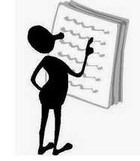
SUCCESS IN
THE WORKPLACE
INDIVIDUAL TASK:
Skim the article entitled “Understanding Workplace Culture” (Task #4) and highlight the title. What does the title mean?
Scan the body of the article highlighting the words that summarize the key points.

Slide 14
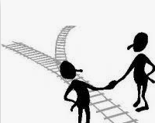
SUCCESS IN
THE WORKPLACE
SMALL GROUP TASK:
In your group list, on flip chart, the things that affect the culture of the workplace:
CULTURE

Slide 15

SUCCESS IN
THE WORKPLACE
DISCUSSION:
After posting flip chart papers, have the learners walk around and view the other poster- starring the key points on each poster.
Discuss with the group what is meant by culture?

Slide 16


SUCCESS IN
THE WORKPLACE
INDIVIDUAL TASK:
Complete Task #5.
Share and discuss with the group one written rule you learned in the workplace

Slide 17


SUCCESS IN
THE WORKPLACE
DEFINITION OF ATTITUDE
The definition of an attitude is a way of feeling or acting toward a person, thing or situation. Passion for a sport, dislike for a certain actor and negativity toward life in general are each an example of an attitude.

Slide 18
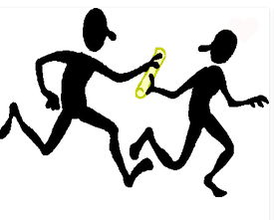
SUCCESS IN
THE WORKPLACE
PAIRS TASK
Complete Task #6 by yourself
Pair up and share your answers.
What negative thoughts did you uncover?
How do you protect from these negative thoughts affecting your work?

Slide 19

SUCCESS IN
THE WORKPLACE
INDIVIDUAL TASK
Skim and scan the article “When things go wrong at work” (Task #7).

Slide 20
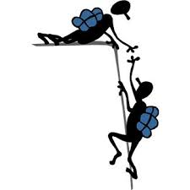
SUCCESS IN
THE WORKPLACE
GROUP TASK
Individually complete your assigned situation (Task #8).
Pair up with another learner and share your situation and labeling of the situation.
Repeat step #2

Slide 21

SUCCESS IN
THE WORKPLACE
DE-BRIEF:
For your assigned situation, how did you classify the problem? Why?
Did you feel it was better to solve informally or formally? Why?
What could be some common problems?

Slide 22
SUCCESS IN
THE WORKPLACE
DEFINITION OF COMMUNCATION
The imparting or exchanging of information verbally. The exchange includes the tone of the voice, facial expression, body language and the words chosen to express the information. 90% of the message is conveyed in these 4 items.

Slide 23

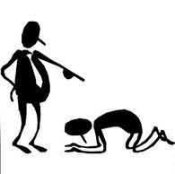
SUCCESS IN
THE WORKPLACE
INDIVIDUAL TASK:
Complete Task #9 individually
Share your positive re-phrasing
So what is important when we communicate?

Slide 24


SUCCESS IN
THE WORKPLACE
INDIVIDUAL TASK
Assess your attitude by completing Task #10

Slide 25

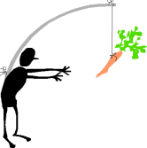
SUCCESS IN
THE WORKPLACE
STAGES OF EMPLOYMENT |  |  | STAGE 4 BUY IN
 |  | STAGE 3 BUYERS’ REMORSE
 | STAGE 2 INITIATION
STAGE 1 HONEYMOON

Slide 26


SUCCESS IN
THE WORKPLACE
INDIVIDUAL TASK
Complete Task #11, individually

Slide 27

SUCCESS IN
THE WORKPLACE
DE-BRIEF:
To be successful, what do you need to do in:
Stage 1- Honeymoon
Stage 2- Initiation
Stage 3- Buyers’ remorse
Stage 4- Buy in

