Slide 1

LIFT to Work Program

Slide 2

WORKING AS A TEAM

Slide 3
OVERVIEW
RATIONALE: Team work does not just happen, individuals need to understand the concept of team work and what they need to do to be a good team member.
OBJECTIVE: To understand some of the skills required to be a good team member
PROCESS: Small group tasks, de-briefs, and reflections, as well as mini-lectures

Slide 4

GOOD TEAM MEMBER
INDIVIDUAL TASK
Read your assigned quote that describes a facet of team work.
Paraphrase the meaning of the quote
Think of an example from your life that illustrates the meaning of the quote (either positively or negatively)

Slide 5

GOOD TEAM MEMBER
PAIRS TASK
Pair up with another learner with a same coloured card
Read your quote and provide your paraphrase that explains the meaning of the quote
Have your partner do the same
After hearing both quotes and paraphrases discuss how the the quotes are similar or different
Create a summary that combines both quotes

Slide 6

GOOD TEAM MEMBER
TRIO TASK
Form a group of three- each member with a different coloured card
Trio shares their summaries & discusses ideas
Develop a list of the characteristics of a good team member

Slide 7

GOOD TEAM MEMBER
LARGE GROUP TASK
Trios take turns sharing their characteristics of a good team member
Responses recorded on flip chart paper

Slide 8
GOOD TEAM MEMBER
DE-BRIEF
Feelings about the process of working as a team to develop your responses?
When you were in the trios, how were the answers shared, evaluated, and selected?
Thoughts about the final list developed?

Slide 9
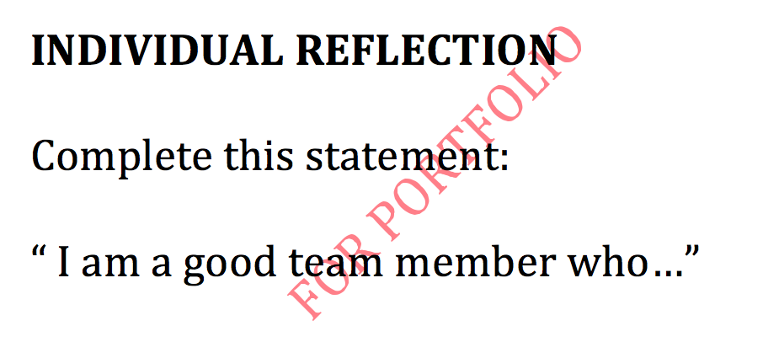

GOOD TEAM MEMBER

Slide 10
TEAM WORK / COMMUNICATIONS
Working as an effective member of a team requires you balance your behaviour between:
Co-operative communications- where you work to understand and satisfy the needs and interests of others
Assertive communications- where you attempt to have others understand and satisfy your needs and interests

Slide 11
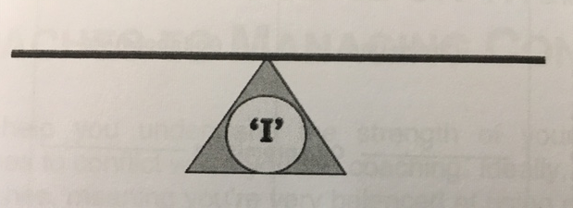
TEAM WORK / COMMUNICATIONS
ASSERTIVE
CO-OPERATIVE

Slide 12
TEAM WORK / COMMUNICATIONS
I-MESSAGE: is an assertion about the feelings, beliefs, values, ideas of the person speaking. Generally, expressed as a sentence beginning with the word "I", and is contrasted with a "you-message”, which indicates a fault with the listener and may communicate blame for the situation.

Slide 13
TEAM WORK / COMMUNICATIONS
3 STEPS OF AN I-MESSAGE
I think/ feel…
When…
I need…

Slide 14
TEAM WORK / COMMUNICATIONS
SAMPLE I-MESSAGE
I think/ feel
When
I need an
I am not able to develop my skills
All I do is sweep the floors
Opportunity to develop my skills

Slide 15
TEAM WORK / COMMUNICATIONS
PRACTICING I MESSAGES:
Form a new pair
In your pair develop messages for each scenario

Slide 16
I MESSAGE #1
SCENARIO: Your coworkers ignore you or they tease you on breaks
ROOT | STATEMENT
I THINK/ FEEL
WHEN
I NEED
Disrespected
When my coworkers ignore me
Some ideas on how I can earn their respect

Slide 17
I MESSAGE #2
SCENARIO: You do not feel comfortable using some of the larger pieces of equipment
ROOT | STATEMENT
I THINK/ FEEL
WHEN
I NEED
Uncomfortable
Using the “X” machine
Some more instruction on using the “X” machine

Slide 18
I MESSAGE #3
SCENARIO: You like your job & you want to make a career of it
ROOT | STATEMENT
I THINK/ FEEL
WHEN
I NEED
I can make a contribution to the company
I learn more about the job
The opportunity to make this my career

Slide 19
TEAM WORK / COMMUNICATIONS
Benefits of I-messages
Allows you to take ownership for your feelings
Conveys the same information as a “you message”. But you will do so in a way that is less likely to provoke a defensive or hostile reaction
Simply describes a situation, without blaming someone for it
Does not escalate a conflictual situation

Slide 20
DE-BRIEF
Feelings/ thoughts about the team work training?
What can you take from this training?
How do you think you can use these skills on the job?

